Slide 1
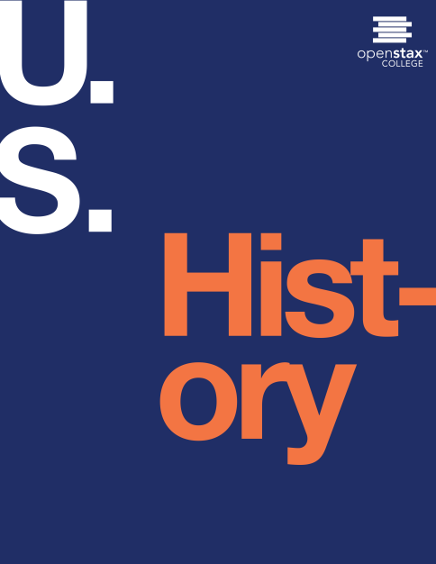
U.S. History
Chapter 30 Political Storms at Home and Abroad, 1968-1980
PowerPoint Image Slideshow

Slide 2
Figure 30.1
Pop artist Peter Max designed this postage stamp to commemorate Expo ‘74, a world’s fair held in Spokane, Washington. The fair’s theme was the natural environment. Unfortunately, and ironically, gasoline shortages prevented many from attending the exposition.

Slide 3
Figure 30.2

Slide 4
Figure 30.3
The crowd at Woodstock greatly exceeded the fifty thousand expected. Mark Goff covered Woodstock as a young freelance reporter for Kaleidoscope, a Milwaukee-based alternative newspaper, and captured this image of Swami Satchidananda, who declared music “'the celestial sound that controls the whole universe” at the opening ceremony.

Slide 5
Figure 30.4
This teepee was erected on the National Mall near the Washington Monument as part of an AIM demonstration (a). Note that the AIM flag (b) combines an Indian silhouette with the peace sign, the ubiquitous symbol of the 1960s and ‘70s.

Slide 6
Figure 30.5
In 1970, supporters of equal rights for women marched in Washington, DC.

Slide 7
Figure 30.6
Patsy Mink (a), a Japanese American from Hawaii, was the first Asian American woman elected to the House of Representatives. In her successful 1970 congressional campaign, Bella Abzug (b) declared, “This woman’s place is in the House... the House of Representatives!”

Slide 8
Figure 30.7
On the 1968 campaign trail, Richard Nixon flashes his famous “V for Victory” gesture (a). Nixon’s strategy was to appeal to working- and middle-class suburbanites. This image of him in the White House bowling alley seems calculated to appeal to his core constituency (b).

Slide 9
Figure 30.8
In his brother’s (John F. Kennedy’s) administration, Robert (Bobby) Kennedy had served as attorney general and had spoken out about racial equality.

Slide 10
Figure 30.9
Despite facing charges following events at the Democratic National Convention in Chicago, Abbie Hoffman continued to protest the war on campuses across the country, as here (a) at the University of Oklahoma. Jerry Rubin (b) visited the campus of the University of Buffalo in March 1970, just one month after his conviction in the Chicago Seven trial. (credit a: modification of work by Richard O. Barry)

Slide 11
Figure 30.10
The oil shortage triggered a rush to purchase gasoline, and gas stations around the country were choked with cars waiting to fill up. Eventually, fuel shortages caused gas stations to develop various ways to ration gasoline to their customers (a), such as the “flag policy” used by gas dealers in Oregon (b).

Slide 12
Figure 30.11
President Nixon and First Lady Patricia Nixon visited the Great Wall on their 1972 trip to China. The Chinese showed them the sights and hosted a banquet for them in the Great Hall of the People. Nixon was the first U.S. president to visit China following the Communist victory in the civil war in 1949.

Slide 13
Figure 30.12
U.S. soldiers in Hue in 1968 at during the Tet Offensive. The frustrating experience of fighting the seemingly unwinnable war left many soldiers, and the public in general, disillusioned with the government.

Slide 14
Figure 30.13
Vietnamese civilians in My Lai await their fate. They were shot a few minutes after this 1968 photograph was taken.

Slide 15
Figure 30.14
On April 30, 1970, Richard Nixon announces plans for the Cambodia Campaign (a), provoking protests on college campuses across the country. Within days, the governor of Ohio had called in the National Guard in response to student demonstrations at Kent State University. Bill Whitbeck, who was a student majoring in photo illustration at Kent State University in May 1970, captured this image (b) on campus on May 3, one day before the shootings that would result in four student deaths. (credit b: modification of work by Bill Whitbeck)

Slide 16
Figure 30.15
In November 1968, Shirley Chisholm (a) became the first African American woman to be elected to the House of Representatives. In January 1972, she announced her intention to run for the Democratic presidential nomination. The nomination eventually went to George McGovern (b), an outspoken opponent of the war in Vietnam.

Slide 17
Figure 30.16
The Watergate hotel and office complex, located on the Potomac River next to the John F. Kennedy Center for the Performing Arts, was the scene of the 1972 burglary and attempted wiretapping that eventually brought down the presidency of Richard Nixon.

Slide 18
Figure 30.17
In April 1974, President Richard Nixon prepares to address the nation to clarify his position on releasing the White House tapes.

Slide 19
Figure 30.18
In one of his first actions as president, Gerald R. Ford announced a full pardon for Richard Nixon on September 8, 1974. Nixon had appointed Ford vice president after the resignation of Spiro Agnew.

Slide 20
Figure 30.19
President Gerald Ford (right) and Democratic challenger Jimmy Carter dueled in Philadelphia in 1976, during the first televised presidential debate since that between Richard Nixon and John F. Kennedy in 1960.

Slide 21
Figure 30.20
President Jimmy Carter meets with Egypt’s Anwar Sadat (left) and Israel’s Menachem Begin (right) at Camp David in 1978. Sadat was assassinated in 1981, partly because of his willingness to make peace with Israel.

Slide 22
Figure 30.21
The fifty-two American hostages return from Iran in January 1981. They had been held for 444 days.

