Slide 1
Lecture 7: Colonial Encounters in Asia, Africa, and Oceania 1750–1950

Slide 2
Outline
1. Capitalism and Colonialism
2. The New Imperialism
3. Political Structures
4. Economic Structures
5. Cultures of Colonialism

Slide 3
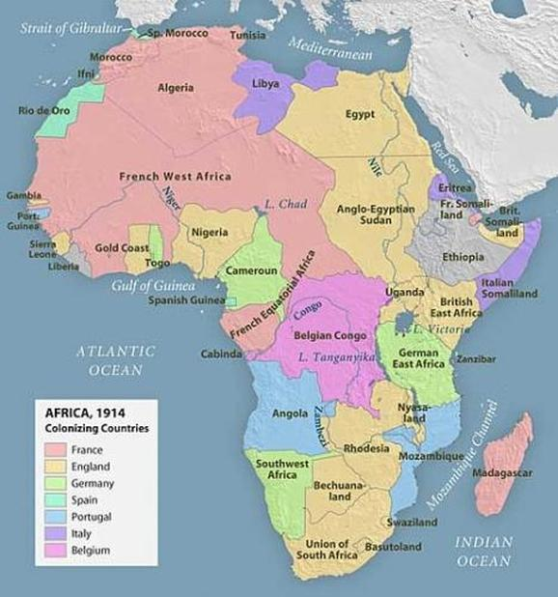
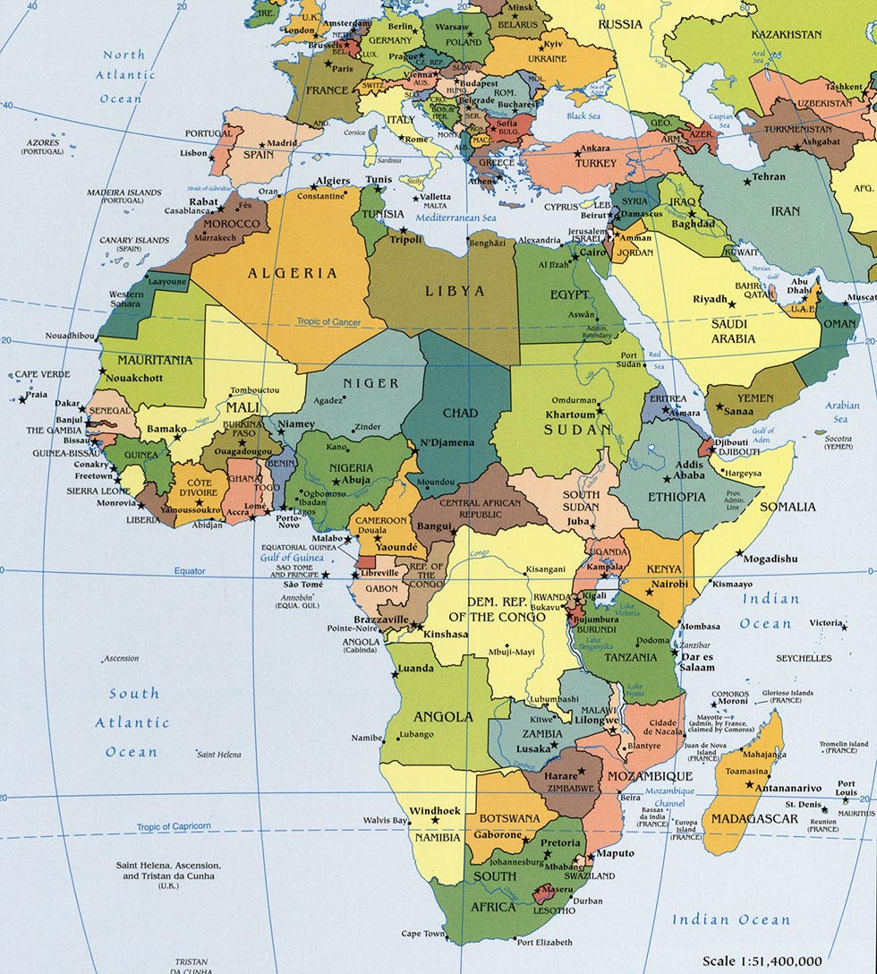
Notes:
• Africa in 1914 (left) and today (right)

Slide 4
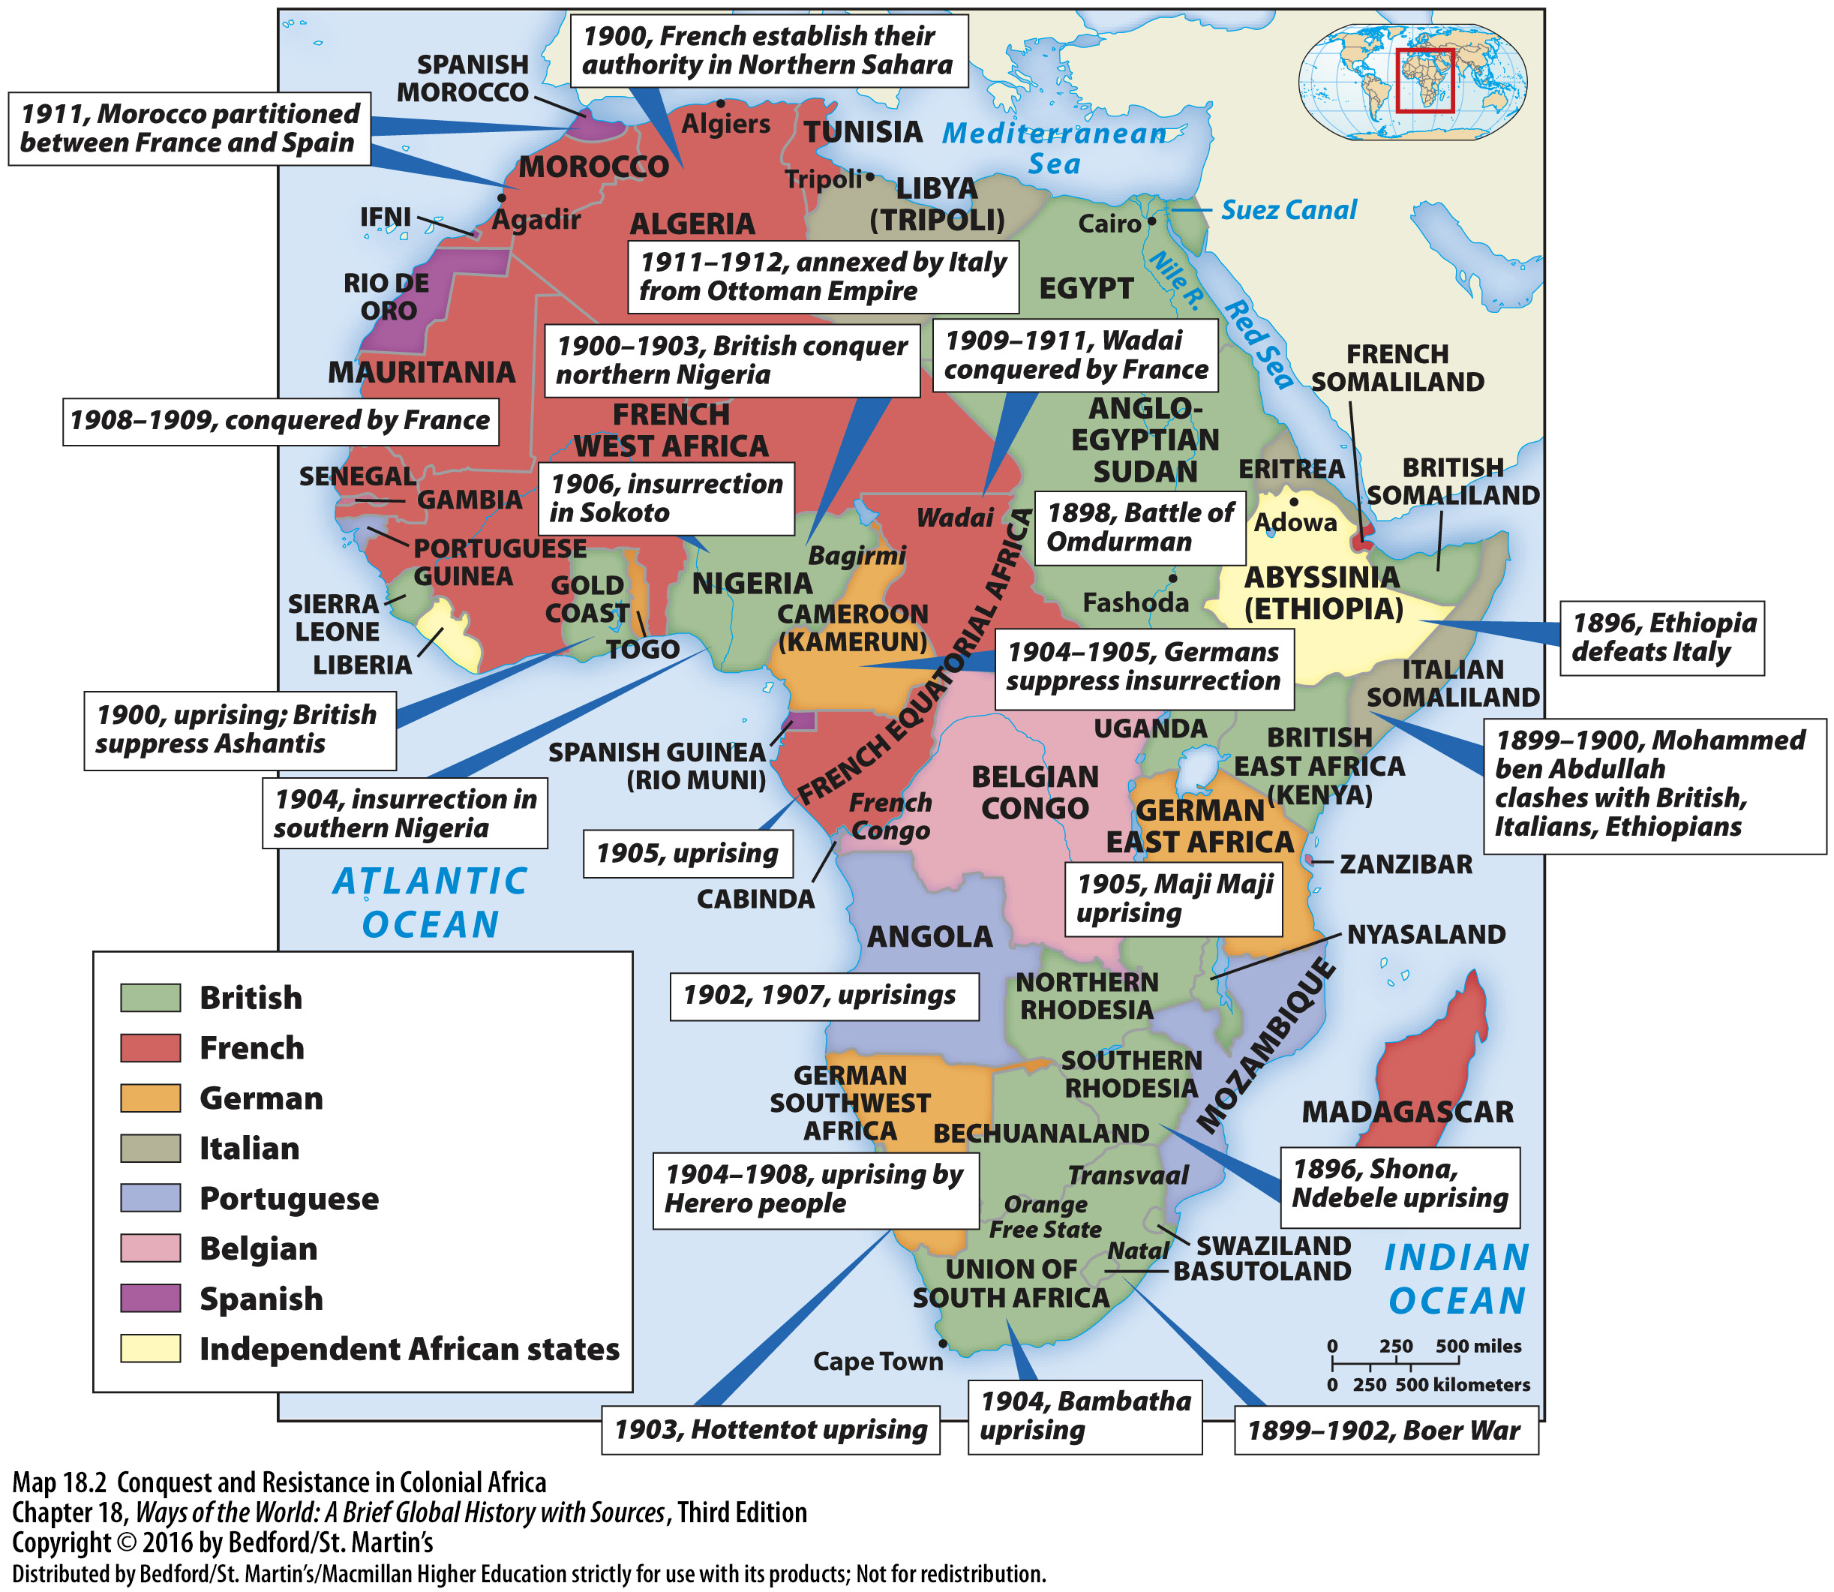
Colonialism and World History
• Origins of modern world order
• Colonies to nations
• Set stage for politics, economics, culture today
• Modernity and tradition
• Enduring legacies
Notes:
1. Notions of race and ethnicity were central to new ways of belonging.
2. By 1900, some African thinkers began to define an “African identity”: united for the first time by the experience of colonial oppression, some argued that African culture and history had the characteristics valued by Europeans (complex political systems, etc.), some praised the differences between Africa and Europe.
3. In the twentieth century, such ideas reached a broader public. Hundreds of thousands of Africans took part in World War I, some Africans traveled widely.
4. For most Africans, the most important new sense of belonging was the idea of “tribe” or ethnic identity: ethnic groups were defined much more clearly, thanks to Europeans, Africans found ethnic identity useful.

Slide 5
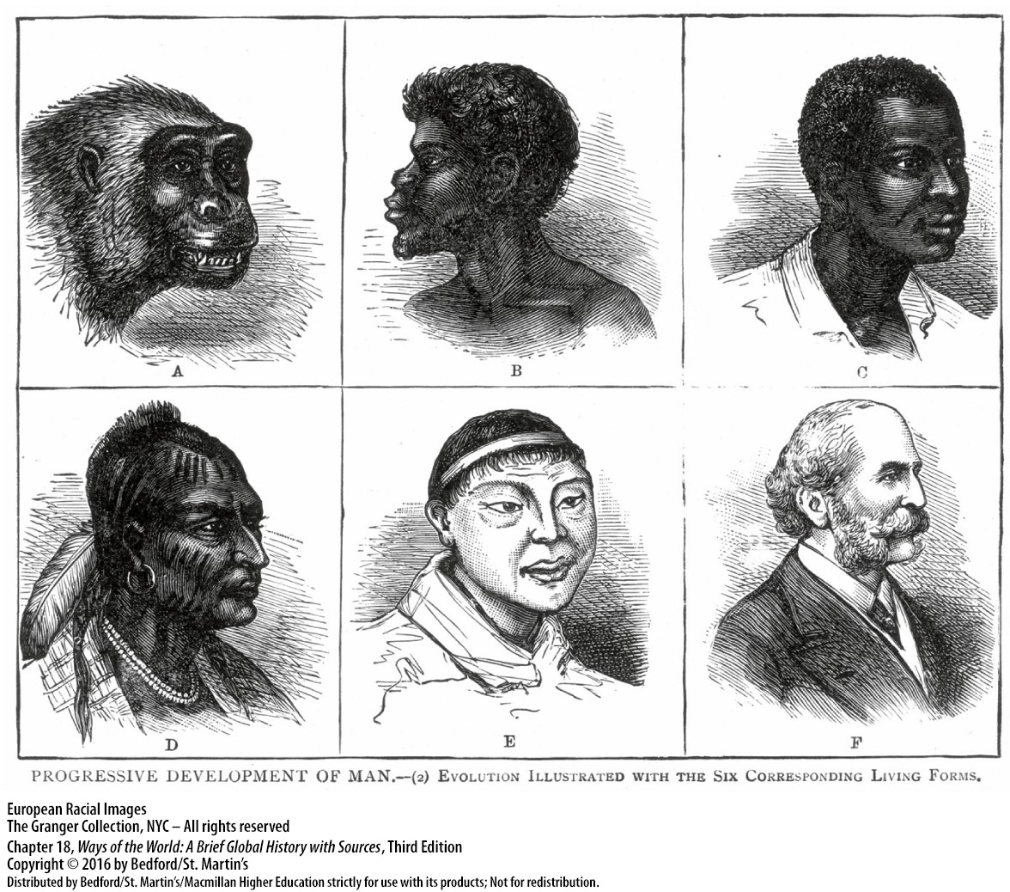
Industry and Empire
• Industrial Revolution fueled Europe’s expansion
→ J.A. Hobson’s Imperialism (1902)
→ V.I. Lenin’s Imperialism, the Highest Stage of Capitalism (1917), others
• European’s perceptions of the “other” changed during industrialization
Notes:
1. The Industrial Revolution fueled much of Europe’s expansion. Demand for raw materials and agricultural products, need for markets to sell European products, European capitalists often invested money abroad, foreign markets kept workers within Europe employed. Growth of mass nationalism in Europe made imperialism broadly popular: Italy and Germany unified by 1871, colonies were a status symbol. Industrial-age developments made overseas expansion possible: steamships, underwater telegraph, quinine, breech-loading rifles and machine guns.
2. Europeans’ perceptions of the “other” changed during the period of industrialization. In the past, Europeans had largely defined others in religious terms, but had also adopted many foreign ideas and techniques, mingled more freely with Asian and African elites, had even seen technologically simple peoples at times as “noble savages.” The industrial age promoted a secular arrogance among Europeans and was sometimes combined with a sense of religious superiority. European opinion of other cultures dropped: image of “John Chinaman” as cunning and deceitful fed “yellow peril” anxiety, Africans as always “primitive,” Pacific Islanders as “big children.” New kind of racism, expressed in terms of modern science. Sense of responsibility to the “weaker races,” duty to civilize them, bringing them education, health care, Christianity, good government, etc., was regarded as “progress” and “civilization.” Social Darwinism: an effort to apply Darwin’s evolutionary theory to human history.

Slide 6
A Second Wave of European Conquests
• Second phase of colonial conquest 1750-1900
• Establishment of second-wave European empires
→ Early colonialism vs. the “New Imperialism”
• Becoming a colony happened in a variety of ways
• Asian and African societies: wide range of responses
Notes:
1. The period 1750–1900 saw a second, distinct phase of European colonial conquest: focused on Asia, Africa, and Oceania. Several new players (Germany, Italy, Belgium, United States, Japan); in general, Europeans preferred informal control, but competition between European powers drove outright conquest in some circumstances
2. The establishment of the second-wave European empires was based on military force or the threat of using it. Original European military advantage lay in organization, drill, and command structure; over the nineteenth century, Europeans developed an enormous firepower advantage (repeating rifles and machine guns). Numerous wars of conquest: the Westerners almost always won.
3. Becoming a colony happened in a variety of ways. Gatherer hunter, agricultural, and pastoralists were incorporated into complex civilizations for the first time. India and Indonesia: grew from interaction with European trading firms. Most of Africa, Southeast Asia, and the Pacific islands: deliberate conquest. African decentralized societies without a formal state structure were the hardest to conquer; Zulu and Boer resistance in South Africa. American, British, French, and German competition for islands in the Pacific eventually draws in Australia and Chile. Australia and New Zealand: similar to the colonization of North America, with massive European settlement and diseases killing off most of the native population. Expansion into Siberia, Amazonia, and Polynesia brings new diseases to isolated communities and mass death. American expansion: imperialist war with Mexico, removal and extermination of Native Americans, Spanish-American War and annexation of the Philippines. Taiwan and Korea: Japanese takeover was done European-style. Liberia: settled by freed U.S. slaves who became a colonizing elite. Ethiopia and Siam (Thailand) avoided colonization via diplomacy and military prowess.
4. Asian and African societies generated a wide range of responses to the European threat.

Slide 7
Cooperation and Rebellion
• Some groups cooperated with new masters
• The promotion of European education
• Periodic rebellions
Notes:
1. Some groups and individuals cooperated willingly with their new masters: employment in the armed forces, elite often kept much of their status and privileges.
2. Governments and missionaries promoted European education: growth of a small class with Western education, governments relied on them increasingly over time.
3. Periodic rebellions: for example, the Indian Rebellion (1857–1858), based on a series of grievances, Indian Rebellion began as a mutiny among Indian troops, rebel leaders advocated revival of the Mughal Empire, widened India’s racial divide; the British were less tolerant of natives, led the British government to assume direct control over India.

Slide 8
Colonial Empires with a Difference
• Race distinguished rulers from the ruled
• Racism especially pronounced in areas with large number of European settlers
→ Political philosopher Charles W. Mills’ notion of “global white supremacy as a political system”
• Colonial states imposed deep changes in daily lives
• Colonizers counted and classified subjects
• The role of gender
• Colonial policies contradicted European values
Notes:
1. In the new colonial empires, race was a prominent point distinguishing rulers from the ruled: education for colonial subjects was limited and emphasized practical matters, suitable for “primitive minds,” even the best-educated natives rarely made it into the upper ranks of the civil service.
2. Racism was especially pronounced in areas with a large number of European settlers (e.g., South Africa).
3. Colonial states imposed deep changes in people’s daily lives.
4. Colonizers were fascinated with counting and classifying their new subjects: in India, appropriated an idealized caste system, in Africa, identified or invented distinct “tribes.”
5. Gender also played a role: colonizers took pride in active masculinity, defined colonized as soft, passive, feminine, link gender ideology and race prejudice in support of colonial rule, European women seen as emblems of civilization, some colonized peoples (Sikhs, Gurkhas, Kamba, and Hausa) were gendered as masculine or martial races and recruited into security forces.
6. Colonial policies contradicted European core values and practices at home: colonies were essentially dictatorships, colonies were the antithesis of “national independence,” racial classifications were against Christian and Enlightenment ideas of human equality, many colonizers were against spreading “modernization” to the colonies, in time, the visible contradictions in European behavior helped undermine the foundations of colonial rule.

Slide 9
Race and Racism
• Notions of Self and Other are universal
• Early European views of Others not uniformly negative
• New Imperial Era different
→ Decline over time; history not “progressive”

Slide 10
Scientific Racism
the use of scientific techniques and hypotheses to support or justify the belief in racism, racial inferiority, or racial superiority, or alternatively the practice of classifying individuals of different phenotypes into discrete races
Social Darwinism
the application of Darwin’s concept of “natural selection” to human populations

Slide 11
Arthur de Gobineau,
Essay on the Inequality of the Human Races, 1856
Applied Darwin’s ideas to biology
One of the major early works of “scientific racism”

Slide 12
Rudyard Kipling’s “The White Man’s Burden” (1898)
Take up the White Man's burden, Send forth the best ye breed
Go bind your sons to exile, to serve your captives' need;
To wait in heavy harness, On fluttered folk and wild—
Your new-caught, sullen peoples, Half-devil and half-child.
Take up the White Man's burden, Have done with childish days—
The lightly proffered laurel, The easy, ungrudged praise.
Comes now, to search your manhood, through all the thankless years
Cold, edged with dear-bought wisdom, The judgment of your peers!

Slide 13
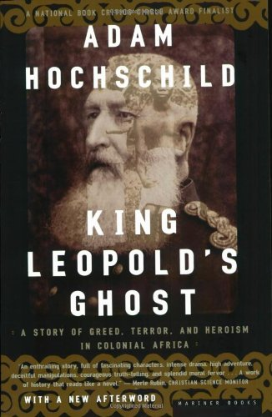
Economics of Coercion: Forced Labor and the Power of the State
• Unpaid labor on public projects (e.g. Congo Free State)
• “Cultivation system” of the Netherlands East Indies
• Resistance to forced cultivation of cash crops
Notes:
1. Many colonial states demanded unpaid labor on public projects. Worst abuses were in the Congo Free State: personally governed by Leopold II of Belgium, reign of terror killed millions with labor demands, forced labor caused widespread starvation, as people couldn’t grow their own crops, Belgium finally stepped in and took control of the Congo (1908) to stop abuses, colonization created social conditions that saw the virus causing AIDS jump from chimpanzees into humans and spread in the crowded colonial city of Kinshasa.
2. “Cultivation system” of the Netherlands East Indies (Indonesia): peasants had to devote at least 20 percent of their land to cash crops to pay as taxes, the proceeds were sold for high profits, financed the Dutch industrialization, enriched the traditional authorities who enforced the system, led to a wave of deadly famines in Java.
3. Many areas resisted the forced cultivation of cash crops: German East Africa: major rebellion in 1905 against forced cotton cultivation, Mozambique: peasant sabotage and smuggling kept the Portuguese from achieving their goals there.

Slide 14
Economies of Cash-Crop Agriculture: The Pull of the Market
• Many happy to increase production for world markets
• Mekong Delta (French-ruled Vietnam)
• Southern Gold Coast (Ghana)
• Colonies specialized in one or two cash crops
Notes:
1. Many people were happy to increase production for world markets. Considerable profit to small farmers in areas like the Irrawaddy Delta.
2. In Mekong Delta of French-ruled Vietnam rice cultivation resulted in significant environmental damage to local fish and shellfish food sources and produced methane gas, contributing to global warming.
3. In the southern Gold Coast (Ghana), African farmers took the initiative to develop export agriculture: leading supplier of cocoa by 1911, created a hybrid peasant-capitalist society, but labor shortages led to exploitation of former slaves, men marrying women for their labor power, influx of migrants.
4. Many colonies specialized in one or two cash crops, creating dependence

Slide 15
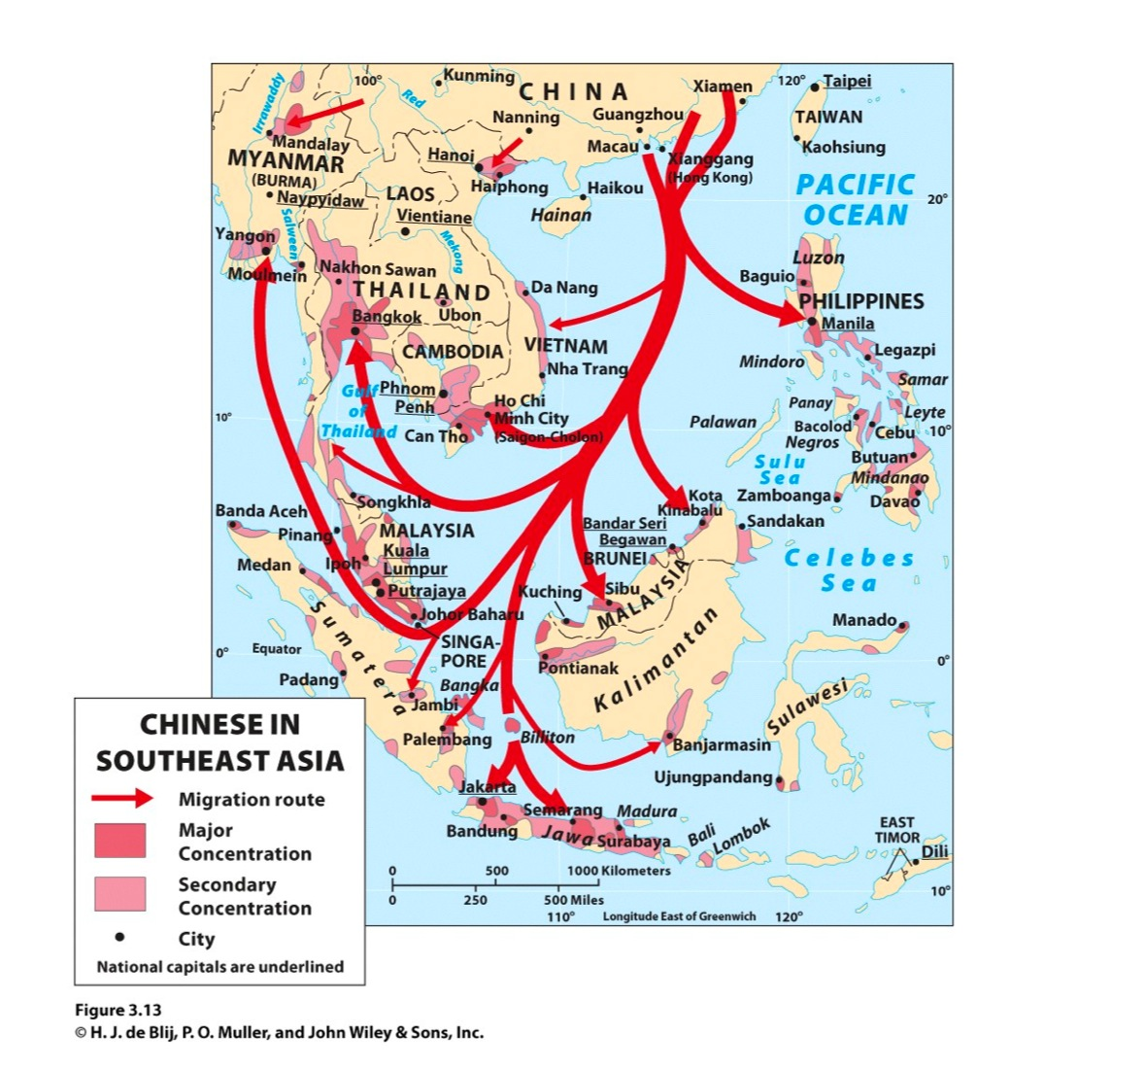
Economics of Wage Labor: Migration for Work
• Wage labor common
• African Migrants in several directions
• Asia: 28 million Indians and 19 million Chinese
• Colonial cities attracted many workers
Notes:
1. Wage labor in European enterprises was common, both from colonized regions and from China and Japan.
2. African migrants moved in several directions: Atlantic slave trade continued for much of the nineteenth century, internal migration grew with European empires, Europeans took over huge tracts of African land employing Africans as workers, gold and diamond mines of South Africa provided employment in harsh conditions
3. In Asia, some 29 million Indians and 19 million Chinese migrated: worked on plantations financed from Europe, harsh conditions and high death rates, the British facilitated migration of Indian labor to far-flung territories of their empire, especially after the end of the slave trade, mines were another source of wage labor, but dangerous work, Chinese migrants also settled Manchuria, participated in the gold rushes of Australia, Peru, and California, Australia, Canada, New Zealand, and the United States all limited Chinese immigration.
4. Colonial cities attracted many workers: were seen as centers of opportunity, segregated, unsanitary, overcrowded, created a place for a native, Western-educated middle class, created an enormous class of urban poor that could barely live and couldn’t raise families.

Slide 16
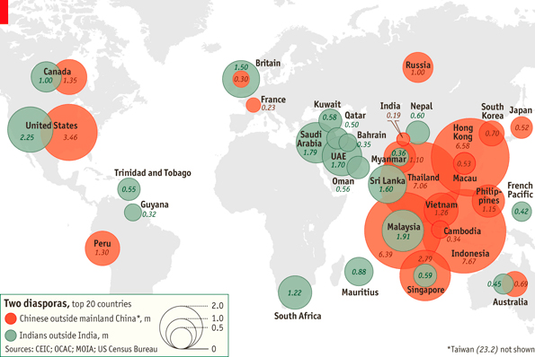

Slide 17
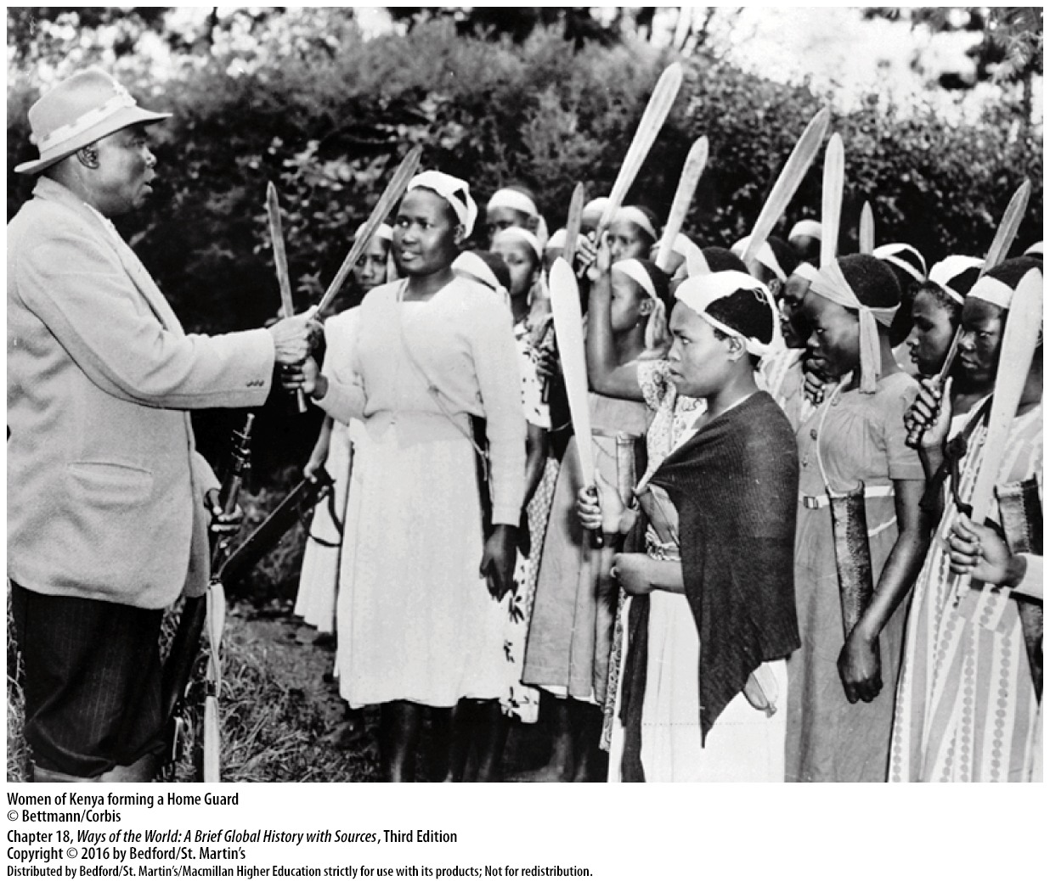
Women and the Colonial Economy: Examples from Africa
• Precolonial Africa: active farmers
• Colonial economy: subsistence work, left home
• Colonial economy: small trade and marketing
Notes:
1. In precolonial Africa, women were usually active farmers, had some economic autonomy.
2. In the colonial economy, women’s lives diverged even more from men: men tended to dominate the lucrative export crops, women were left with almost all of the subsistence work, large numbers of men (sometimes a majority of the population) migrated to work elsewhere, women were left home to cope, including supplying food to men in the cities. Women coped in a variety of ways.
3. The colonial economy also provided some opportunities to women: especially small trade and marketing. Sometimes women’s crops came to have greater cash value, some women escaped the patriarchy of husbands or fathers, led to greater fear of witchcraft and efforts to restrict female travel and sexuality.

Slide 18
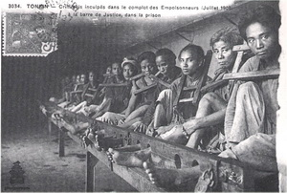
Assessing Colonial Development
• Defenders: jump-started modern growth
• Critics: long record of exploitation and limited, uneven growth
• Helped integrate Asian and African economies into modern global exchange network
• Did not lead to breakthroughs to modern industrial societies
Notes:
1. The overall economic impact of colonial rule. Defenders: it jump-started modern growth. Critics: long record of exploitation and limited, uneven growth.
2. Colonial rule did help integrate Asian and African economies into a global exchange network, and introduced some modernizing elements: administrative and bureaucratic structures, communication and transportation infrastructure, schools, health care.
3. Colonial rule did not lead to breakthroughs to modern industrial societies

Slide 19
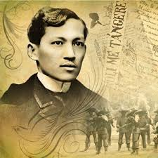
Education
• Western education brought new identity
• Created cultural divide: educated and non-educated
• Western-educated elite saw colonial rule as path to a better future
Notes:
1. Getting a Western education created a new identity for many: the almost magical power of literacy, escape from obligations like forced labor, access to better jobs, social mobility and elite status.
2. Many people embraced European culture: created a cultural divide between them and the vast majority of the population.
3. Many of the Western-educated elite saw colonial rule as the path to a better future, at least at first: in India, they organized reform societies to renew Indian culture, hopes for renewal through colonial rule were disappointed.

Slide 20
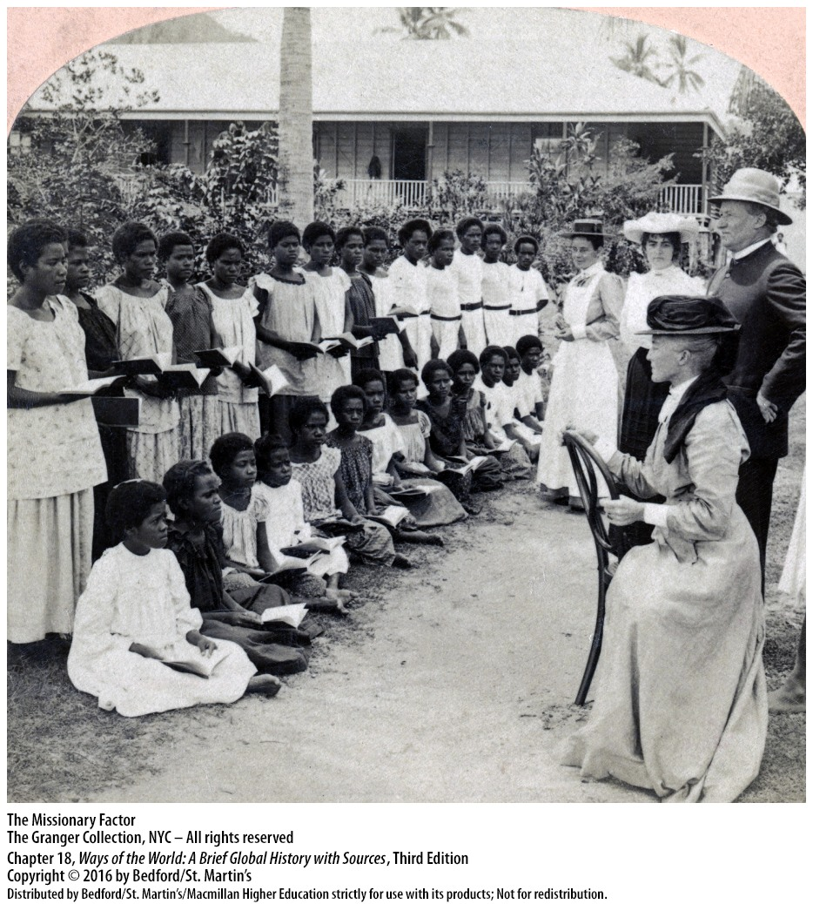
Religion
• Widespread conversion to Christianity
• Christianity attractive in Africa
• Conflicts over gender roles and sexual norms
• Christianity Africanized with “independent churches”
• Christianity did not spread widely in India
Notes:
1. Widespread conversion to Christianity in Pacific Oceania and non-Muslim Africa: around 10,000 missionaries had gone to Africa by 1910; by the 1960s, some 50 million Africans were Christian; many Oceanic elites strengthened their position by association with Christianity; missionaries make gains in Oceanic societies devastated by newly arrived diseases.
2. Christianity was attractive to many in Africa: military defeat shook belief in the old gods, Christianity was associated with modern education, Christianity gave opportunities to the young, the poor, and many women, Christianity spread mostly through native Africans.
3. Conflicts over issues that touched on gender roles and sexual norms.
4. Christianity was Africanized: continuing use of charms, medicine men, some simply demonized their old gods, wide array of “independent churches” was established.
5. Christianity did not spread widely in India: but it led intellectuals and reformers to define Hinduism, Hindu leaders looked to offer spiritual support to the spiritually sick Western world, new definition of Hinduism helped distill a clearer sense of Muslims as a distinct community.

Slide 21
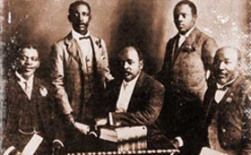
“Race” and “Tribe”
• Race and ethnicity central to new ways of belonging
• 1900: African thinkers begin to define “African identity”
• Twentieth century: Africans took part in World War I
• Idea of “tribe” or ethnic identity
Notes:
1. Notions of race and ethnicity were central to new ways of belonging.
2. By 1900, some African thinkers began to define an “African identity”: united for the first time by the experience of colonial oppression, some argued that African culture and history had the characteristics valued by Europeans (complex political systems, etc.), some praised the differences between Africa and Europe.
3. In the twentieth century, such ideas reached a broader public. Hundreds of thousands of Africans took part in World War I, some Africans traveled widely.
4. For most Africans, the most important new sense of belonging was the idea of “tribe” or ethnic identity: ethnic groups were defined much more clearly, thanks to Europeans, Africans found ethnic identity useful.

