Slide 1
On Shafer’s “Southernization”

Slide 2
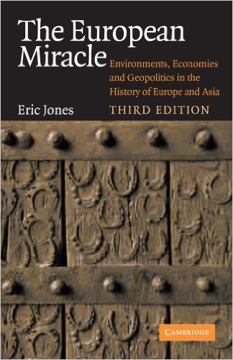
Why Europe?
• Europe a political, economic, cultural periphery in 1400
• Home of global empires by 1900
• How and why did this happen—and happen in the way it did?
• “European Miracle” thesis

Slide 3
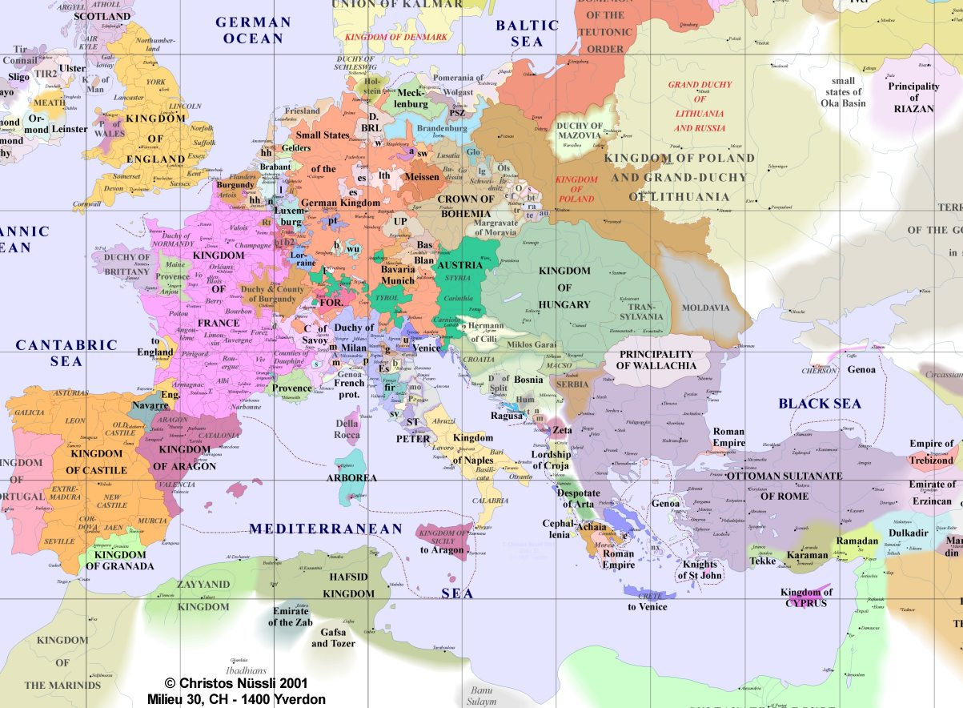

Slide 4
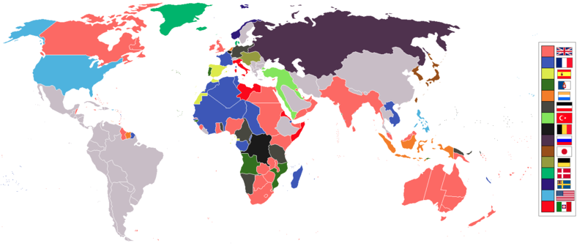
Notes:
• What empires do you see?
→ Britain, France, Germany, Belgium, Italy; Russia, US
• China and Siam as “semi-colonies”
• Post-Ottoman Empire and “protectorates”
• “Neocolonialism”

Slide 5
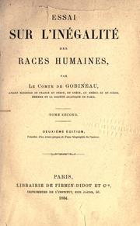
Contemporary Explanations
• Variety of explanations in 16th to early 20th centuries; examples?
• Divine providence, cultural superiority, scientific racism
• What happened to these theories after decolonization?
→ Often reappeared in more subtle and sophisticated ways
→ Modernization Theory in Post-WWII; “Westernization”

Slide 6
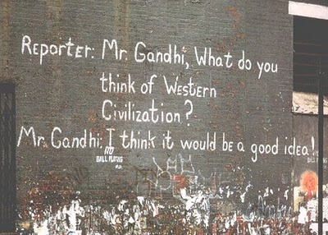
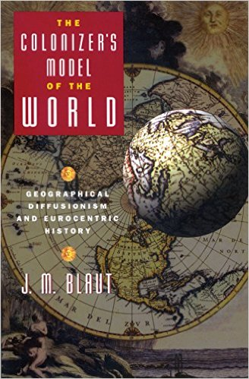
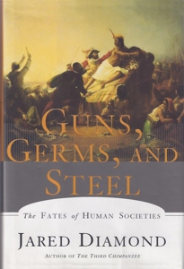
European Ascent and World History
• History, “Western Civilization,” “World History”
→ Gandhi: “I think it would be a good idea!”
• “West and the Rest”
• Blaut, The Colonizer’s Model of the World (1993)
• Question of enduring significance, e.g. Diamond’s Guns, Germs, Steel (1997)
• Continuing disciplines and debates
• Be aware of historians’ intellectual formation

Slide 7
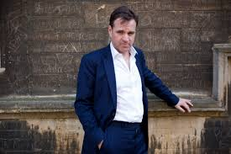
Niall Ferguson, Nostalgist for British Empire Who Plays One on TV
“The 19th-century empire undeniably pioneered free trade, free capital movements and, with the abolition of slavery, free labour. It invested immense sums in developing a global network of modern communications. It spread and enforced the rule of law over vast areas. Though it fought many small wars, the empire maintained a global peace unmatched before or since. In the 20th century too the empire more than justified its own existence. For the alternatives to British rule represented by the German and Japanese empires were clearly – and they admitted it themselves – far worse. And without its empire, it is inconceivable that Britain could have withstood them” (N-Ferg, Empire: The Rise and Demise of the British World Order and the Lessons for Global Power [New York: Basic, 2014], 304)
Notes:
• If we don’t understand the deeper history of European ascent, then we might ahistorically valorize its products—and the violence they necessitated
• History complicates our understandings of culture, it shows their multiple origins

Slide 8
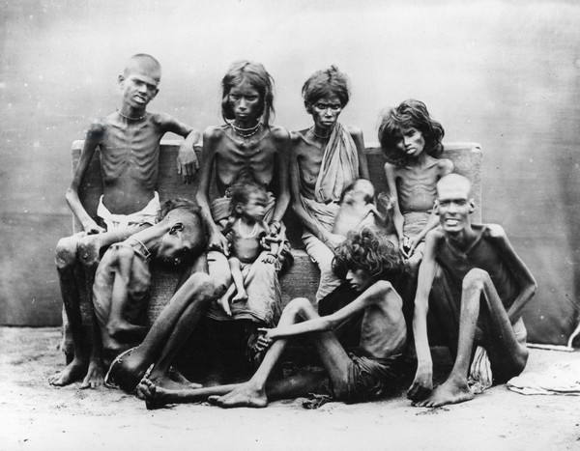

Slide 9
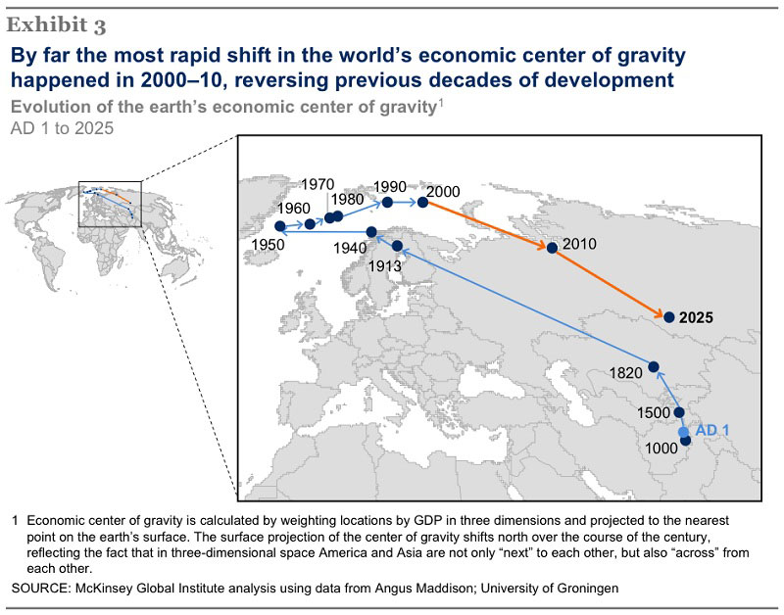
Notes:
• Explain: econ center of world; Africa, India, SEA 10, 7, 5
• Shift from Asia- to Atlantic-centered world
• Purpose: account for this shift, say something significance, see what this suggests

Slide 10
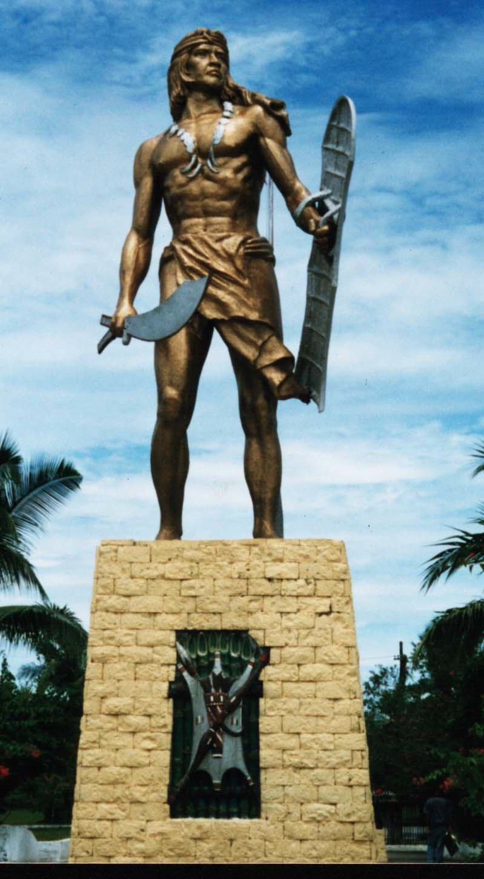
Considerations on Southernization
• Weakness of European expansionism in 1400s, increasing dominance by late 1800s
• Basis of lengthy process?
• “Southern” technologies and more, deployed in a particular political, economic, cultural context
• What is Southernization?
• Early Southernized sites?
• How benefited Europe; history?
• How does Shafer help us reconsider history of the Rise of the West?

