Slide 2
Payroll Activity
12

Slide 3
Payroll

Slide 4
QBO and Payroll
QBO has several payroll plans available for purchase (set up as subscription plans).
Core
Calculates employee paychecks
Calculates and files federal and state payroll tax returns
Allows for next-day direct deposit of paychecks
Premium
Everything in the Self Service Payroll Plan PLUS
Same-day direct deposit
Employee self-reporting of hours
Hours can be reviewed and changed
Elite
Payroll setup by Intuit

Slide 5
Payroll for this Class
You will be using the Core plan.
A new company using a special 30-day free trial license will be set up.
Directions are included in Step 1 of the Payroll Walkthrough starting on page12-9.
Make sure your company name starts with SBGTEST_ or you won’t be able to access payroll. (See Figure 12.5)

Slide 6
Activating Payroll

Slide 7
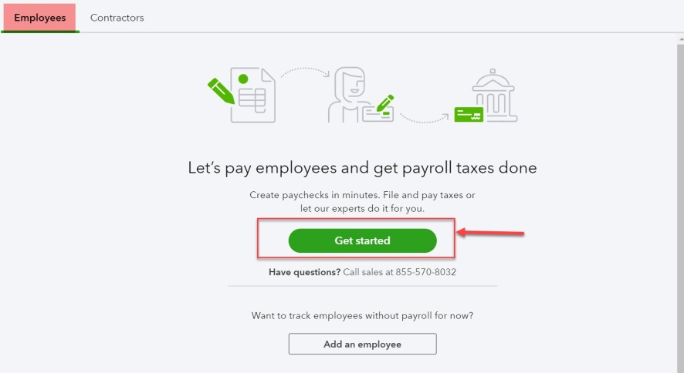
Activating Payroll
Payroll is activated by clicking Employees (formerly called Workers) on the navigation bar.
On the Employees tab, click Get started.

Slide 8
Activating Payroll
You will be asked a series of questions:
Have you paid employees in the current year?
You will answer No
When is your next payday?
You will select the 15th of the current month (the month you’re doing your work.
Where is your business located?
You can use the same address as your homework company (3835 Freeport Blvd, Sacramento, CA 95822)
Who’s your payroll contact?
You can be creative here but you must use the email address you used to set up the company file.

Slide 9
Adding & Editing Employees

Slide 10
Employee Setup
There are seven sections to be completed for each employee.
1. Personal Info (Name, Hire Date)
2. How often do you pay employee? (Pay schedule)
3. How much do you pay employee? (Compensation)
4. Does employee have any deductions? (Health insurance, etc.)
5. What are employee’s withholdings?
6. What are employee’s personal details? (Birth date)
7. How do you want to pay employee? (Paper check or automatic deposit)

Slide 11
Adding Employees
You will be given sufficient information to answer the questions. A few things should be noted:
Name, address, and social security number are required fields when answering the withholding question.
You will be creating pay schedules, pay types, and deductions as you add your first employee. Those settings will be available to use on your second employee,
Every employee must be assigned a primary pay type:
Hourly
Salary OR
Commission Only
Additional pay types can be added as well.
Remember, you will be processing payroll for the current month (the month you’re doing your homework). Watch those dates!

Slide 12
Deleting Employees
Once an employee name has been entered, the employee can not be deleted from the employee list.
An employee’s status can be changed to Terminated, Not on payroll etc.

Slide 13
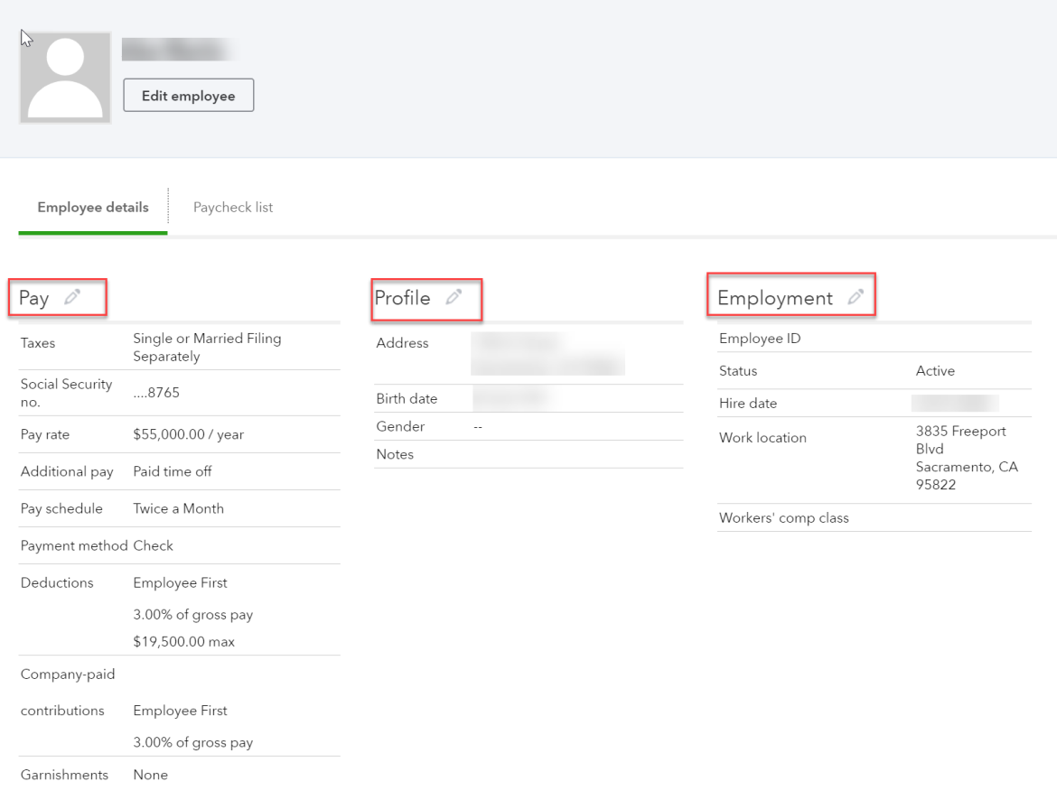
Editing Employee Information
Employee records can be edited by double-clicking the employee’s name in the Employee Center to open the employee record.
All three areas (Pay, Profile, and Employment) can be edited.
Changes to compensation amounts would be effective for the next payroll period.

Slide 14
Payroll Tax Settings

Slide 15
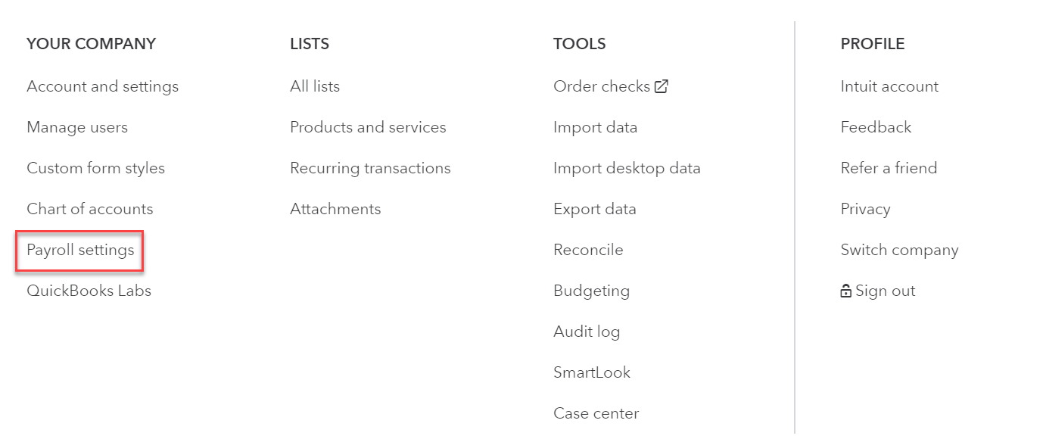
Payroll Setting
Once you’ve added employees, you’ll be prompted to set up payroll taxes.
If you don’t see the prompt, click the on the icon bar.
Click Payroll settings.

Slide 16
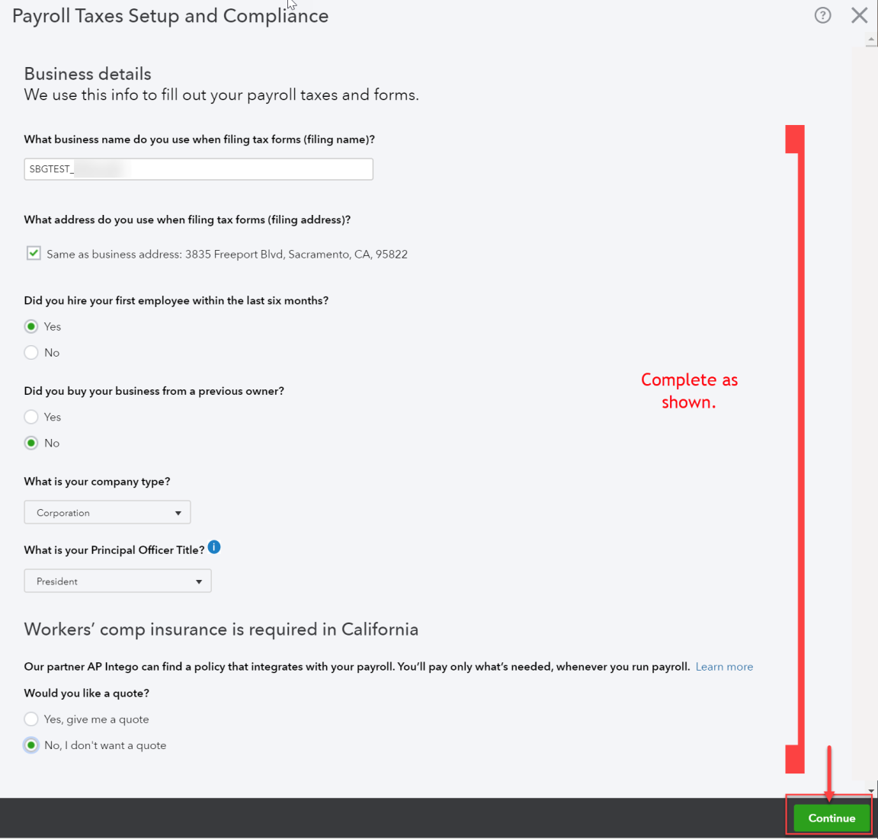
Payroll Settings Window
You’ll start by answering questions related to the company.
On the next few screens, you’ll provide information about federal and state employer identification numbers.

Slide 17
Bank Connections

Slide 18
Bank Connections
In order to use payroll in the trial company, you’ll need to set up fake bank connections.
Instructions are included in Step 5 of the Payroll Walkthrough on page 12-33.

Slide 19
Identifying Payroll Accounts

Slide 20
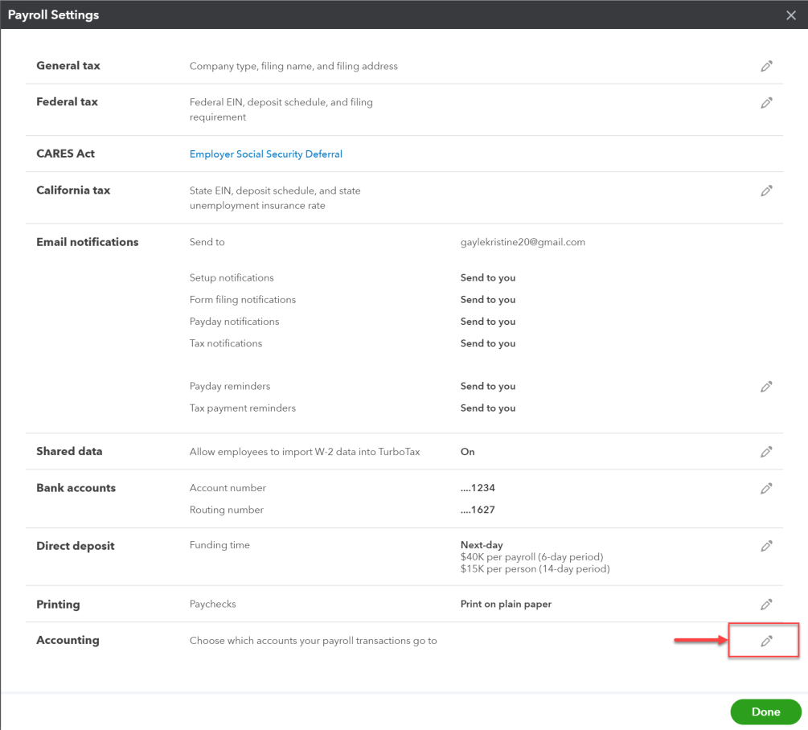
Identifying Payroll Accounts
To map payroll items to general ledger accounts, click on the icon bar and select Payroll settings.
Click the pencil icon in the Accounting section.

Slide 21
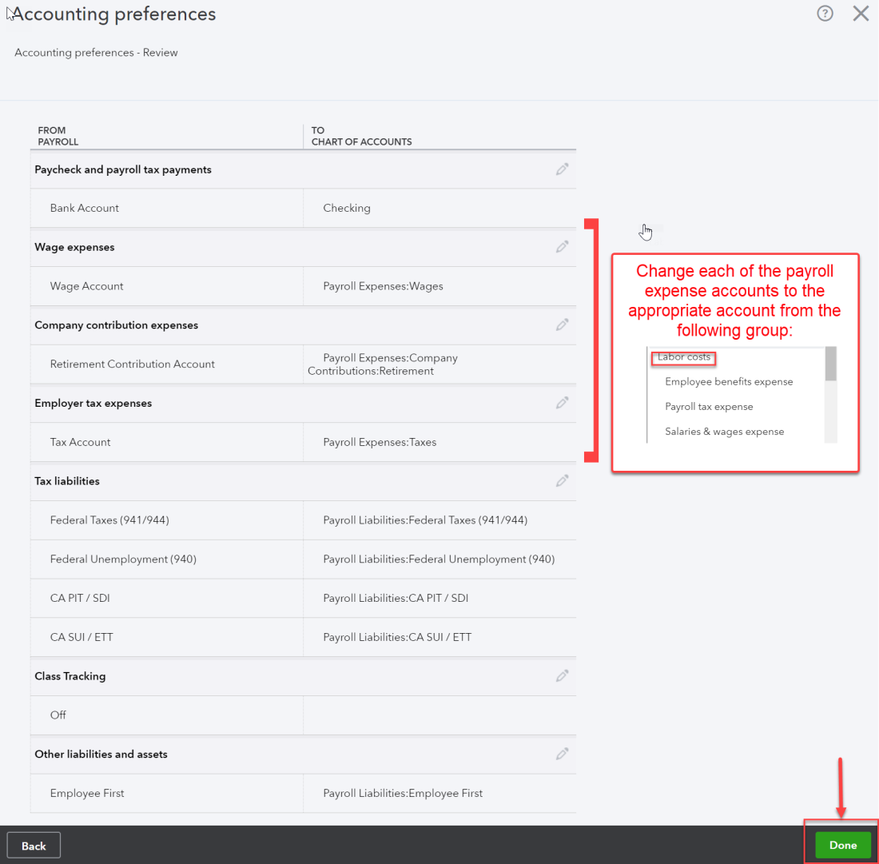
Identifying Payroll Accounts
You’ll need to map the accounts to be used for the bank account and all expense and liability accounts related to payroll.
The accounts to be used for expenses are identified in this screenshot.

Slide 22
Processing Payroll

Slide 23
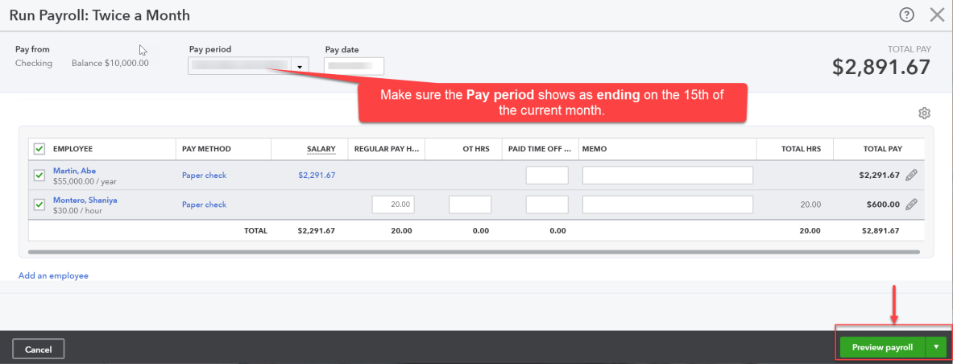
Creating Paychecks
Creating paychecks can be done by:
Clicking Employees (or Workers) on the navigation bar and clicking Run Payroll on the Employees tab.
Hours are entered for any hourly employees.
Certain fields can be changed by clicking the pencil icon in the TOTAL PAY column.
Click Preview payroll.

Slide 24
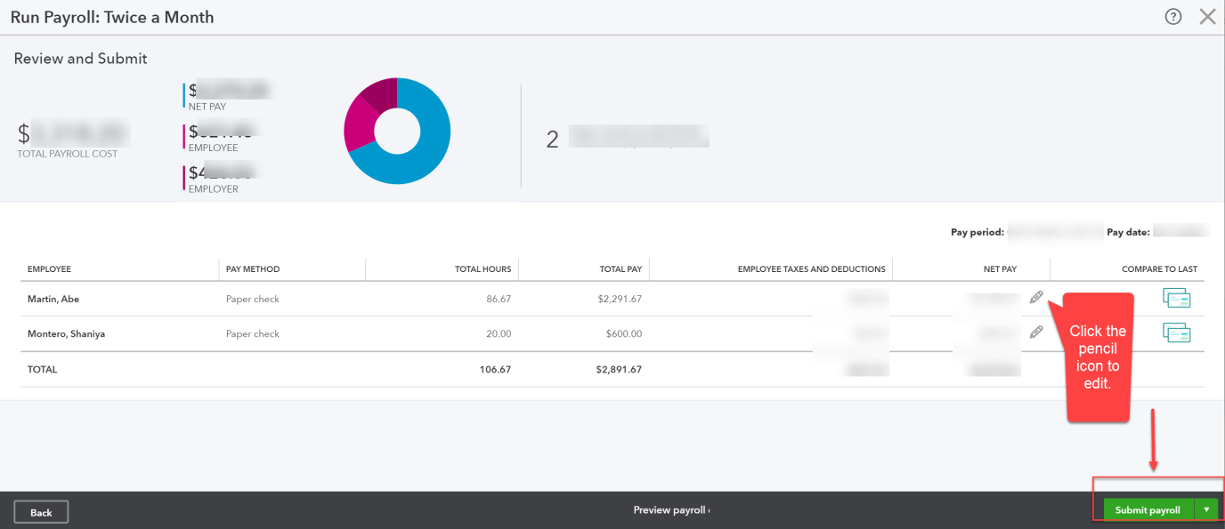
Creating Paychecks
Summary payroll information is displayed on the Review and Submit screen.
Employees hours, etc. can be edited at that point.
To complete the process, click Submit payroll and enter paycheck numbers (if employees are paid by check).

Slide 25
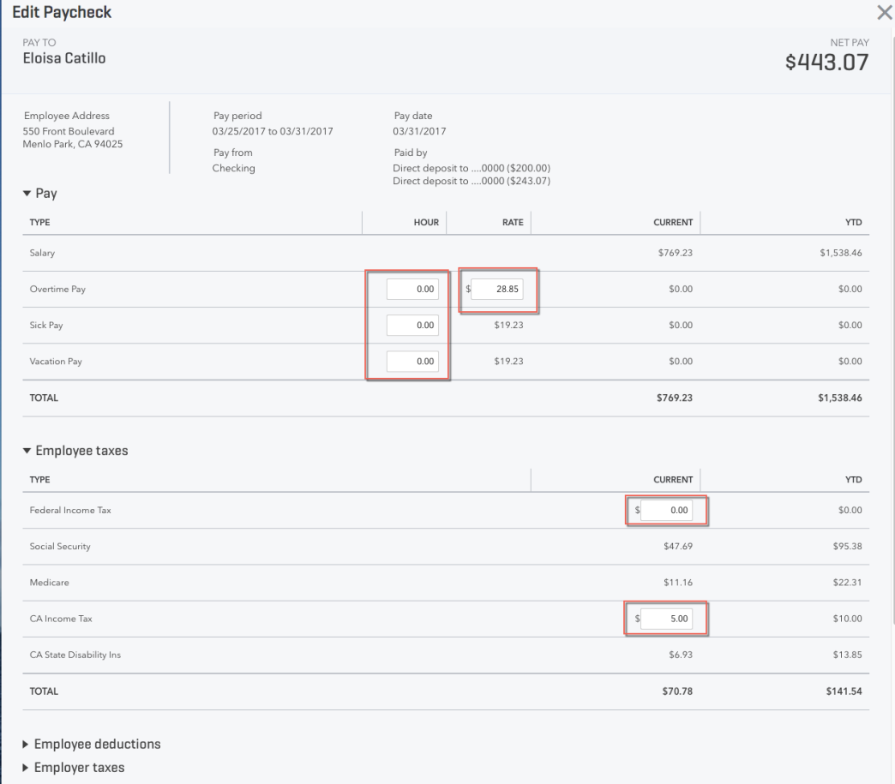
Editing Paychecks
Certain information on paychecks can be edited, if necessary. To open the paycheck for editing:
Double-click the appropriate employee name in the Employee Center.
Click the Paycheck list tab and double-click the paycheck to be edited.
Fields that can be edited will be clearly highlighted in the Edit Paycheck window.

Slide 26
Payroll Reports

Slide 27
Reviewing Payroll Taxes and Other Payroll Reports
You will not be remitting payroll taxes in this class, but you can see the payroll tax liabilities in the Payroll Tax Liability report.
All payroll reports can be accessed in the Payroll section on the Standard tab of Reports.

Slide 28
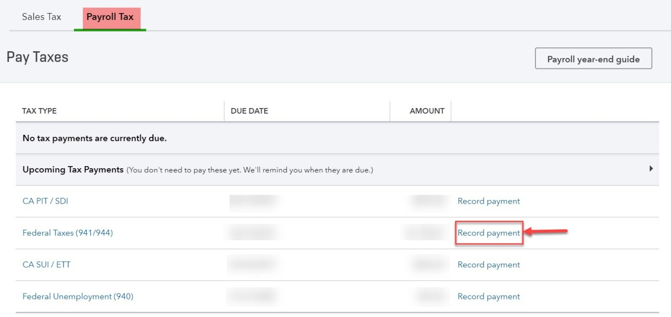
Remitting Payroll Taxes
The taxes currently due (as well as upcoming payments) will be displayed in the window.
Click Record payment in the row of the tax to be remitted.

Slide 29
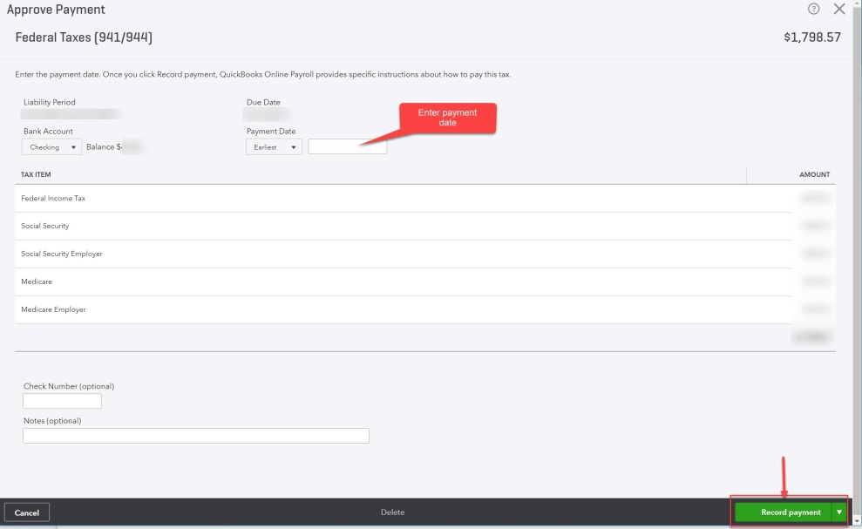
Remitting Payroll Taxes
Click Record payment on the Approve Payment screen to move forward.
The final step is to identify the method of payment—submission or manual check.

Slide 30
Editing Payroll Taxes
Payroll tax liability checks cannot be edited.
If an error was made, the check would need to be deleted and a new check created.
Errors in payroll tax liability accounts may require Intuit assistance.

Slide 31
Payroll Reports

Slide 32
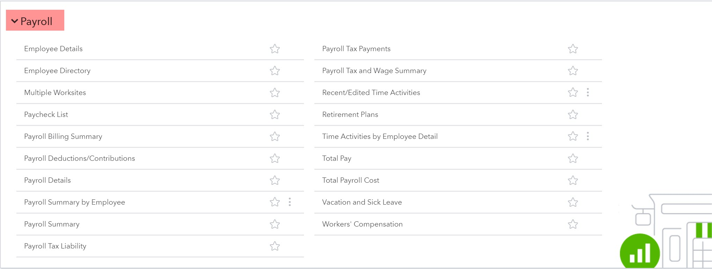
Payroll Reports
Payroll reports are included in the Payroll section of Standard reports.

