Slide 2
Purchasing Activity (Service Company)
4

Slide 3
Purchase Cycle— Service Company

Slide 4
What is the Purchase Cycle in a Service Company?
Incur the cost
Receive the bill for the cost
Pay the vendor

Slide 5
Managing Vendors

Slide 6
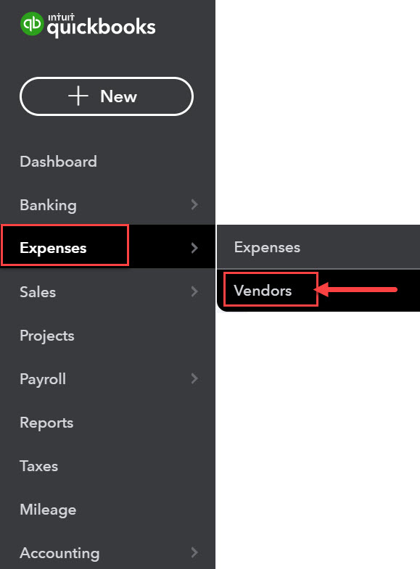
Vendor Center
Vendors are set up, edited, and deleted through the Vendor Center.
The Vendor Center can be accessed by hovering your mouse over Expenses on the navigation bar and selecting the Vendors drawer.

Slide 7
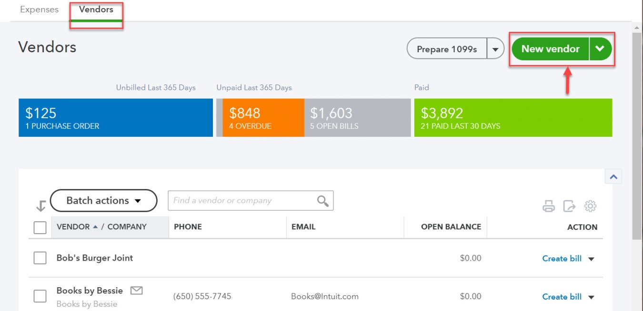
Vendor Center
To add a vendor, click New vendor to open a new vendor record window.

Slide 8
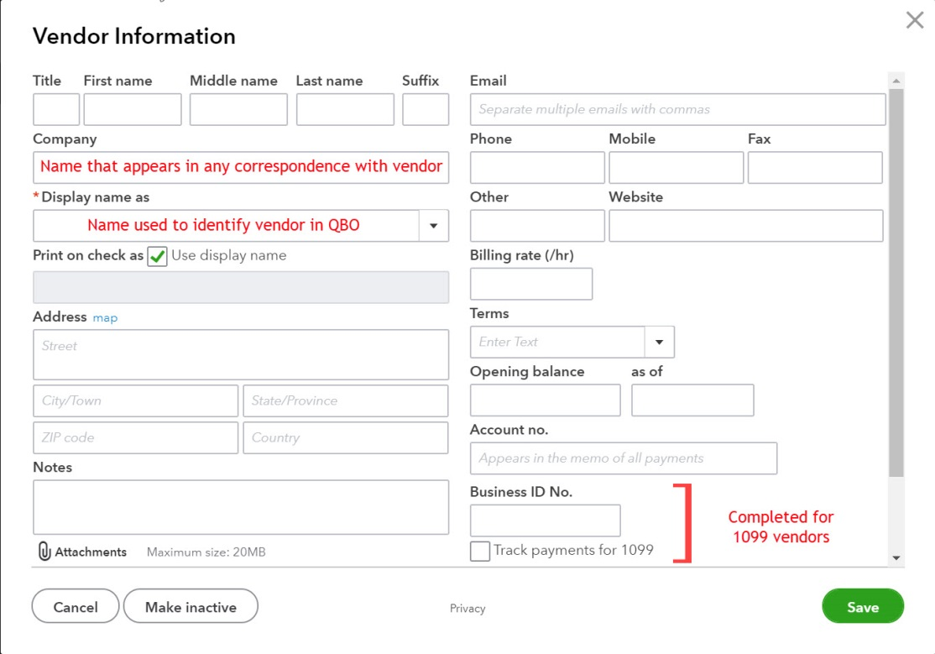
Vendor Record
The only required field is the Display name as field, the field used to identify the vendor record in QBO
The Company field can be different than the Display name field. The Company name is used on purchase forms.
Terms available for vendors are the same as those available for customers.
1099 vendors are identified in the vendor record.
Business identification number is required for completing year-end 1099 forms.

Slide 9
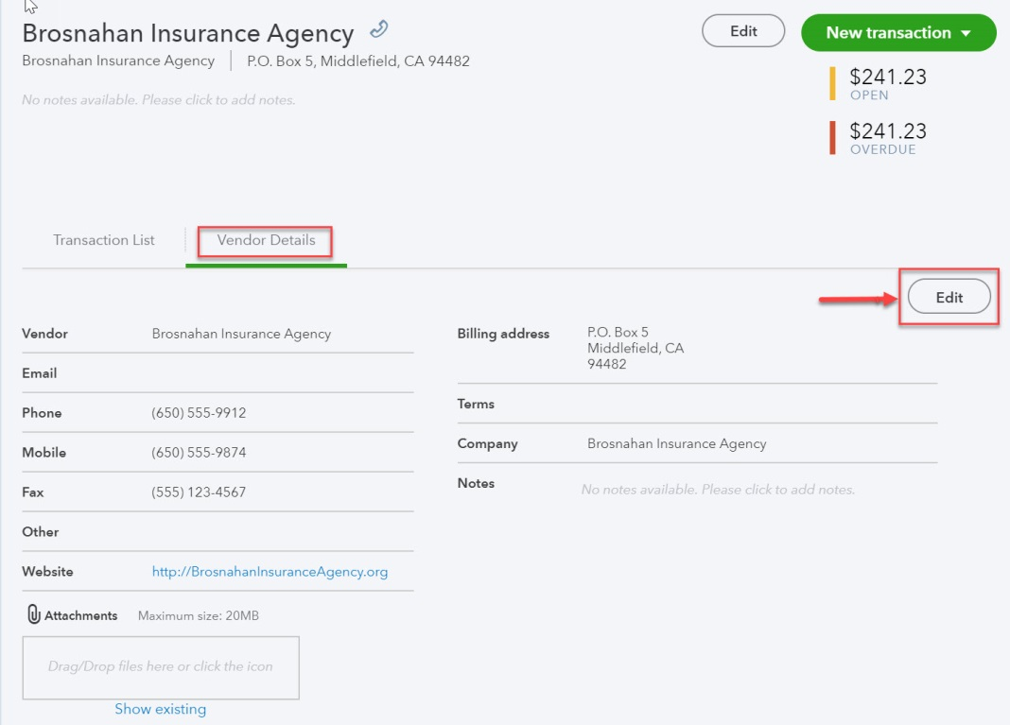
Editing a Vendor
Changes are made to vendor records in the Vendor Details tab of the vendor record.
Click the vendor name in the Vendor Center
Click the Vendor Details tab.
Click Edit to make changes. (Either Edit link works!)

Slide 10
Inactivating a Vendor
Vendors with any current or past activity can’t be deleted.
Vendors with zero balances can, however, be made inactive.
Done by selecting Make inactive in the dropdown menu in the ACTION column (far right column) of the appropriate vendor’s row in the Vendor Center.
Inactive vendors will not be accessible in transactions or in searches. They will appear on appropriate reports.

Slide 11
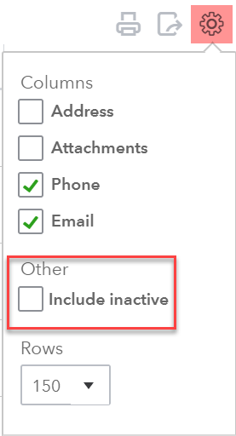
Reactivating a Vendor
Inactive vendors can be re-activated.
Select Include Inactive on the gear menu of the Vendor Center to make vendor visible in the list.
Click Make active in the Action column of the appropriate vendor row.

Slide 12
Incurring Costs

Slide 13
Incurring Costs
Companies can:
Purchase and pay immediately
Purchase and pay later (purchase on account)

Slide 14
Paying at the Time of Service
When payment is made at the time of service, companies can pay by:
Check
Transaction type check
Credit Card
Transaction type expense

Slide 15
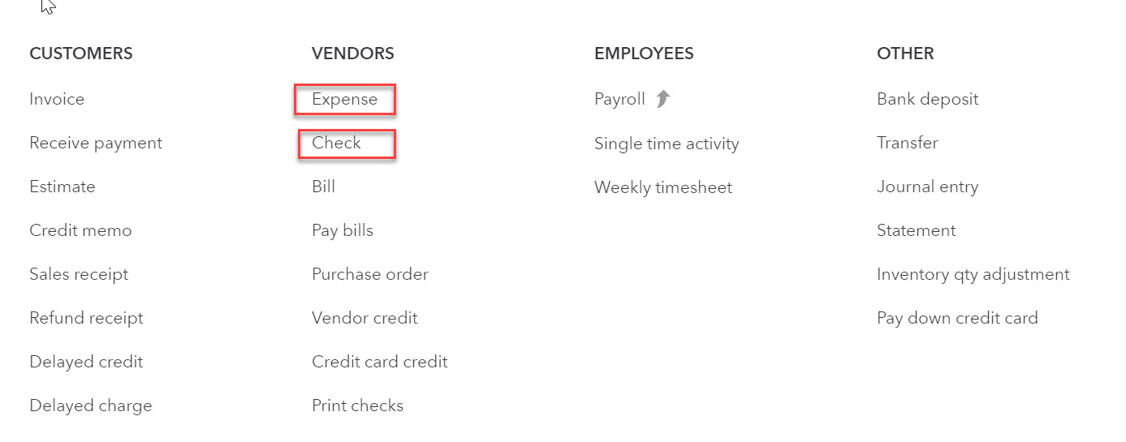
Paying at the Time of Service
Both forms (check and expense) can be accessed by clicking on the navigation bar.

Slide 16
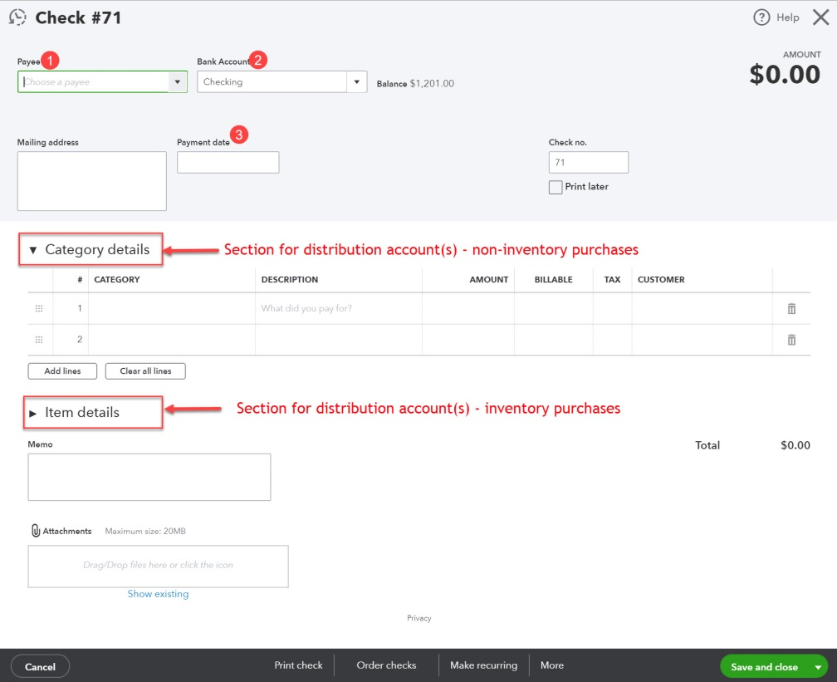
Paying Up-Front with a Check
The vendor (payee) is selected and the payment date is entered.
Account(s) to be debited is(are) selected in the Category or Item details section.
Defaults (from the vendor) will automatically appear for address
Vendor address information can be changed.

Slide 17
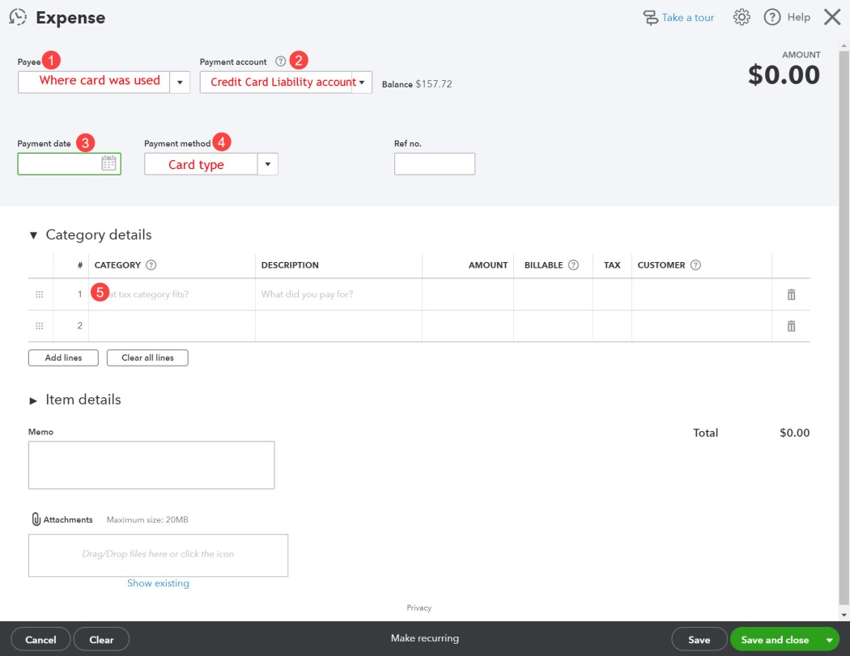
Paying Up-Front with a Credit Card
The vendor (payee) name and the credit card liability account are selected.
Account to be debited is selected in the Category details section (or Item details section if inventory products are purchased).

Slide 18
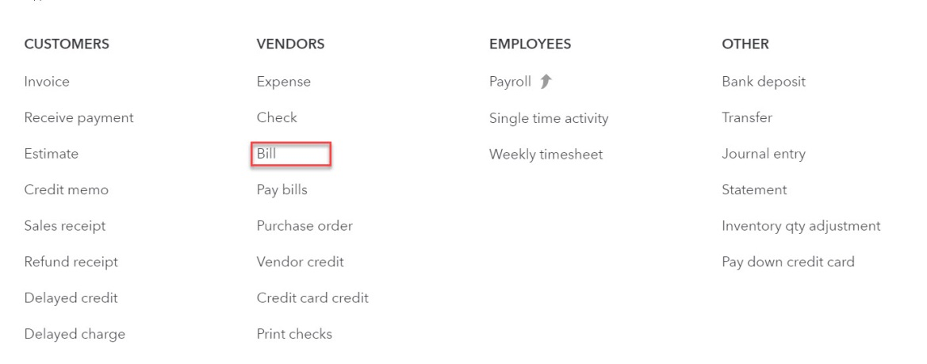
Buying on Account
The transaction type for vendor invoices is bill.
Remember, the transaction type invoice is used for billing customers.
The bill form can be accessed by clicking on the navigation bar.

Slide 19
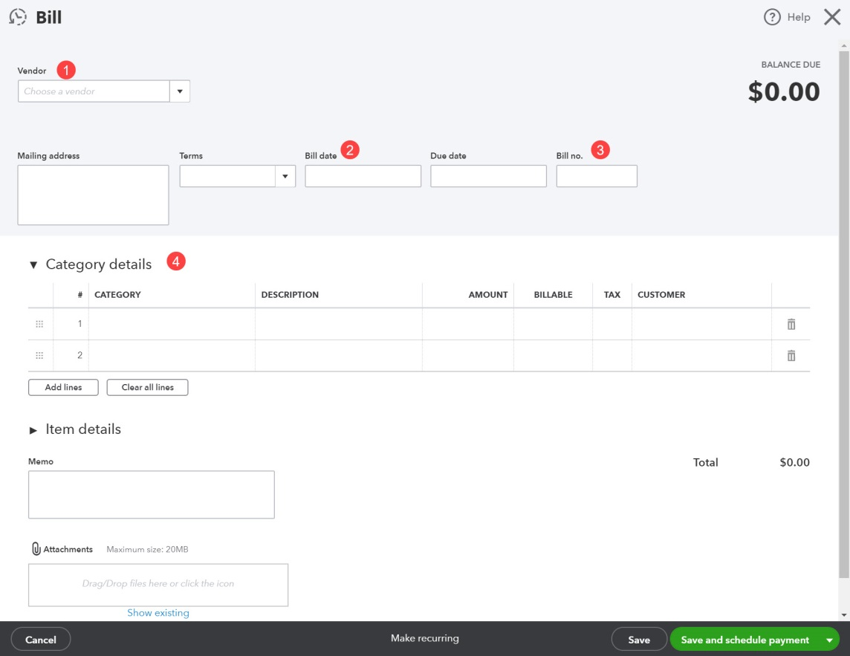
Buying on Account
The Vendor is selected and the Bill date is entered.
The account(s) to be debited is(are) selected in the Category details (or Item details)section.
Defaults (for the vendor) will automatically appear for Mailing address and Terms
Vendor address information and terms can be changed.
NOTE: The Save and schedule payment option is only available for QBO online bill pay users.

Slide 20
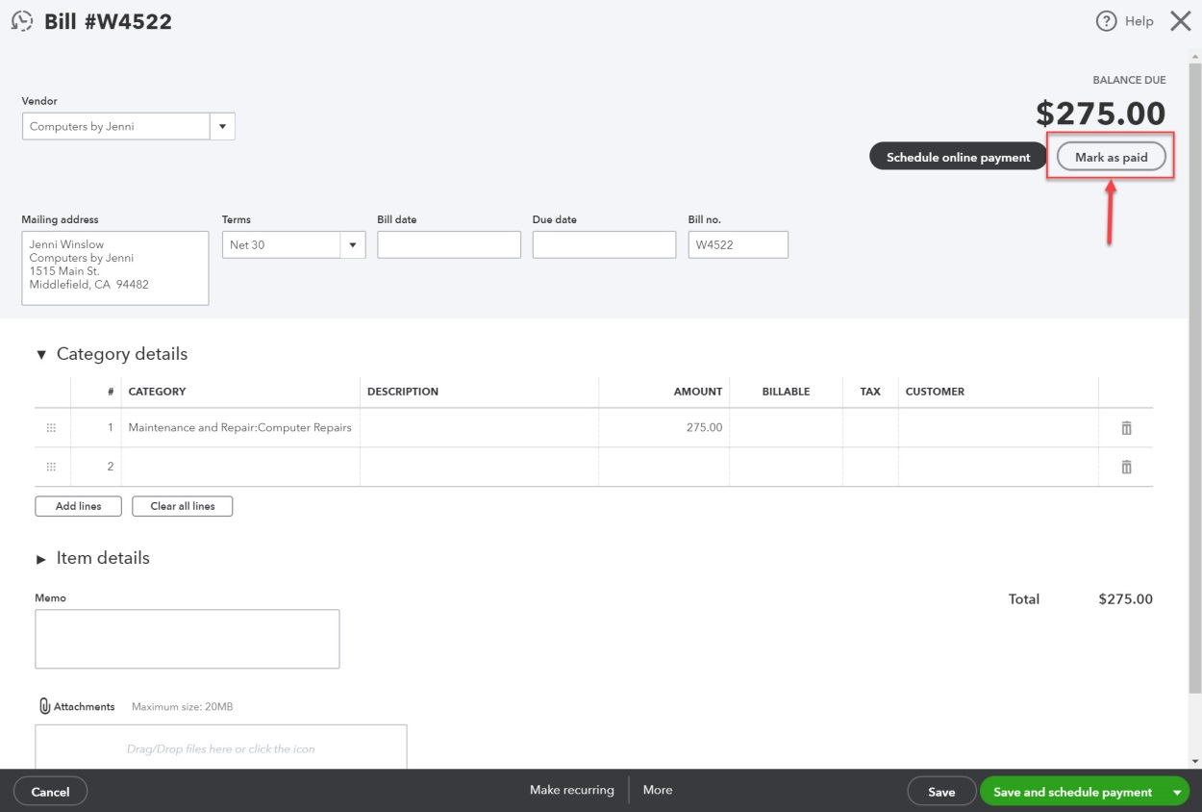
New Feature
Once a bill is saved, bill payments can be recorded by clicking Mark as paid on the bill form.

Slide 21
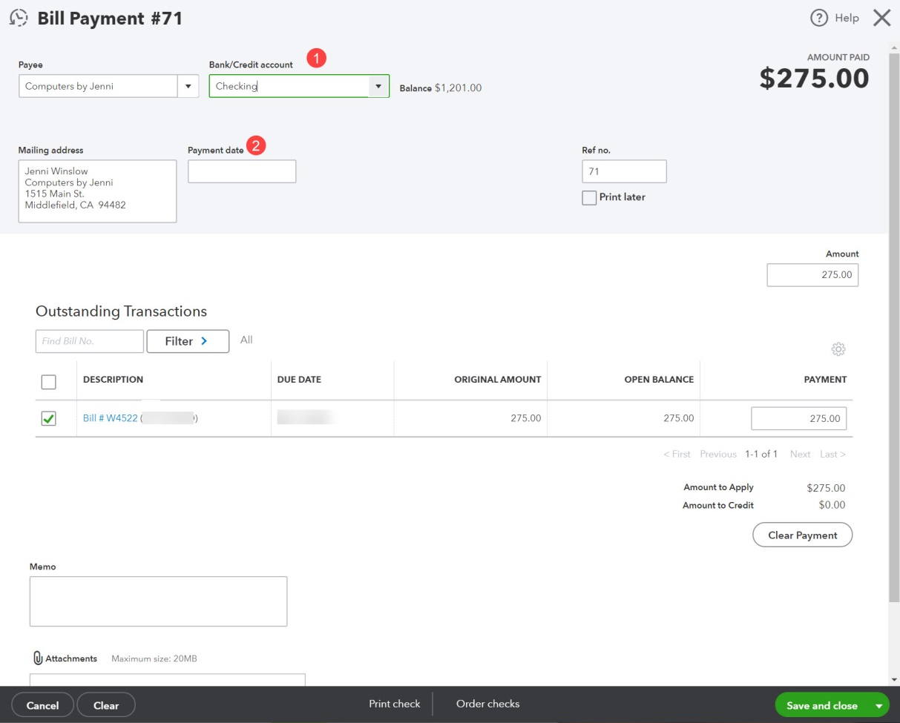
New Feature
A bill payment form appears.
Bank/Credit account and payment date are entered.

Slide 22
Summary Account Distributions
On the forms for bills, checks, or credit card transactions, there are two sections for designating the account that should be debited.
Category details section—Used for distributions to any account except accounts associated with product or service items
Can be asset, liability, equity, income or expense accounts
Item details section—Used in merchandising or manufacturing companies when purchases are for inventory
Will be debited to the account associated with the product or service
There can be multiple distributions for an individual transaction.
Negative amounts can be entered on the distribution tabs as long as the net amount of the distribution entries is positive.
Negatives will be recorded as a credit to the identified account.

Slide 23
Paying Vendor Account Balances

Slide 24
Paying Vendor Account Balances
Vendor account balances can be paid by check, cash, or credit card.
The transaction type for payment on account by cash or check is bill payment (check).
The transaction type for payment on account by credit card is bill payment (credit card).
Multiple vendors can be paid at the same time.
If multiple bills from the same vendor are selected, QBO will automatically combine the amounts and create a single payment record.

Slide 25
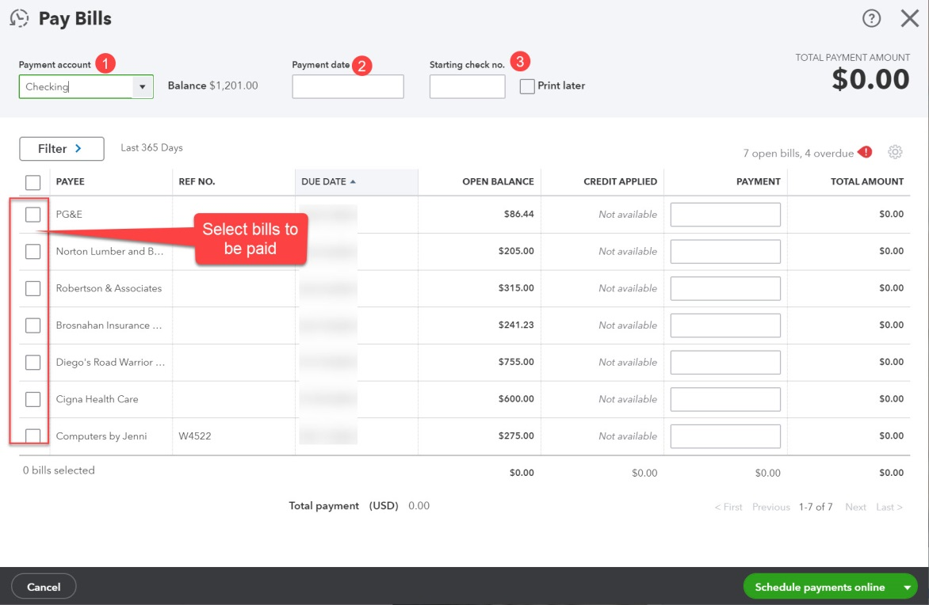
Paying Vendor Bills
The pay bills window can be accessed by clicking on the navigation bar and selecting Pay Bills.
Partial payments can be made by changing the amount in the PAYMENT field after bill to be paid is selected.
NOTE: The Save and schedule payment option is only available for QBO online bill pay users.
NOTE: Any available vendor credits will be displayed in the Credit Applied column. (Vendor credits are covered in Chapter 7.

Slide 26
Purchases and Payable Reports

Slide 27
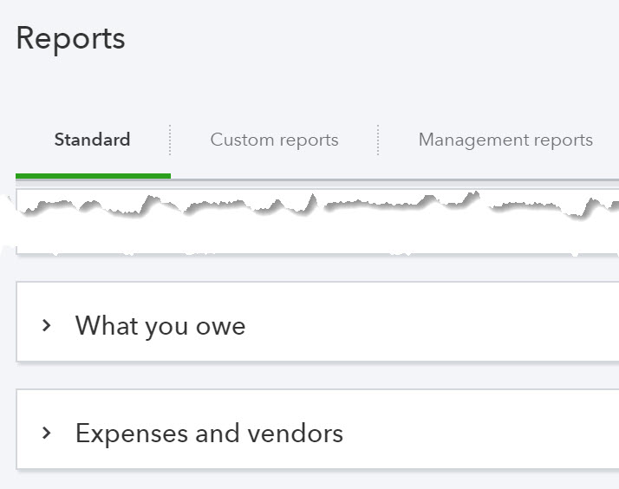
Reports
Purchases and payable reports are accessed by clicking Reports on the navigation bar and clicking the Standard tab.
Reports are included in the What you owe and Expenses and vendors sections.

