Slide 2
Sales Activity (Merchandising Company)
6

Slide 3
Sales Cycle— Merchandising Companies

Slide 4
What is the Sales Cycle in a Merchandising Company?
Purchase product
Get orders for product
Fill product orders
Bill for product orders
Collect the money

Slide 5
Things to Remember
Products sold by merchandising companies are normally purchased in advance and held in inventory until sold.
In states with a sales tax, companies often are required to collect state and local sales taxes on sales of products to customers.

Slide 6
Setting Up Inventory Items

Slide 7
Inventory Item Types
Products held for sale can be set up in QBO as:
Inventory OR
Non-inventory product items
Only inventory items are tracked in QBO (quantities and unit cost).
Tracked as assets using a perpetual inventory tracking system, and valued using FIFO.
Non-inventory items are not tracked.
Expensed when purchased.

Slide 8
Inventory Items vs. Non-Inventory Items
Normally all products sold by merchandising companies would be set up as inventory items.
Non-inventory items might be used by:
Companies that buy products directly for customers
Items not held in inventory
Manufacturing companies that choose not to track parts with insignificant costs

Slide 9
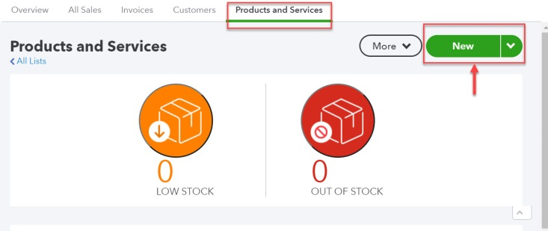
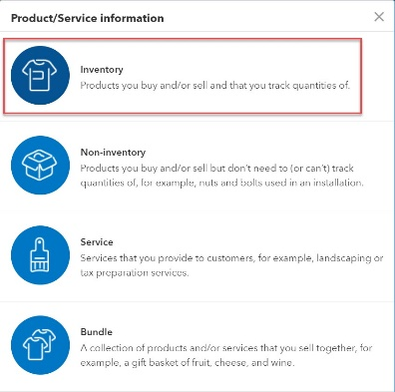
Setting Up Inventory Items
Click the on the icon bar and select Products and Services.
Click New.
Click the appropriate product type (inventory or non-inventory).

Slide 10
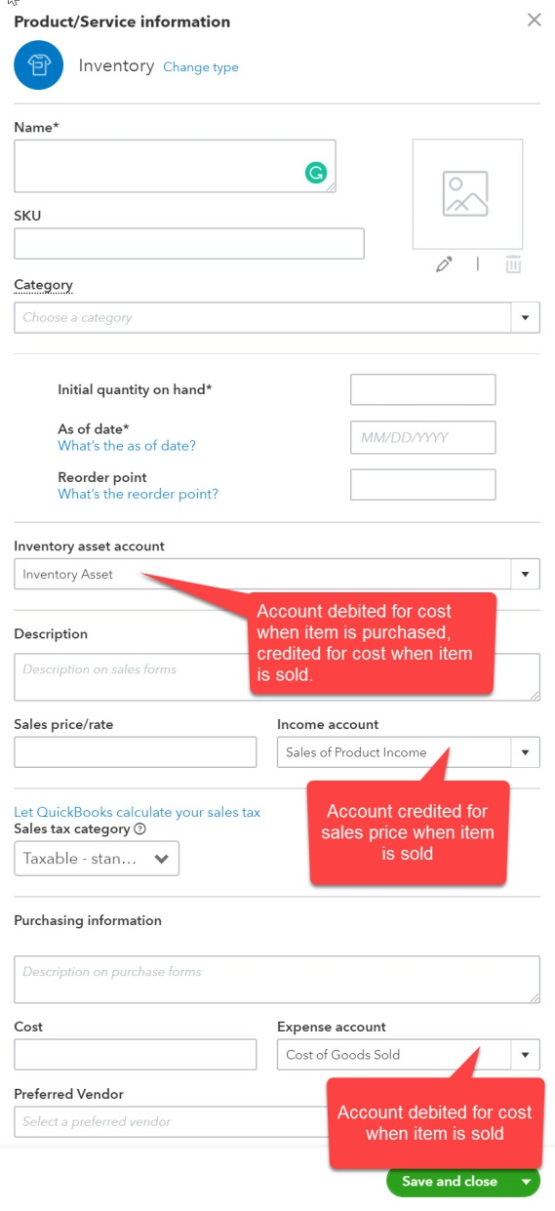
Setting Up Inventory Items
Unique Name is required.
Users identify
the account to be debited when the item is purchased (Inventory asset account),
the account to be credited for revenue when the item is sold (Income account) and
the account to be debited for the cost when the item is sold (Expense account).
MUST enter 0 as the Initial quantify on hand when setting up new items.
The As of date must represent the first date an item would be available for sale.
Sales price/rate and Cost entered here are defaults.
Descriptions, sales rates, and cost amounts can be changed when transactions are recorded.

Slide 11
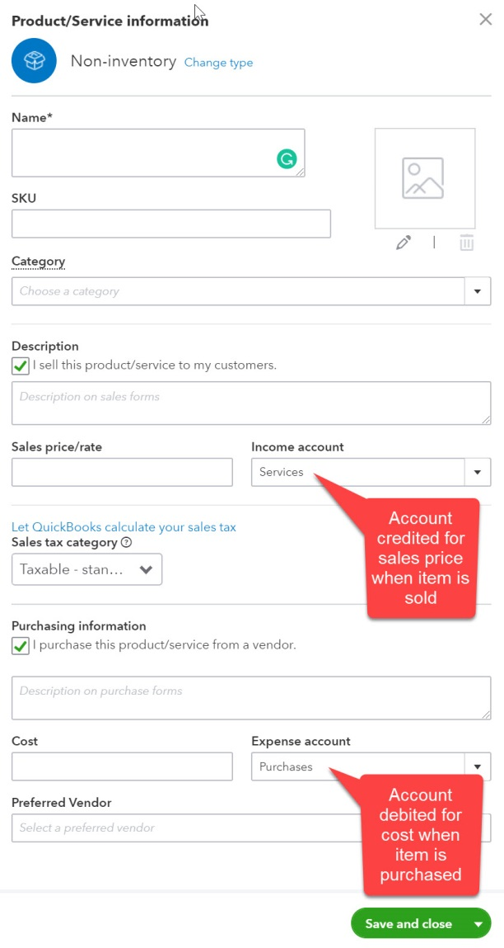
Setting Up Non-Inventory Items
Unique Name is required.
Users identify the account to be credited for revenue when the item is sold (Income account) and the account to be debited when the item is purchased (Expense account).
Descriptions entered will appear on forms.
Sales price/rate and Cost entered here are defaults.
Descriptions, sales rates, and cost amounts can be changed when transactions are recorded.

Slide 12
One Other Item Type
Companies that sell multiple services or products as a package can create bundle items.
All items to be included must be set up in QBO.
Items sold in the package are added to the bundle.
Examples:
Sale of a refrigerator with delivery and installation
Sale of a mattress with headboard and a mattress cover
Items included in a bundle can be inventory, non-inventory, or service items.
Bundles aren’t covered in this course.

Slide 13
Working with Sales Tax

Slide 14
Sales Taxes in QBO
Once the sales tax feature is activated, QBO automatically calculates the appropriate sales tax based on:
Tax status of product (or taxable service) sold.
Tax status of customer
Physical address of sale location or customer location depending on state tax rules.

Slide 15
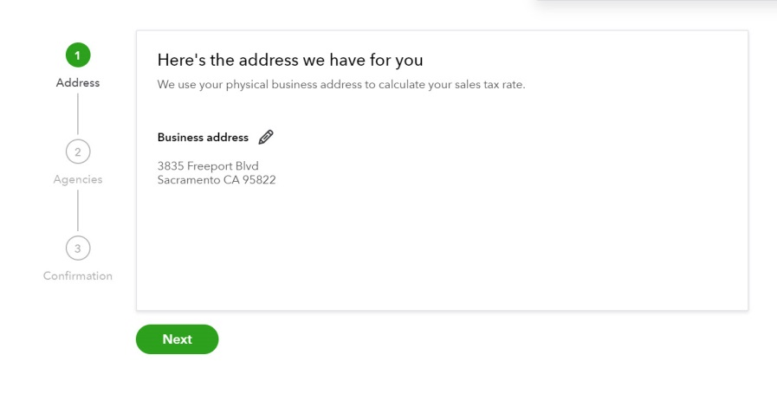
Activating Sales Taxes
Click Taxes on the navigation bar to start.
Click Set up sales tax on the first screen.
The company’s address is verified next.
Additional states can be added in subsequent screens if the company is required to collect sales taxes in other states.

Slide 16
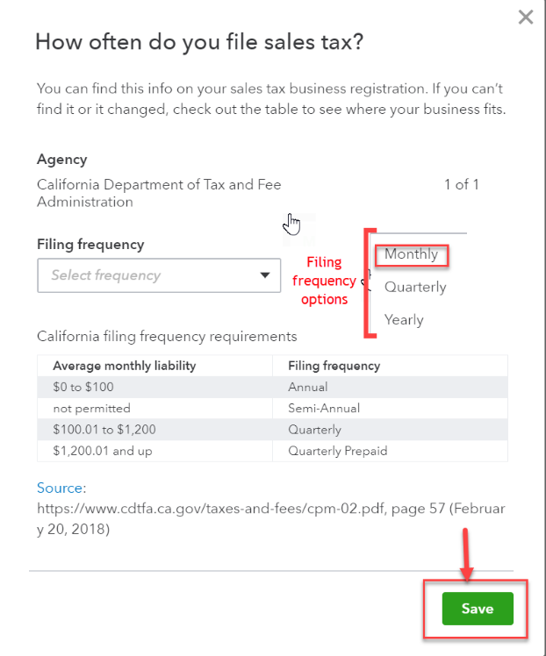
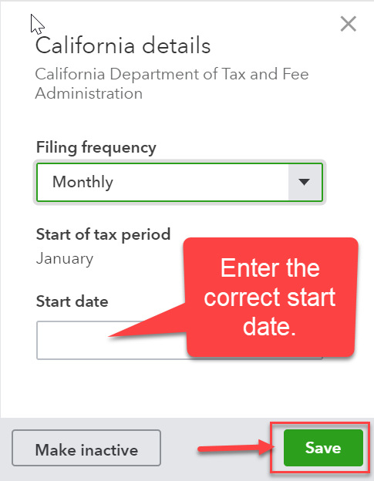
Activating Sales Taxes
The final steps are to identify:
How often the company is required to remit taxes
The date the company is first responsible for collecting sales taxes.
Both can be entered by clicking Sales Tax Settings in the Sales Tax Center. QBO will remind users to provide information if necessary.

Slide 17
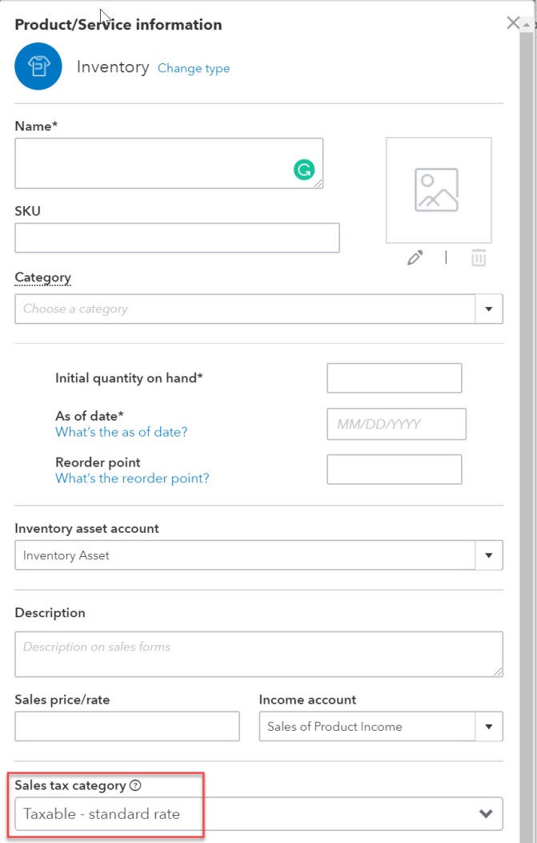
Identifying the Tax Status of Products and Services
If an item is ever taxable, Taxable – standard rate should be selected in the Sales tax category field.
The tax status of items can be changed on invoices and sales receipts, if necessary.

Slide 18
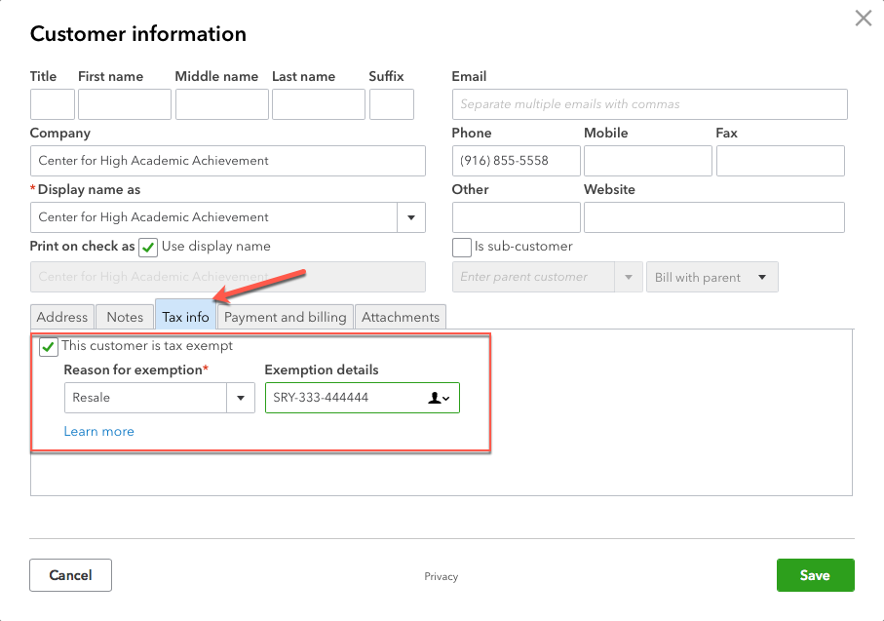
Identifying the Tax Status of Customers
By default, all customers are initially identified as taxable in QBO.
If a specific customer is exempt, the status can be changed in the customer record.
The reason for the tax exemption must be identified.
The tax status of customers can be changed on invoices and sales receipts, if necessary.

Slide 19
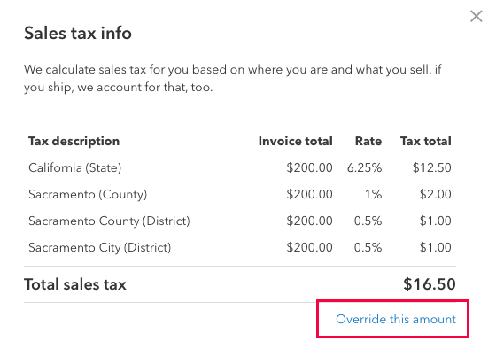
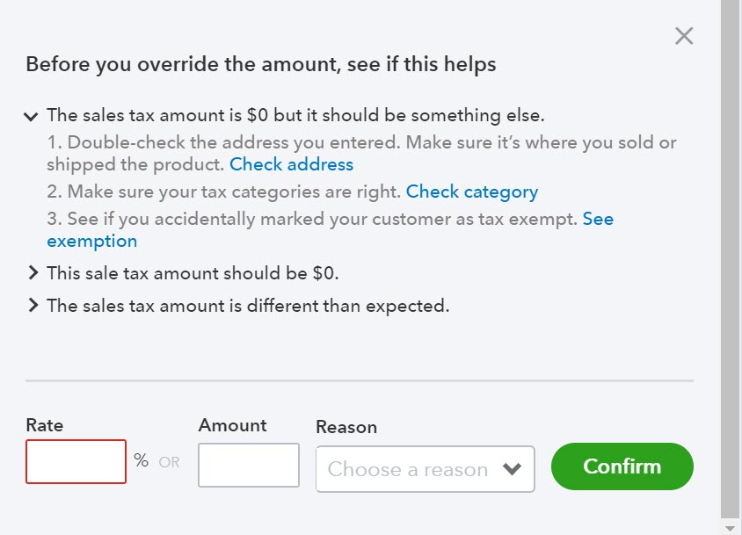
Issues with Sales Taxes
QBO updates state and local tax rates automatically.
These rates cannot be changed by users.
If a user believes a tax rate in QBO is correct, the sales tax amount can be changed by clicking Sales Tax in the sales form to open a dialog box.
Click Override this amount in the dialog box.
Enter the adjusted rate or amount and the reason for the override.

Slide 20
Working with Other Types of Sales Transactions (not covered in other chapters)

Slide 21
Sales with Discounts
Discounts might be given to various customers:
Based on quantity of product ordered
Based on type of customer (nonprofits, seniors, etc.)
As part of a marketing program.

Slide 22
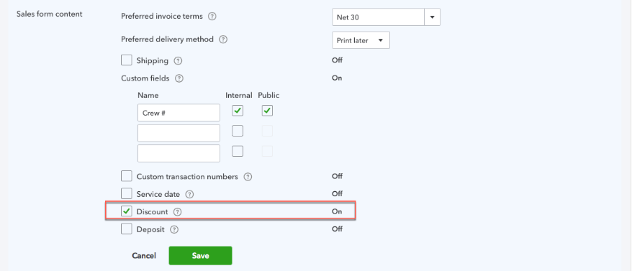
Sales with Discounts
The Discount feature is activated on the Sales tab of Account and Settings.
Click the on the icon bar to open Account and Settings.
The account used in recording discounts is set up on the Advanced tab of Account and Settings.

Slide 23
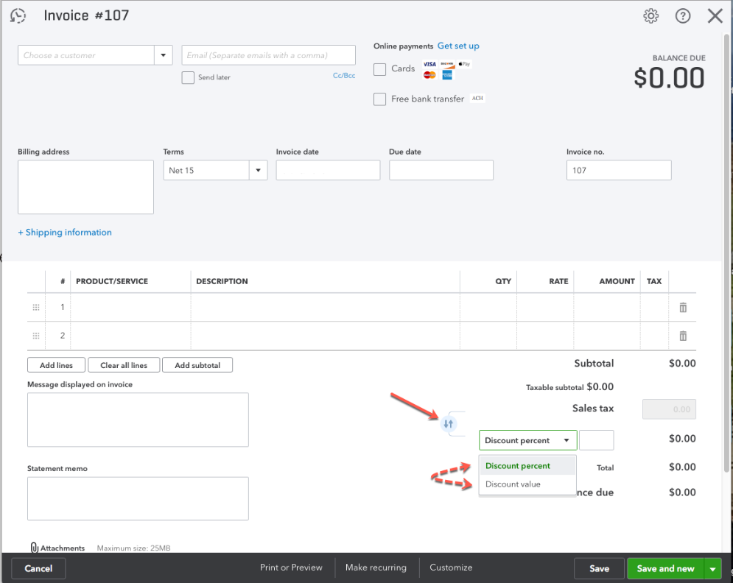
Sales with Discounts
Once the discount feature is activated, a discount field will be available sales forms.
QBO will either calculate the discount on the total before or the total after tax, depending on the order of the tax and discount fields.
The user can change the order using the up/down arrows to the left of the fields.

Slide 24
Pending Sales Transactions
Users can create ”pending” invoices (called Delayed Charges) or “pending” credit memos (called Delayed Credits) in QBO.
Delayed transactions are useful when some additional activity is necessary before a sale or credit is recognizable.
A delayed charge might occur when a customer has ordered a product but it hasn’t yet been shipped.
A delayed credit might occur when a product returned by a customer hasn’t been received yet.

Slide 25
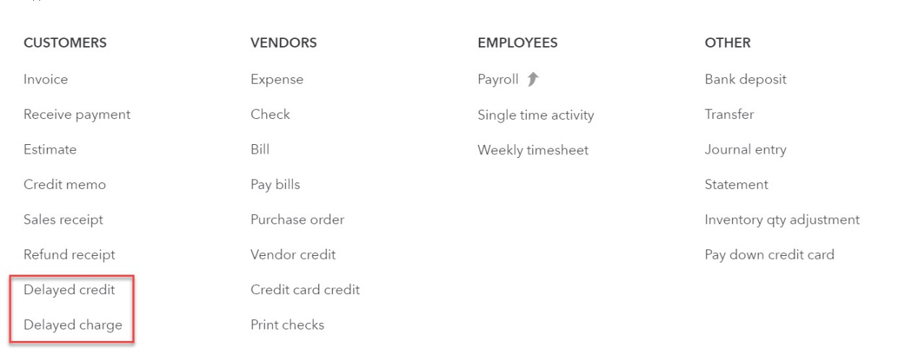
Pending Sales Transactions
Delayed charge and delayed credit forms are accessed by clicking on the navigation bar.
Both of these transaction types are non-posting transactions (no journal entry is created)

Slide 26
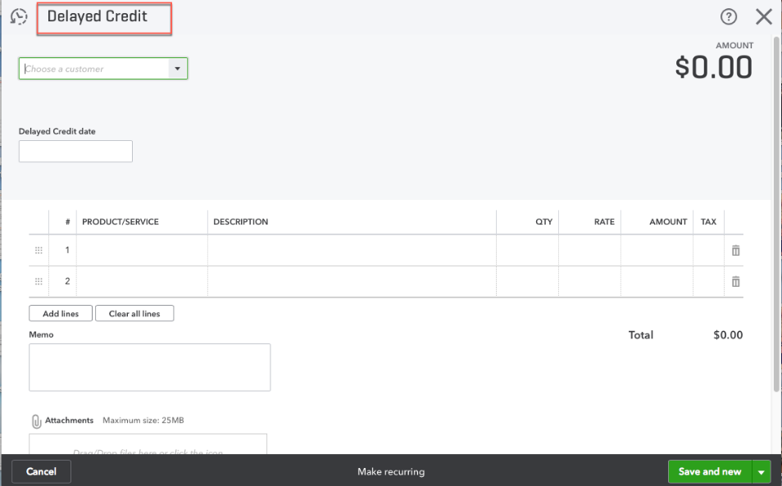
Delayed Charges and Delayed Credits
The delayed transaction forms are similar to the invoice and credit memo forms.
NOTE: Sales tax and discount fields are not available on delayed charge forms. Those fields will appear when the delayed charge is converted to an invoice or sales receipt.

Slide 27
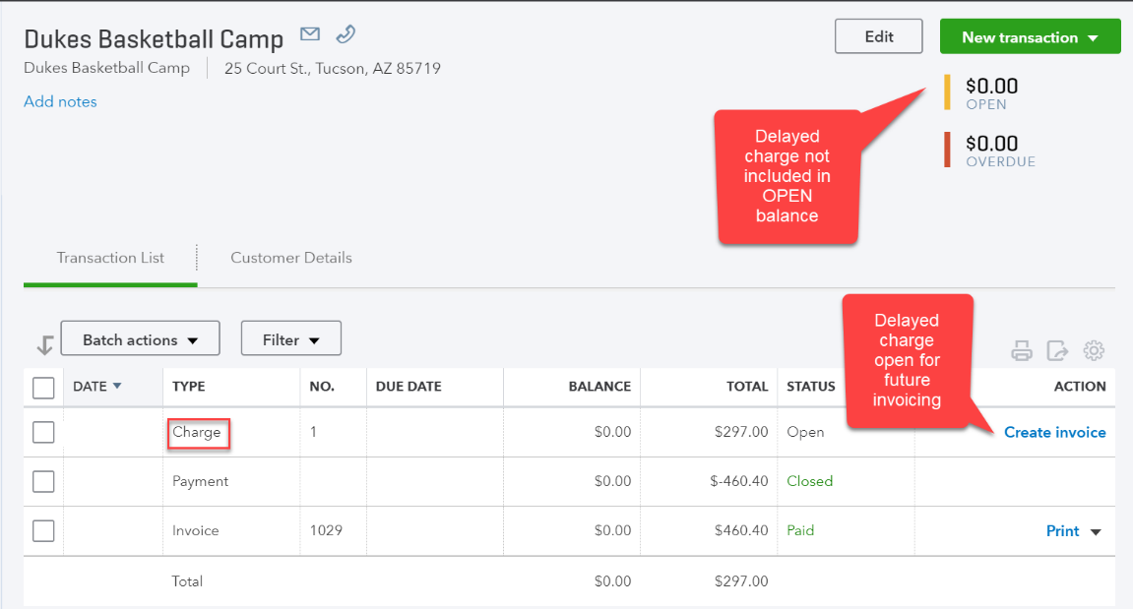
Recognizing Delayed Transactions
Delayed charges are recognized in QBO by clicking Create invoice in the transaction list tab of the customer record.
Delayed credits are recognized by applying them to an invoice.
See Chapter 2 for a refresher on applying credit memos to invoices.

Slide 28
Writing Off Uncollectible Accounts
In most businesses, there are at least some sales on account that will never be collected.
In QBO, write-offs of uncollectible invoices can be done by:
Recording a credit memo for the uncollectible amount using a service item specifically created for write-offs.
The income account would be Allowance for Doubtful Accounts or Bad Debt Expense, depending on whether the allowance or direct write-off methods are used. Remember, the income account is debited in a credit memo transaction.
Applying the credit memo to the uncollectible invoice.
Invoices can also be written off using a journal entry. Using the credit memos, however, allows users to easily apply write-offs to specific invoices.

Slide 29
Customers Paying with Credit Cards
Customers paying with credit cards at point of sale are processed on sales receipts.
Customers using credit cards to make payments on account balances are processed through Receive Payment form.

Slide 30
Customers Paying with Credit Cards
It’s best practice to record deposits of credit card receipts separate from deposits of cash/check receipts in order to mirror bank activity.
Credit card receipts (batch totals) are normally deposited in the seller’s bank account within 2-3 days of the transaction date.
Merchant banks generally charge fees for processing credit card payments. The fees (generally a percentage of the transaction total) can be entered when deposit is created if rate is known.
If the rate is not known, deposits should be adjusted when statement is received.

Slide 31
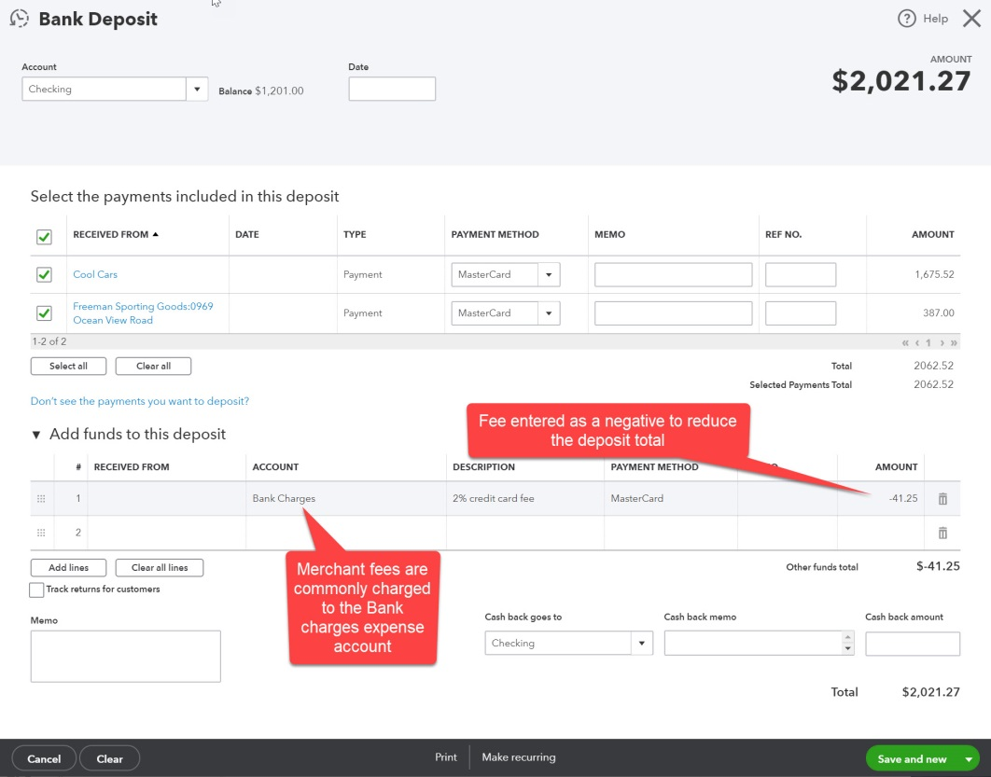
Customers Paying with Credit Cards
Example of a deposit of credit card receipts (2% merchant fee)

Slide 32
Early Payment Discounts Taken by Customers
Automatic processing of early payment discounts is not yet available in QBO.
2%/10, 1%/10 are examples of terms that include a discount for early payment by the customer.
As a work around:
A service item can be created (the income account would normally be a contra revenue account like Sales Discounts).
A credit memo is then issued to the customer taking the discount using the new service item.
The credit memo is applied to the invoice when the customer payment is recorded.

Slide 33
Managing Customer Checks Returned Due to Insufficient Funds (NSF checks)
Having customer checks returned by the bank for lack of funds is a risk of doing business.
Companies must choose whether to
Attempt to redeposit the check OR
Re-invoice the customer for the amount of the check plus any processing fees OR
Write off the check.

Slide 34
Managing Customer Checks Returned Due to Insufficient Funds (NSF checks)
If the company elects to re-invoice the customer for the check amount plus any appropriate fees, several new service items should be created.
One for the NSF amount
Income account selected in the setup would be the bank account so the underlying journal entry would be DR A/R and CR Checking.
One for any processing fee to be charged to the client.
Income account selected in the setup might be bank service charges or miscellaneous income, etc.
A new invoice would then be created using the two new service items.

Slide 35
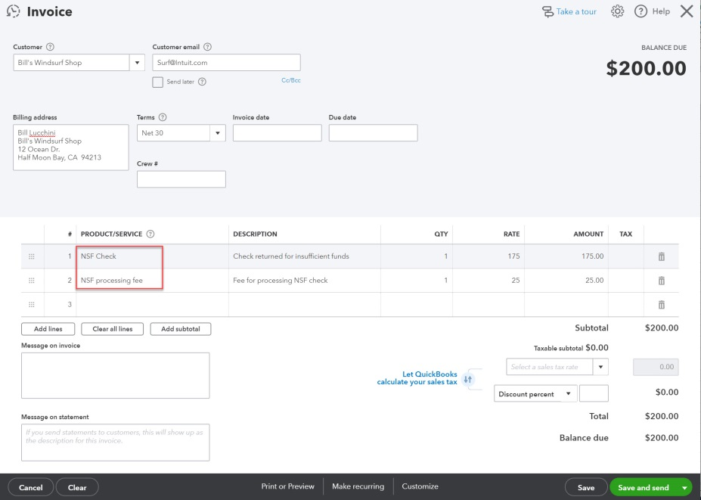
Example of an Invoice for Recovery of an NSF Check Amount
The invoice to the customer:
The underlying journal entry:

Slide 36
Managing Customer Checks Returned Due to Insufficient Funds (NSF checks)
If the company elects to write off the NSF check, a new invoice can be created using the steps outlined on the previous slides.
Creating the invoice is necessary for crediting the cash account for the NSF check.
A processing fee wouldn’t be included in this case.
The invoice would then be “written off” using the process outlined in the ”Writing off uncollectible accounts” section of this PowerPoint.
NSF checks can also be written off using a general journal entry.

Slide 37
Statements

Slide 38
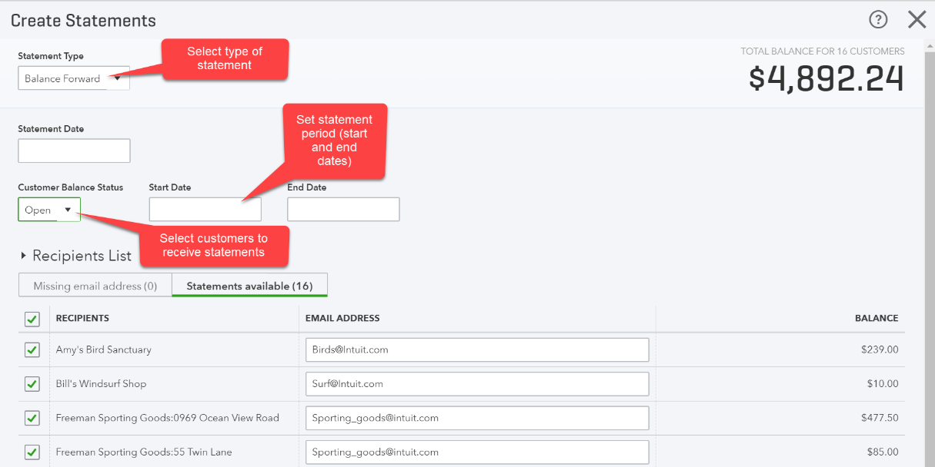
Statements
Statements can be sent to customers using QBO.
Statements are created by clicking on the navigation bar and selecting Statement.
Statement types include:
Open item
Only open transactions are displayed
Balance forward
Beginning balance plus all current period transactions are displayed.
Transaction Statements
All current period transactions are displayed.

Slide 39
Reports

Slide 40
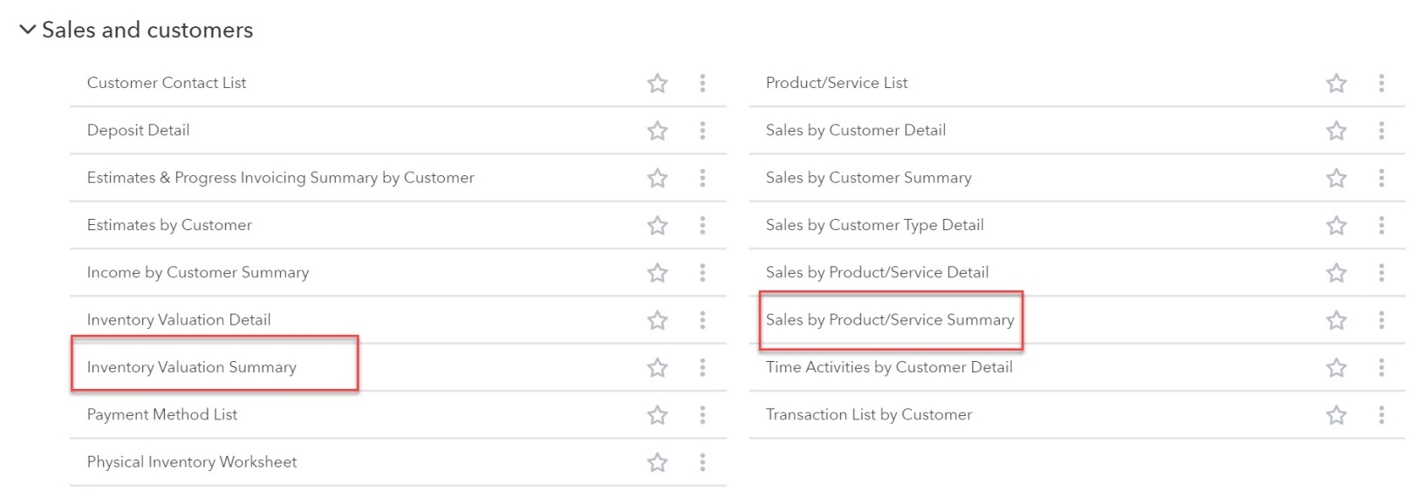
Inventory Reports
Inventory reports are included in the Sales and customers section of Standard Reports.
Some commonly used reports are highlighted below:

