Slide 2
Introduction to QuickBooks ® Online (QBO)
1

Slide 3
Introduction

Slide 4
A Little Bit of History
Intuit released their first desktop accounting software for small businesses (QuickBooks) in 1992. Other more robust versions (Pro, Premier, Accountant, Enterprise, and Desktop for Mac) followed.
QuickBooks Online (QBO) was introduced in 2001; a major upgrade was completed in 2013.
Five versions of QBO are available. (Self-Employed, Simple Start, Essentials, Plus, and Advanced)
There is also a QuickBooks Online Accountant version for accountants with multiple clients.
Your academic license is for QuickBooks Online Plus.

Slide 5
Features
QBO Benefits
Is flexible (can be used on any operating system)
Is fairly intuitive
No file management skills required (cloud based)
Software improvements are available immediately
QBO limitations
Does not yet include some of the features available in the desktop version
Lacks controls over access to data available in larger software products
Is less functional for manufacturers

Slide 6
Software Updates
Intuit modifies the software frequently.
The modifications may include
Additional features
Updates to existing features
Changes in locations of links to transactions
Changes in terminology
Because QBO is cloud-based, the updates are done automatically.
Sometimes Intuit rolls out the updates in batches; some users might see certain changes before other users.

Slide 7
The Good and Bad News for Students re: Updates
The good news is that software improvements are immediately available to users.
The bad news is that textbooks are written and printed before various improvements are known and available which mean:
Some of the screenshots in the textbook will not match what you see on the screen.
Some of the instructions provided in the textbook will need to be modified to work with new features.*
* Your instructor will be provided with supplements and/or videos whenever a significant change occurs.

Slide 8
What is “Computerized Accounting”?
Computerized accounting, like manual accounting,
Is based on the accounting equation
Uses debits and credits
But sometimes you don’t even have to think about the debits and credits!
In computerized accounting, there’s a lot less tedium!

Slide 9
Manual Accounting
In a manual accounting system:
Documentation (for transactions) is received from external sources or prepared manually.
Details from documents are recorded in journals.
Journals are summarized to create journal entries for posting to the general ledger (G/L).
Transactions are also posted to subsidiary ledgers
A trial balance is prepared to determine that the G/L is in balance.
Financial statements are prepared from the trial balance.
Subsidiary ledger reports are also prepared manually.

Slide 10
Accounting with QBO
In QBO:
Certain documents are prepared in QBO directly (invoices, vendor checks, payroll checks).
QBO automatically prepares the journal entries for those transactions and posts the entries to the general ledger and any subsidiary ledgers.
Information from documents externally prepared (e.g. vendor invoices) is entered into QBO using forms.
QBO automatically prepares journal entries for those transactions and posts the entries to the general ledger and any subsidiary ledgers.
Financial statements are automatically updated every time an accounting transaction is entered.

Slide 11
WARNING !
You still have to know accounting even if you’re using QBO.
QBO doesn’t automatically know:
That the account you just set up was classified in the correct category.
That the invoice you just created represents income you earned on that date.
That the expense you just entered IS an expense and not an asset.
That there are salaries that employees have earned but haven’t been paid for.
Etc.

Slide 12
Organization of QBO

Slide 13
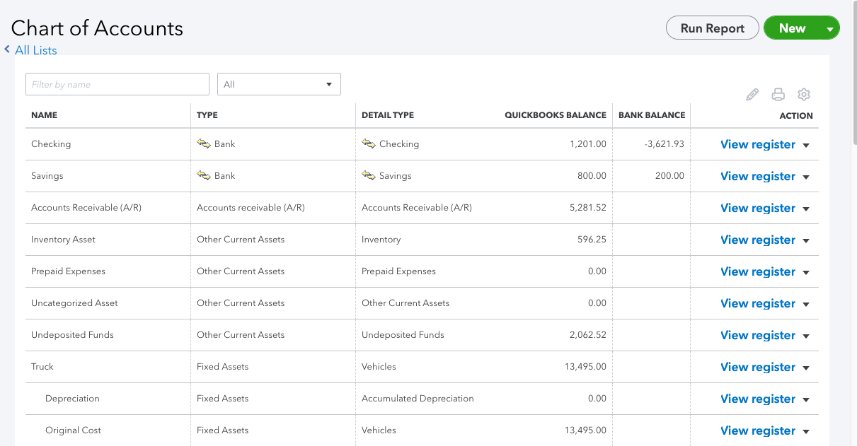
How QBO is Organized
QBO uses lists to organize information.
The chart of accounts is the primary list.

Slide 14
Account Types
An account type must be selected for every account set up in QBO. The account type chosen by the user will determine:
Where the account will appear on financial statements.
Which features will be available in QBO for that account.
A detail type must also be selected for each account set up in QBO.
Each category type has a unique set of detail type.
You may not find a detail type that matches your account exactly. Simply select the closest one.

Slide 15
Account Types
Account types used by QBO…
Asset account types
Bank
Accounts receivable (A/R)
Other current assets
Fixed asset
Other asset
Liability account types
Accounts payable (A/P)
Credit card
Other current liability
Long term liability
Equity account types
Equity
Revenue account types
Income
Other income
Expense account types
Cost of goods sold
Expense
Other expense

Slide 16
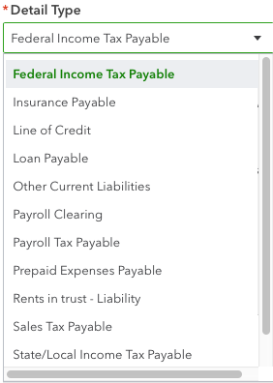
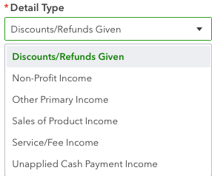
Detail Types—Examples
Detail types for Other Current Liabilities accounts
Detail types for Income accounts

Slide 17
Other Lists in QBO
Another important list in QBO is the Products and Services list.
List of all products sold and services performed
QBO also includes lists of
Customers
Vendors
Employees

Slide 18
Transaction Types
Different types of transactions are recorded in QBO using different forms.
Each form is considered a transaction type.
Examples of transaction types:
Transaction Type | Purpose
Sales Receipt | Used to enter cash sale.
Invoice | Used to enter sales on account.
Payment | Used to enter payment on account received from customer.
Bill | Used to enter vendor invoice.
Bill Payment | Used to enter payment to vendor on account.
General Journal | Used to enter adjusting journal entries.

Slide 19
Transaction Types
Behind every completed form (every transaction type) is a journal entry EXCEPT for:
Payroll Purchase orders
Estimates
Delayed charges and delayed credits
Timesheets
None of the above are considered accounting transactions because none of them immediately change the accounting equation.

Slide 20
Moving Around in QBO

Slide 21
Moving Around in QBO
You can access forms and lists, change settings, and create reports from the:
Icon bar
Navigation bar
Dashboard

Slide 22
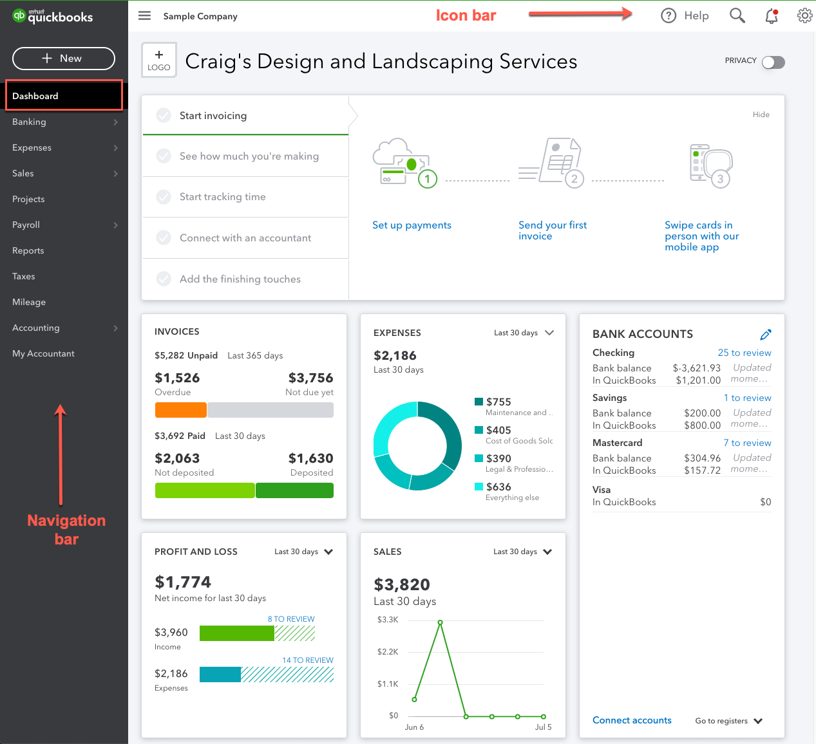
The Dashboard
The Dashboard provides basic information about the company.

Slide 23
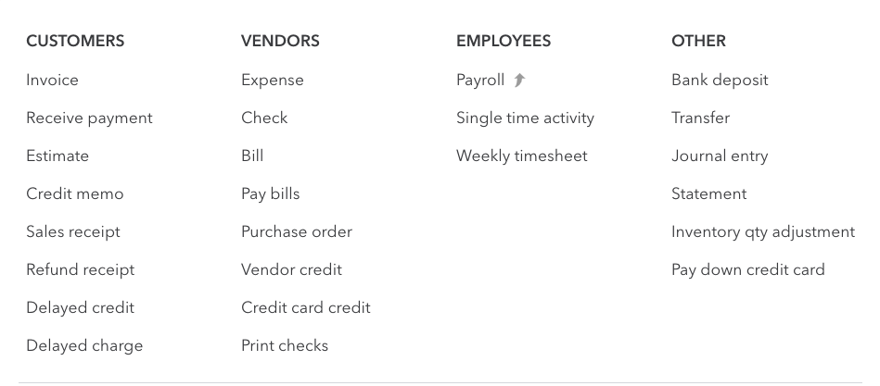
+ New Menu
Most convenient access to forms used for entering transactions is through the + New link on the navigation bar.
The + New menu is also referred to as the Create menu.

Slide 24
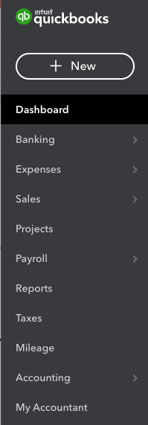
Navigation Bar
The navigation bar is on the left side of the QBO home screen.
By clicking the appropriate link, you can:
add, edit, or create accounting transactions.
add, edit, or create customer, vendor, or employee records.
Access reports

Slide 25
The Icon Bar
The icon bar is in the top right corner of the QBO Dashboard.
There are five icons on the icon bar.
Help
Bell
Gear
Magnifying Glass

Slide 26
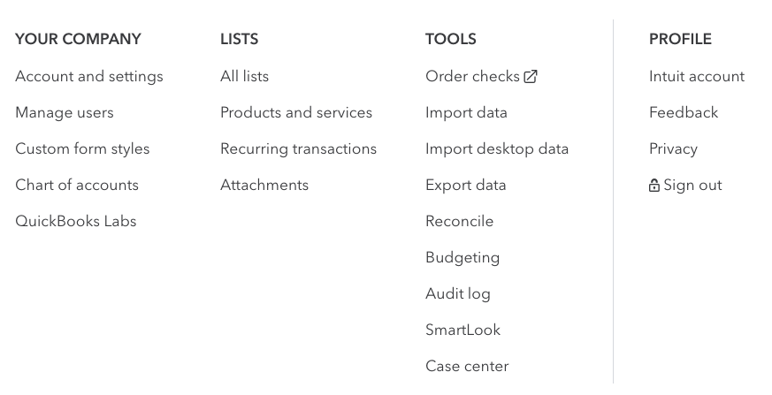
Gear Icon
Lists and settings are accessible by clicking the gear icon on the icon bar.

Slide 27
Other Icons
If you need information about a transaction or need to change a transaction, you can search for it using the magnifying glass icon.
Can search using multiple filters.
Notifications from Intuit about new features, etc. are displayed when you click the bell icon
If you’re not sure how to do something in QBO, you can click the Help icon and type in your question.
You’ll have access to online help from Intuit and other QBO users.

Slide 28
QBO Reports

Slide 29
Examples of QBO Reports
Standard statements
Balance Sheet
Profit and loss
Cash flow statement
Agings (receivable and payable)
Inventory reports
Inventory valuation reports
Inventory status reports
Transaction reports
By name
By account
By date
Payroll tax reports

Slide 30
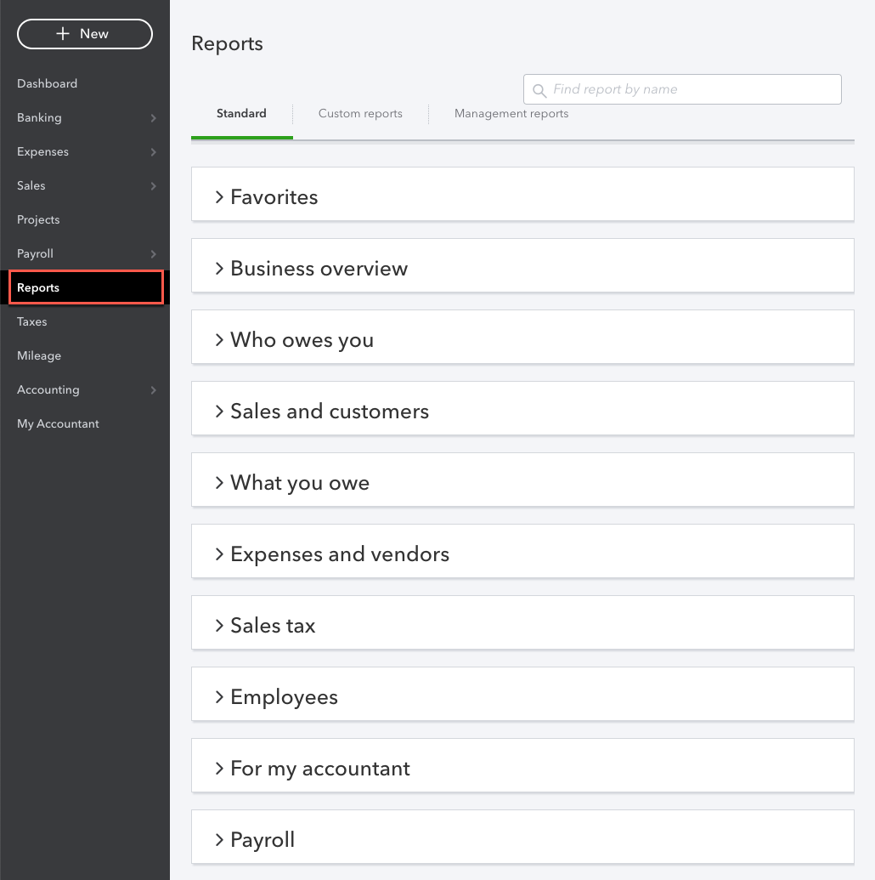
Accessing Reports
To access reports, click Reports on the navigation bar.
Reports are grouped by category.

Slide 31
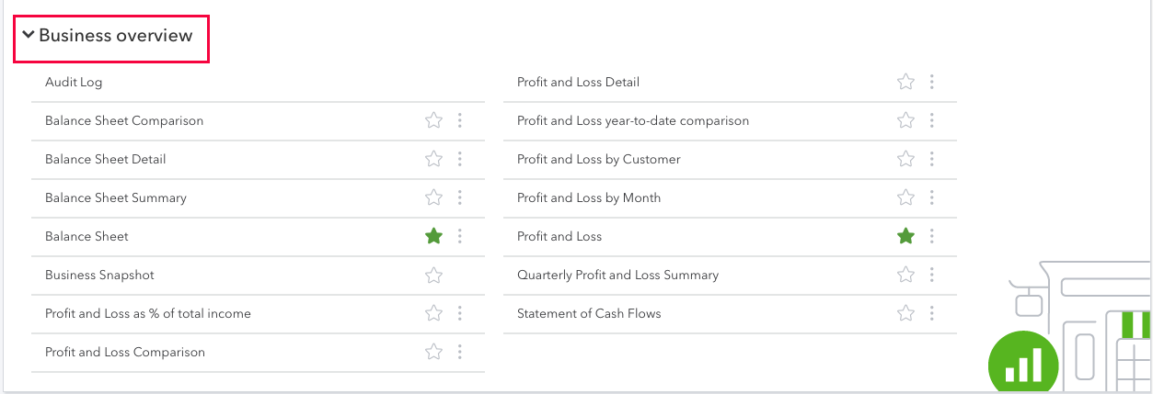
Accessing Reports
For example, here are the reports included in the Business Overview section.
Clicking the star next to a report in any of the report groups adds that report to the Favorites group.

Slide 32
Functionality in Reports
Within a report, users can drill down to the next level of detail by clicking the amount.
By clicking customize in the top right corner of QBO reports, users can:
Modify level of detail in reports
Limit transactions included in reports
Change how reports are displayed
Customized reports can be saved.

