Slide 2
End-of-Period Activity (Service Company)
5

Slide 3
Reconciling Bank and Credit Card Accounts

Slide 4
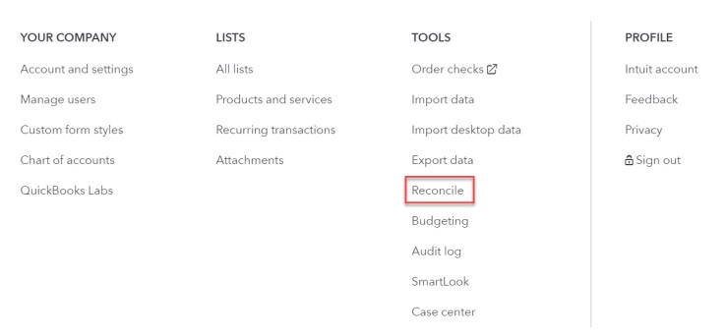
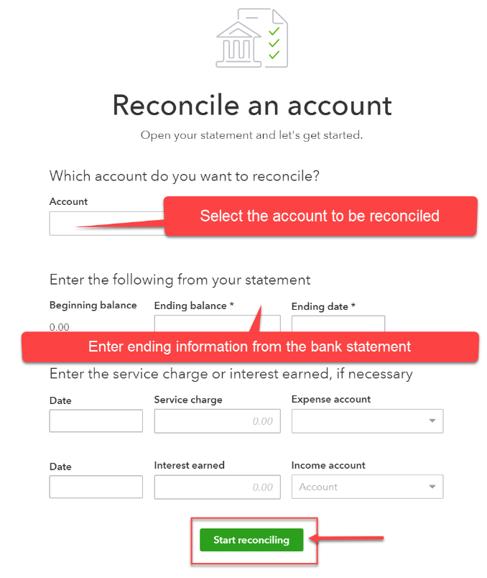
Reconciliation Feature
The reconciliation tool can be accessed by clicking the on the icon bar and selecting Reconcile.
After a few introduction screens, the account to be reconciled is selected and the ending balance and date of the bank statement is entered.

Slide 5
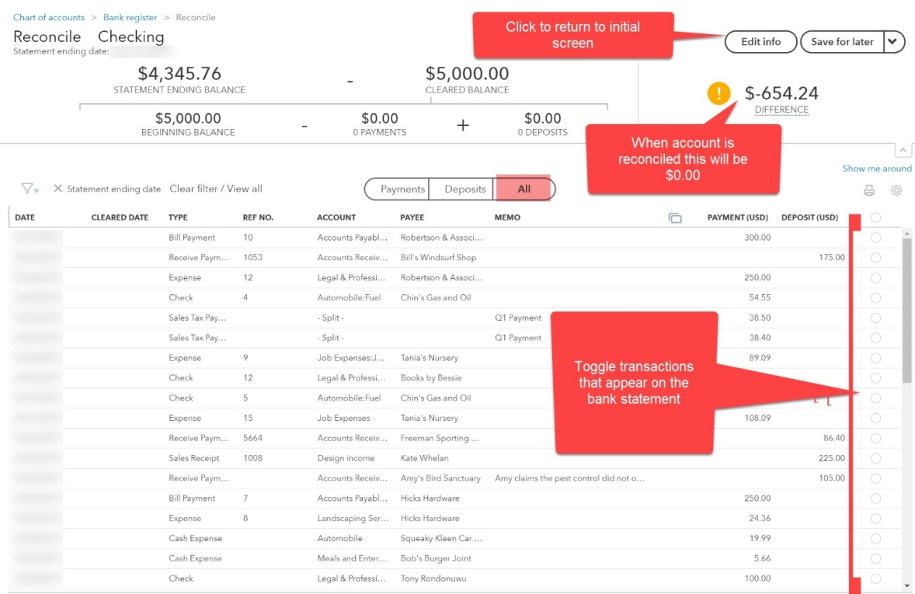
Bank Reconciliations
All unreconciled cash transactions appear on the next screen.
Listed transactions appearing on the current bank statement should be toggled.
These transactions have”cleared” the bank.
When the account is reconciled, the “difference” amount shows as 0.00

Slide 6
Bank Reconciliations
Transactions can be added, edited, or deleted while the reconciliation is in process.
The screen will automatically be updated.
Click Save for later (top right corner dropdown menu) to close the screen without completing the reconciliation.
Cleared transactions, ending balances, etc. will be saved.
When the account is reconciled, select Finish now in the top right dropdown menu to complete the process.

Slide 7
Bank Reconciliation Warning
It’s best not to click Finish now unless the difference is $0.00. If you do, QBO will given you a warning. If you choose to continue, a journal entry for the unreconciled difference will be automatically created.
The entry will debit or credit the account being reconciled with the difference. The offset account is called reconciliation discrepancy. That account would then have to be corrected later.

Slide 8
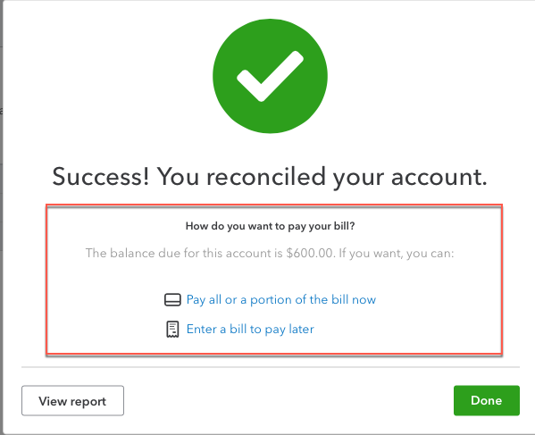
Credit Card Reconciliation
Reconciling a credit card in QBO follows the same process just described for reconciling a bank account.
The credit card statement balance is entered along with any finance charges.
Charges and payments appearing on the statement are cleared on the Reconcile screen.
When the account is reconciled, the user indicates in the final dialog box whether the statement balance should be
Paid now (full or partial payment)
Recorded as a bill for payment later
NOTE: Credit card balances cannot be paid using the Pay Bills feature unless a bill has been created for the liability.

Slide 9
Making Adjusting Journal Entries

Slide 10
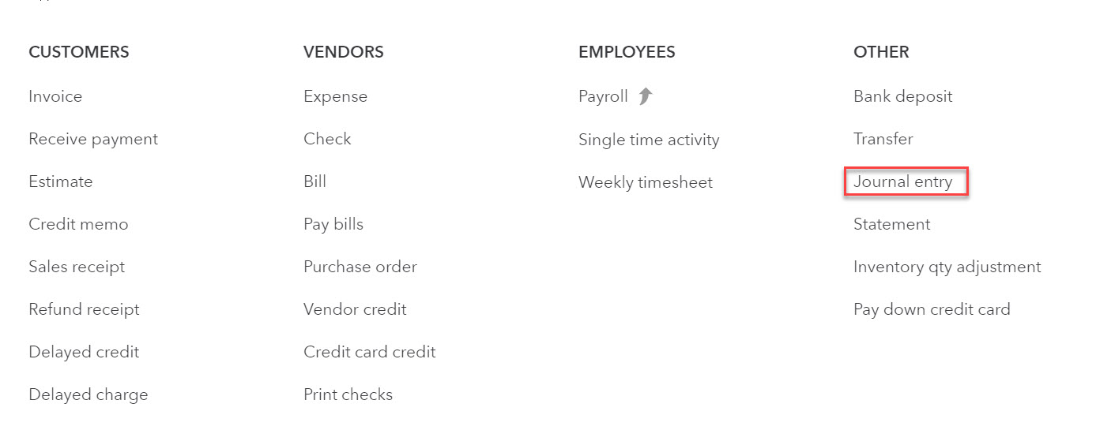
General Journal Entries
The transaction type for general journal entries is journal entry.
The form is accessed by clicking on the navigation bar and selecting Journal Entry.

Slide 11
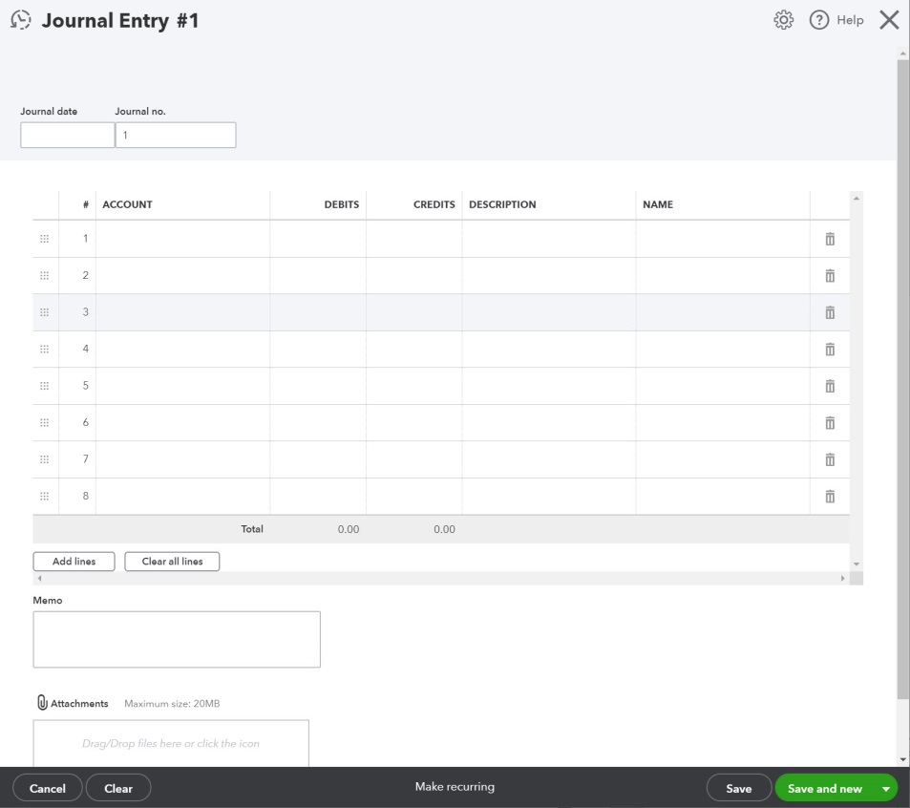
Journal Entry Form
The journal form looks similar to a manual general journal.
HINT: It can be very helpful to enter a brief summary of the purpose for the entry in the DESCRIPTION field.

Slide 12
Does This Look Right? Reviewing the Financials

Slide 13
Last Review
The accountant is responsible for the accuracy of the financial statements.
The accountant should be able to provide documentation or explanation supporting balance sheet account balances. Documentation might include:
Bank reconciliations
A/R and A/P agings
Loan documents
Supporting worksheets
Income (profit & loss) statement accounts should appear reasonable overall. The accountant should be able to provide explanations for any unusual balances.

Slide 14
Last Review
The accountant should review not only the accounts that do appear on the financials but also consider accounts that don’t, but likely should appear.
If there are fixed assets, there most likely should be depreciation expense and accumulated depreciation.
If there is debt, there most likely should be interest expense and possibly interest payable.
If certain expenses were paid at the end of the accounting period for the next accounting period, there should be prepaid expense balances.
If customers paid in advance for services not yet performed, there should be unearned revenue accounts.
Prepaid accounts (assets) should not include expenses related to the current period. Unearned revenue (liability accounts) should not include income earned during the current period.

Slide 15
Tips
Tip #1
When you’re reviewing balance sheets and looking for errors, it helps to modify the balance sheet report dates to display beginning and ending dates.
The report numbers will still represent the balance at the end of the period, but you’ll see all transactions within the period when you double-click the account balance.
Tip #2
Start by looking for errors in accounts other than Cash, A/R, and A/P.
Errors are harder to find in accounts with large numbers of transactions. If you can find and correct the error in the offset account, Cash, A/R, or A/P will be fixed as well.

Slide 16
Financial Statement Presentation

Slide 17
Presentation
Financial statements should be presented in a way that draws the reader’s attention to the most significant accounts.
In general,
Assets should be listed in order of liquidity.
Liabilities should be listed in order of maturity (due date).
Revenues should be listed in order of magnitude (high to low).
Cost of goods sold should be listed in the same order as revenue (where applicable).
Expenses should be listed in order of magnitude (high to low).
Categories first; expenses within categories next.
Some companies list depreciation (a non cash expense) and miscellaneous (containing multiple insignificant expenses) at the bottom.
In QBO, order of accounts can only be changed by changing the account numbers, if used.

Slide 18
Closing an Accounting Period

Slide 19
Closing Accounts at Year-End
All revenue and expense account balances are automatically transferred to equity by QBO based on the fiscal year end identified by the user in Account and Settings.
In a sole proprietorship, revenue and expense accounts are closed to Owner’s Equity; in a corporation or partnership, the accounts are closed to Retained Earnings.
Users must create journal entries to close:
Owner’s contributions or distributions to Owner’s Equity in a sole proprietorship.
Dividends to Retained Earnings in a corporation.

Slide 20
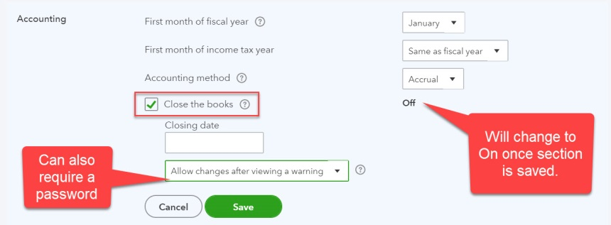
Closing the Books— End of an Accounting Period Other than Year End
Users can elect to “close” any accounting period to further transactions by entering a closing date in the Advanced tab of Account and Settings.
The Close the books setting must be turned on and a Closing date entered.
The user can elect to require a password before entries can be made to the closed period or can elect to simply have a warning message displayed before the entry is saved.

