Slide 2
Additional Tools
11

Slide 3
Saving Customized Reports

Slide 4
Saved Reports
There are many reports automatically set up in QBO that can be used as-is.
However, users might need to modify some of the QBO reports to fit their particular needs.
Columns might be added or removed.
Reports might be filtered.
If modified reports are frequently accessed, users have the ability to save the customized report for future use.

Slide 5
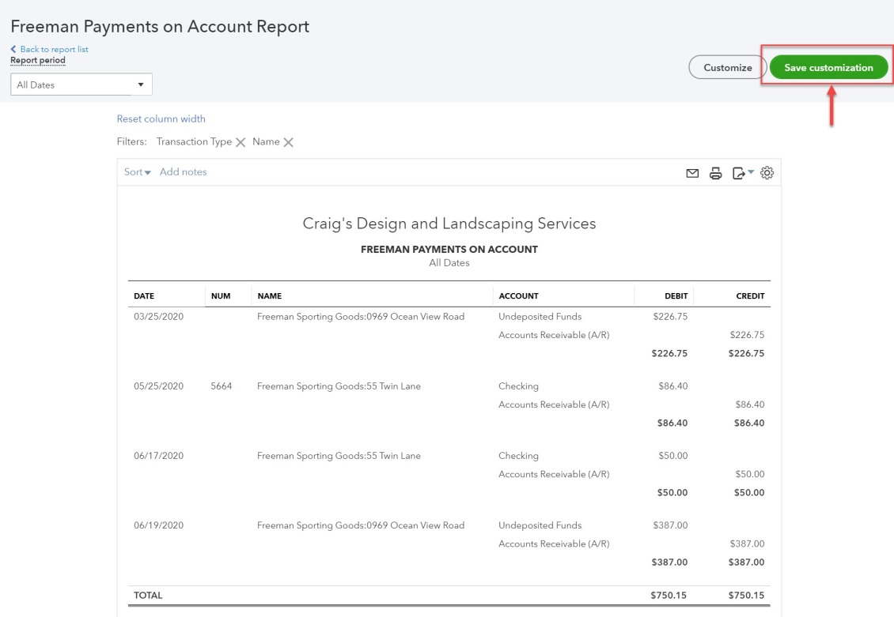
Saving Customized Reports
Start by customizing the report you want to save.
Click Save Customization.

Slide 6
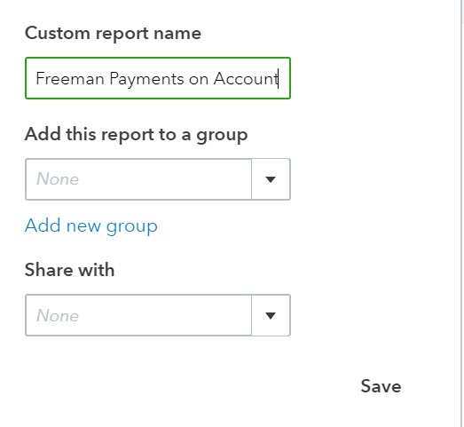
Saving Customized Reports
Give the report a name.
If appropriate, save the report in a saved report group.
Users can set up multiple report groups.
Indicate whether the report will be accessible to other users.
All or None are the options on the Share with dropdown menu.

Slide 7
Saving Customized Reports
To access saved reports, click Reports on the navigation bar and select the Custom Reports tab.
All filters and changes to information included on the report will be saved.
When a saved report is opened, the dates may need to be changed if more current data is needed.

Slide 8
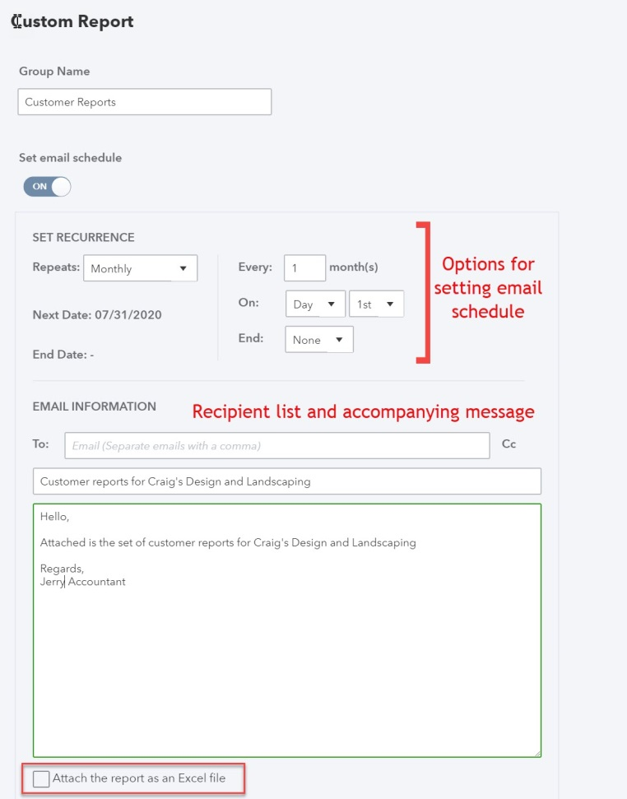
Scheduled Delivery of Saved Reports
Users can schedule emails of saved reports (or groups of saved reports) to interested parties by clicking Edit in the ACTION column in Custom Reports.
Turn Set email schedule to On.
Set the email schedule (in Set Recurrence section).
Add an email message (in Email Information section).

Slide 9
Creating Management Reports

Slide 10
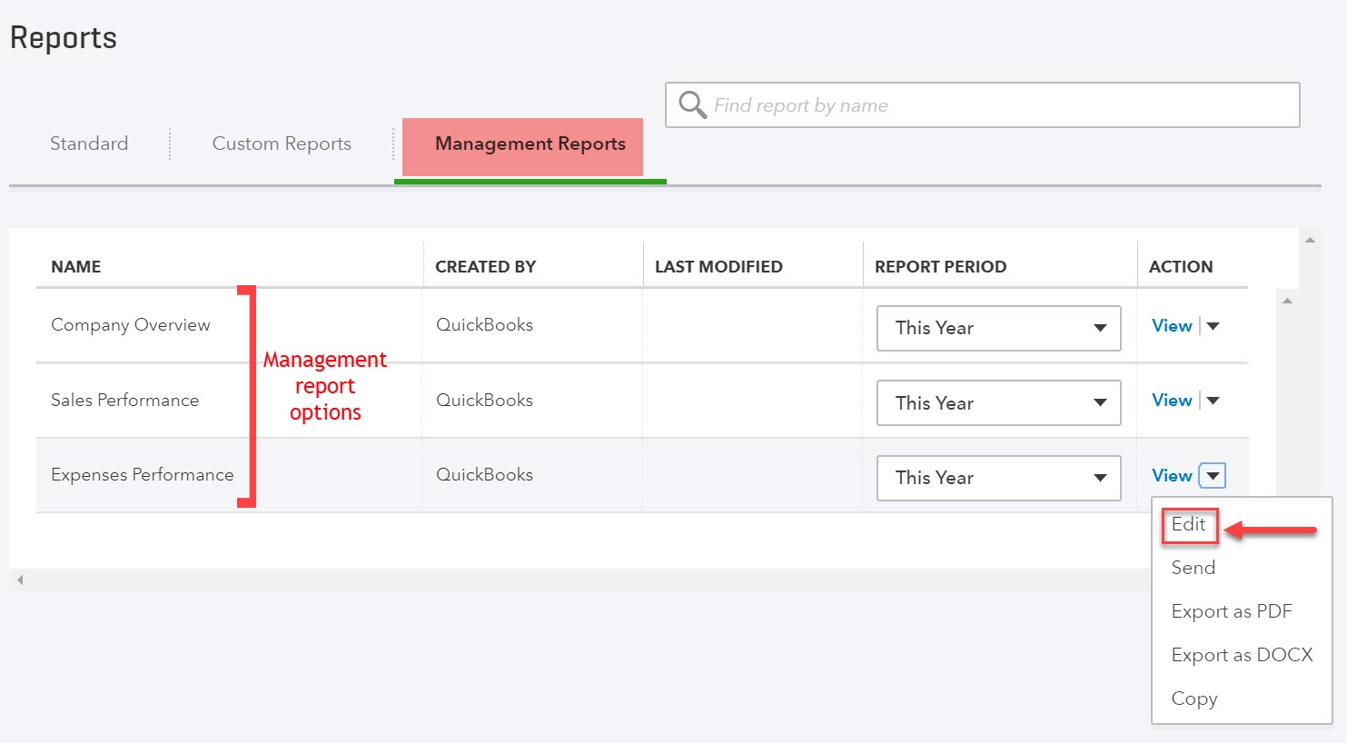
Management Reports
Templates for several formal report packages are available in QBO.
The templates can be accessed on the Management Reports tab of Reports.

Slide 11
Types of Available Management Reports
The default reports included in the package templates are:
Company Overview—Profit and Loss, Balance Sheet
Sales Performance—Profit & Loss, A/R Aging Detail, Sales by Customer Summary
Expenses Performance—Profit & Loss, A/P Aging Detail, Expenses by Vendor Summary
Reports can be added to or deleted from the packages.

Slide 12
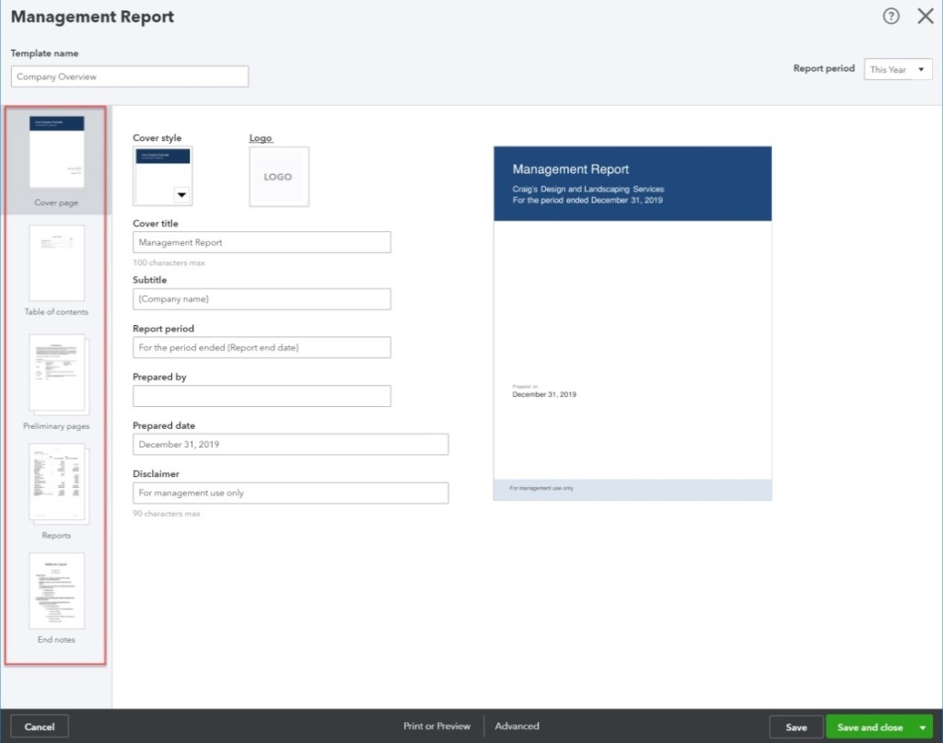
Creating Management Reports
Select Edit (or Copy if a similar report is needed) in the ACTION column dropdown menu for the type of report to be created (Company Overview, Expenses Performance, Sales Performance)
Click the tabs (left side) to customize the report

Slide 13
Creating Management Reports
There are five sections to the report:
Cover page
Several different styles are available.
Logos can be added.
Table of Contents
Section is optional.
Preliminary Pages
Narrative added by user.
Section is optional.
Reports
Default reports can be deleted.
Additional QBO reports can be added.
End Notes
Narrative added by user.
Section is optional.

Slide 14
Creating Custom Fields

Slide 15
Custom Fields
Custom fields can be created in QBO for companies who need to track information not already available in QBO. Common fields that might be added would include:
Sales Rep
Project Manager
Buyer
Up to three custom fields can be added to QBO
For sales transactions
For purchase orders

Slide 16
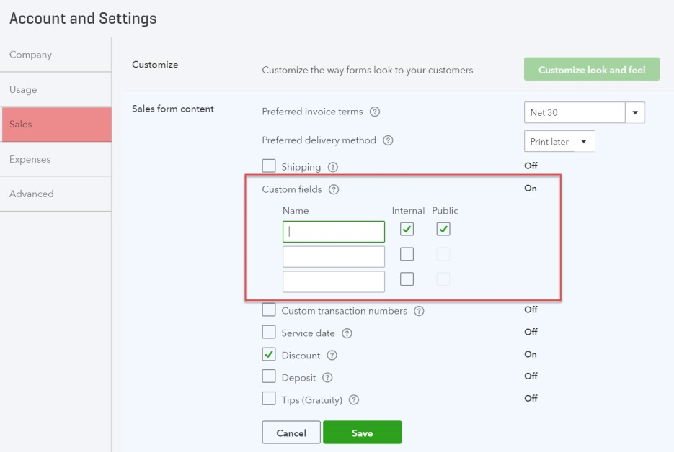
Creating Custom Fields
Custom fields are added in Account and Settings (accessed by clicking on the icon bar).
Custom fields for use in sales transactions are added on the Sales tab.
Custom fields can be limited to internal use (only displayed on transaction form) or can be set up to also appear on sales forms.
Custom fields for use in purchase order transactions are added on the Expenses tab.
Custom fields on purchase orders are limited to internal use.

Slide 17
Customizing Forms

Slide 18
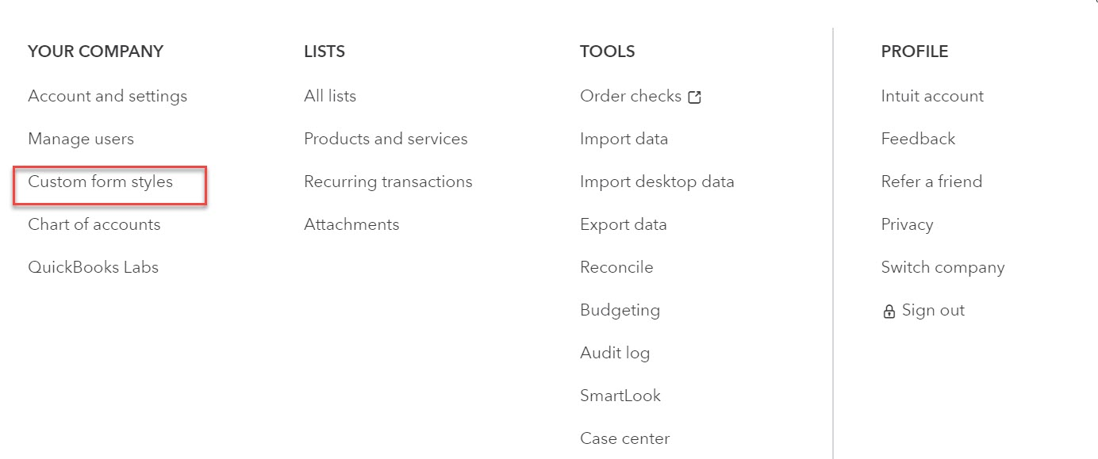
Creating Custom Forms
Users can customize invoice, estimate, and sales receipt forms in QBO.
Multiple customized forms can be created.
Custom forms are created by clicking the on the icon bar and selecting Custom Form Styles.

Slide 19
Creating Custom Forms
Select the form to be customized in the New style dropdown menu.
Currently, only invoices, estimates, and sales receipts can be customized.

Slide 20
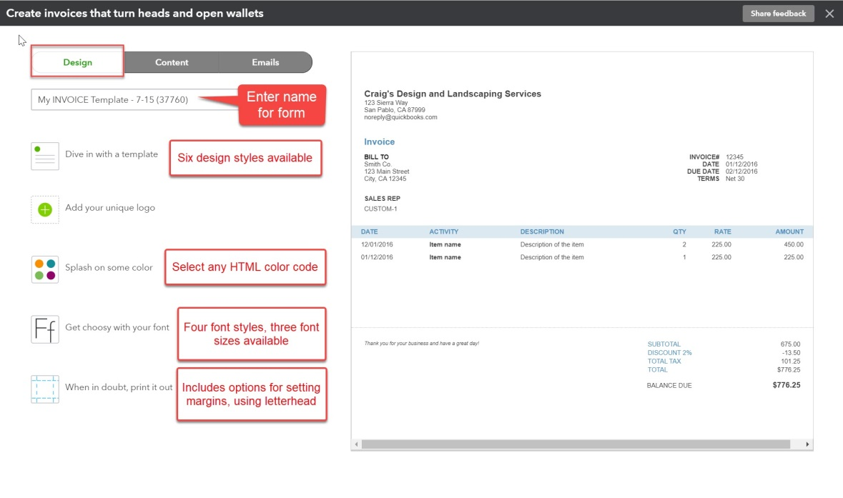
Design Tab
There are five tabs in the form customization window. Actual customization is done on the Design and Content tabs.
On the Design tab:
Logo can be added.
Colors and Font can be changed.
Template style can be changed.

Slide 21
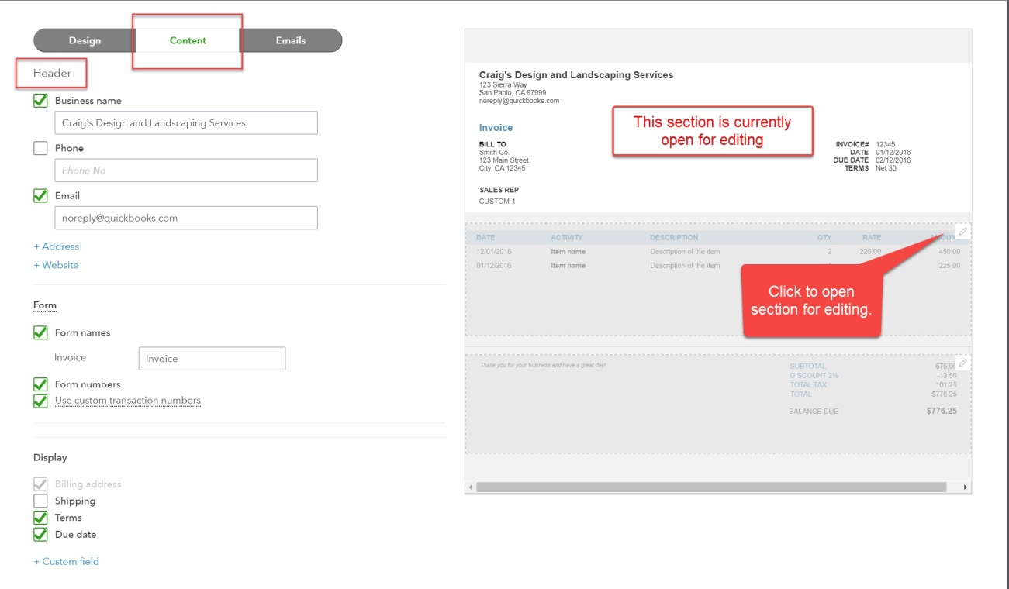
Content Tab
On the Content tab, changes can be made to Header, Table, or Footer sections
Fields can be added or deleted.
Field descriptions can be customized.

Slide 22
Exporting Reports to Excel®

Slide 23
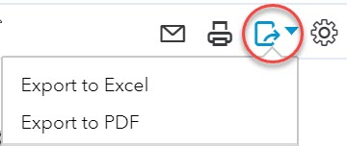
Exporting to Excel®
QBO reports can be exported to Excel for
Additional customization
Integration with internally produced company spreadsheets
Reports are exported by selecting Export to Excel in the export icon on the report menu bar.

Slide 24
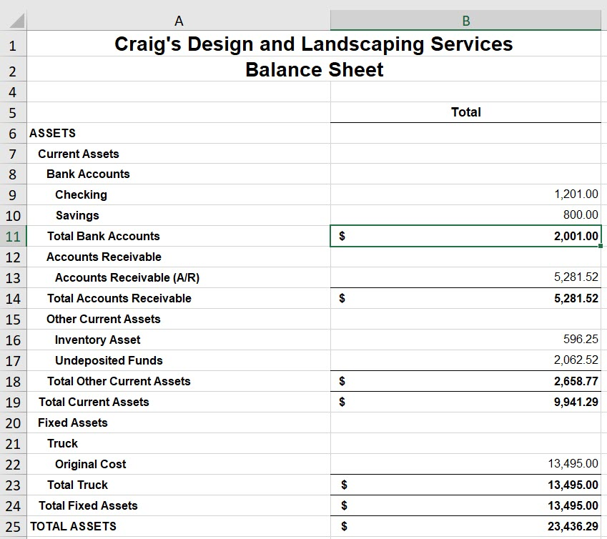
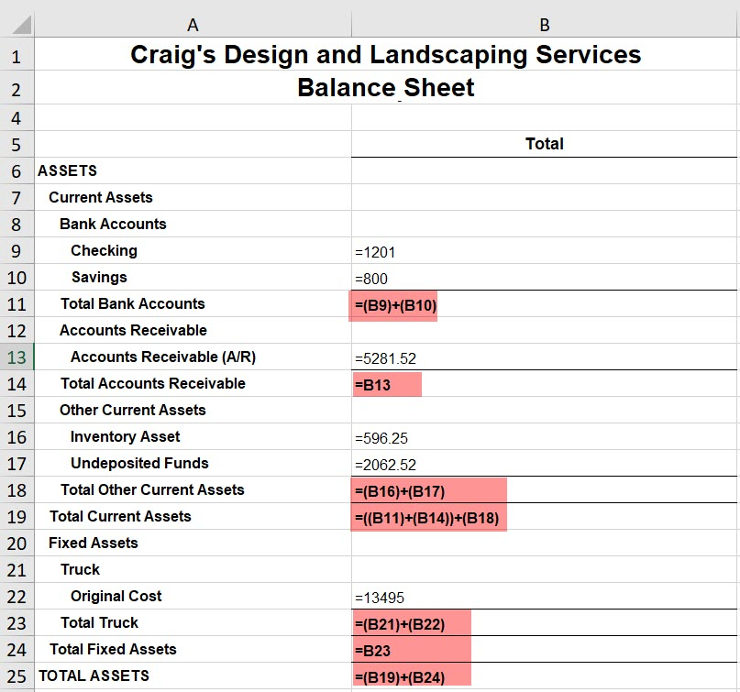
Exported Reports
Formulas are included in exported reports.

Slide 25
Managing Attachments

Slide 26
Attachments
Documents, spreadsheets, pictures, and PDF files can be uploaded to QBO.
Uploads are known as Attachments.
Attachments can be added to:
Customer, vendor, and employee records
Most transaction forms
Attachments can also be included in emails sent directly through QBO to customers, vendors, etc.

Slide 27
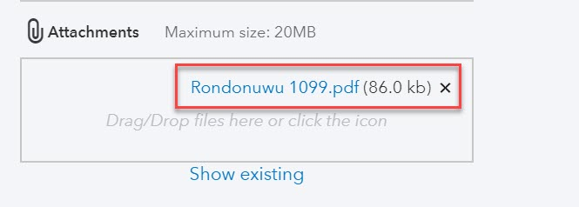
Uploading Attachments to Forms
To upload an attachment directly to a form or record:
Click the paperclip icon (bottom left section of the form) to open a search box and then click the item to be uploaded OR
Click and drag the item to be uploaded into the attachments box.

Slide 28
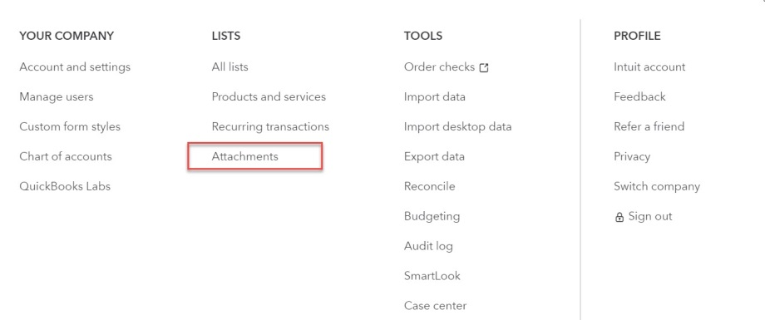
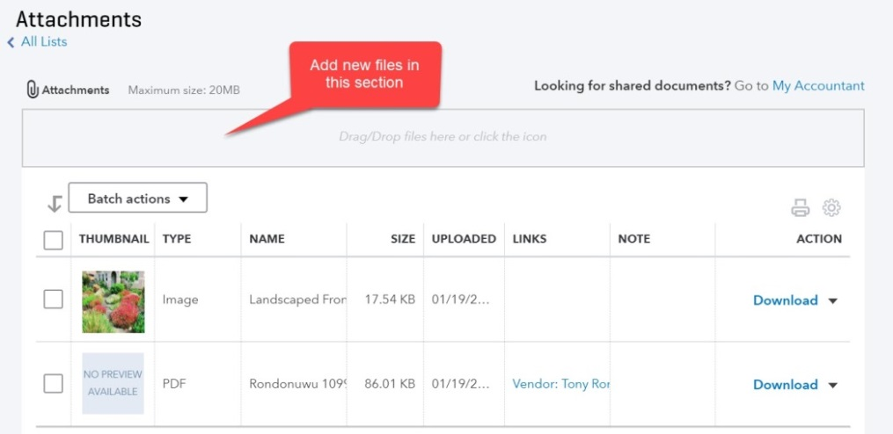
Uploading Attachments to Attachment List
Attachments can also be uploaded to the Attachment list.
Click the on the icon bar and select Attachments.
Click the paperclip icon and find the item to be uploaded OR click and drag the item to the attachment box.

Slide 29
Uploading Receipts

Slide 30
Uploading Receipts
Images or PDFs of credit card receipts or bills can be uploaded to QBO.
This is especially useful for employees traveling for business, vendors, or employees without access to QBO.
Receipts are uploaded on the Receipts tab in the Banking Center.

Slide 31
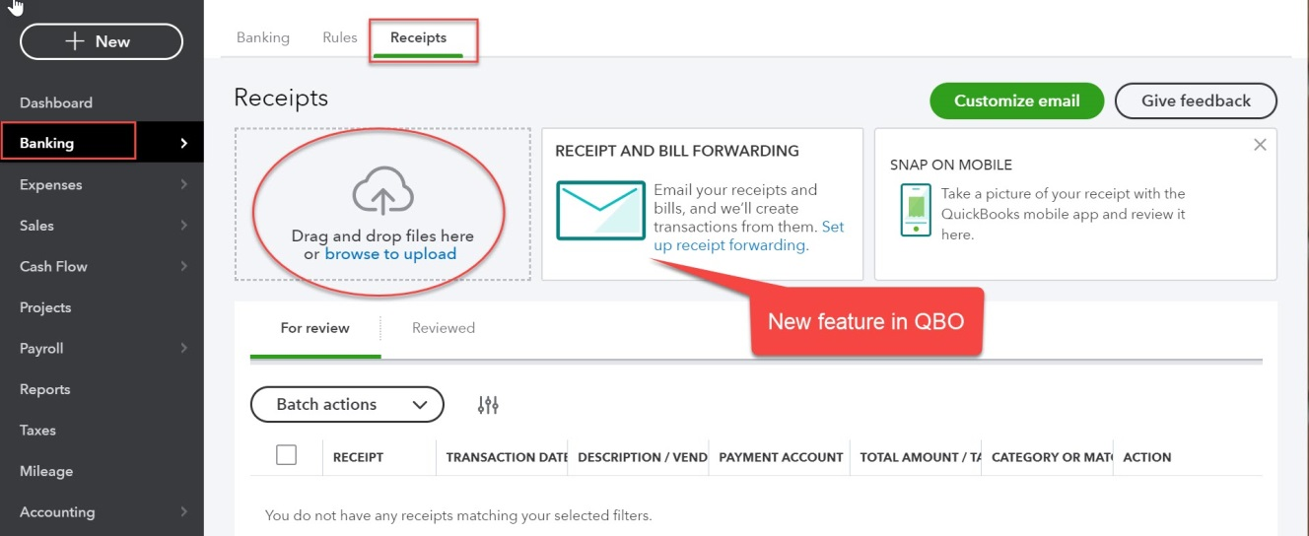
Uploading Receipts
The receipt screen has been updated since your textbook was printed. It now looks like this:
Receipts or images are uploaded in the Receipts box.
Receipt forwarding is a new feature. Companies create a special email address (ending in qbodocs.com).
Employees or vendors can then email images or PDFs directly to QBO.

Slide 32
Uploading Receipts
Once receipts or images are uploaded, the data will appear in the For review tab
The uploaded file can be viewed by clicking the image below the transaction row.

Slide 33
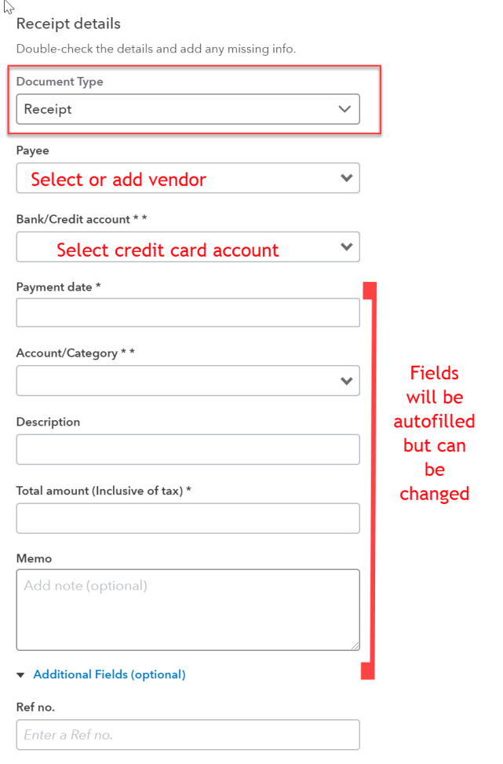
Uploading Receipts
Select Review in the ACTION column.
The Receipt Document Type would be used for credit card receipt images.
Credit card receipts would be uploaded to a Credit Card Liability account.
QBO will auto fill date, account, and amount fields. These can be changed if necessary.
NOTE: If the document is a vendor bill, Bill should be selected in the Document Type field. The transaction amount would then be credited to the accounts payable account.

