Slide 2
Purchasing Activity (Merchandising Company)
7

Slide 3
Purchase Cycle— Merchandising Companies

Slide 4
Purchase Cycle—Inventory
Order product
Receive product
Receive bill for product
Pay for product

Slide 5
Setting Reorder Points

Slide 6
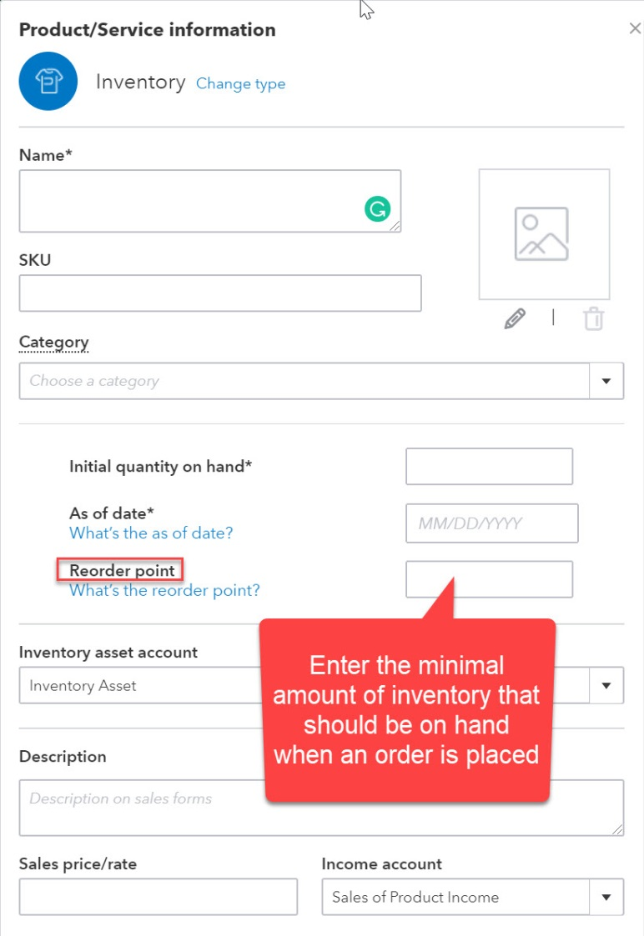
Reorder Points
Companies can set reorder points in QBO.
Reorder points represent the lowest acceptable level of inventory to have on hand.
Reorder points are entered on the inventory item record.

Slide 7
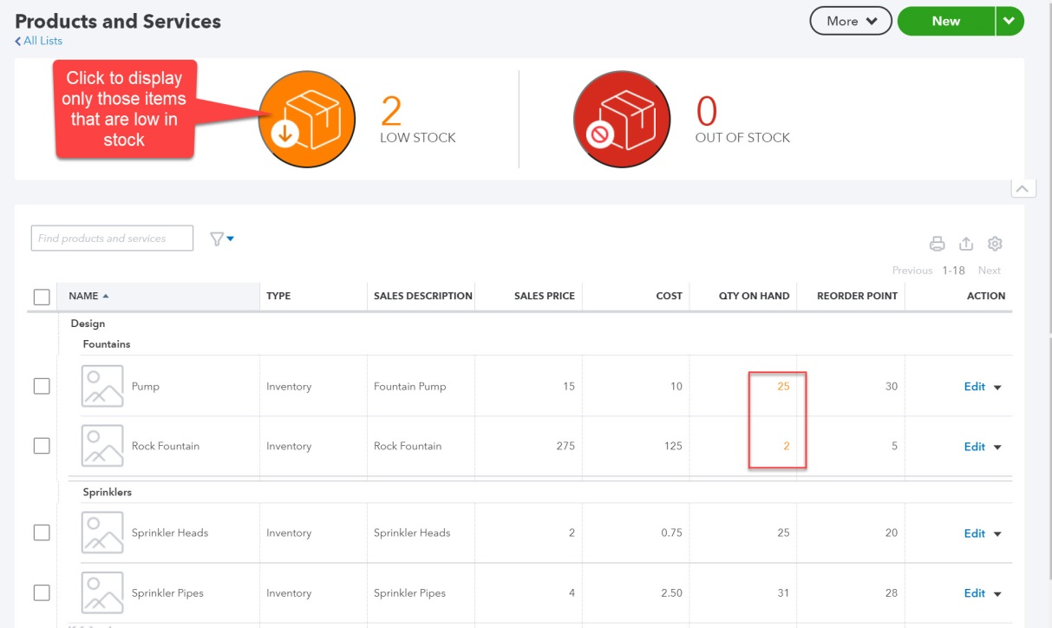
Reorder Points
Items with stock levels below the reorder point are highlighted in the Products and Services Center.
Screenshot was modified to better illustrate.
Clicking the LOW STOCK or OUT OF STOCK icon customizes the list to display only those items meeting that criterion.

Slide 8
Paying for Inventory at Time of Purchase

Slide 9
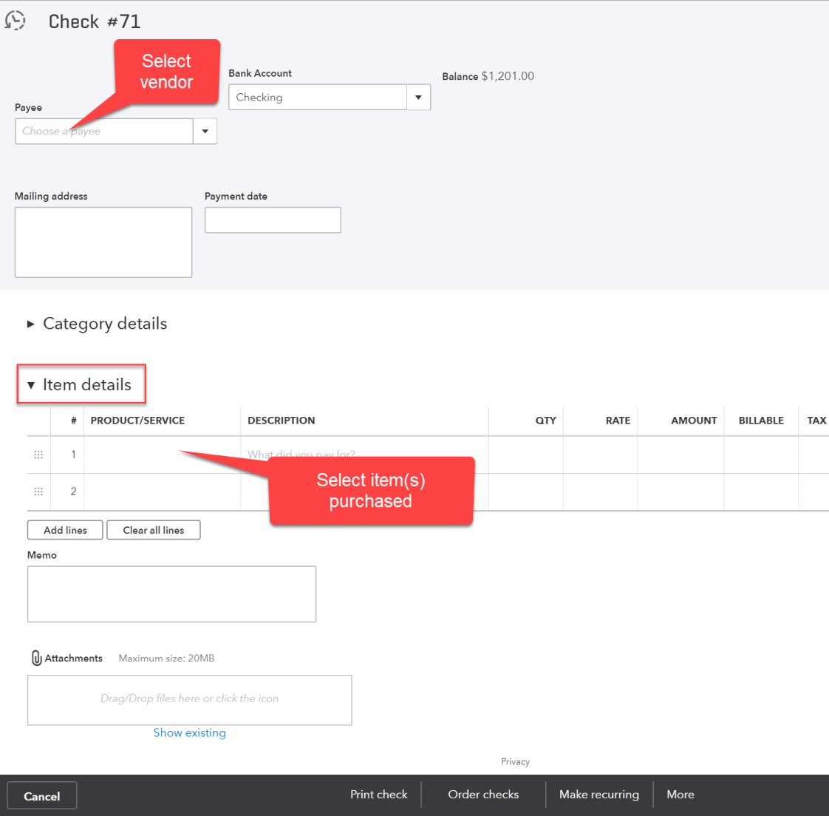
Paying at Time of Purchase
Inventory paid for at time of purchase would be recorded using either a
Check—Purchase was made with cash or check, OR
Expense—Purchase was made using a credit card.
Purchases of inventory are recorded in the Item details section of either form.

Slide 10
Ordering and Receiving Inventory Items

Slide 11
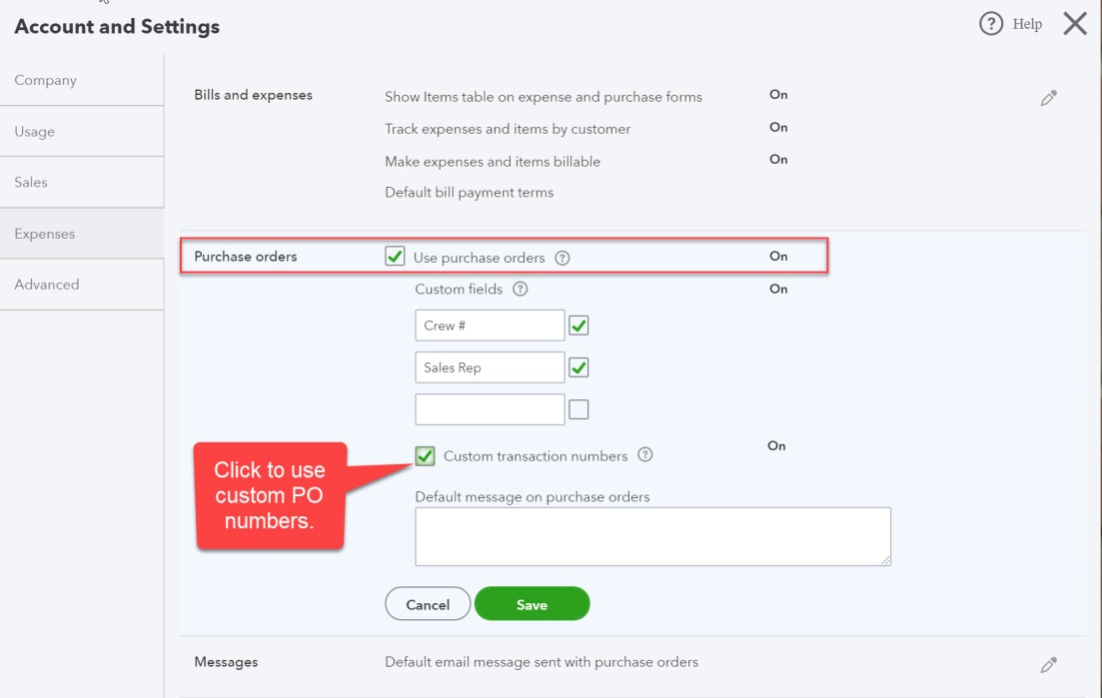
Purchase Orders
Purchase orders can be tracked in QBO.
Allows company to manage inventory more effectively
The purchase order feature is activated on the Expenses tab of Account and Settings.

Slide 12
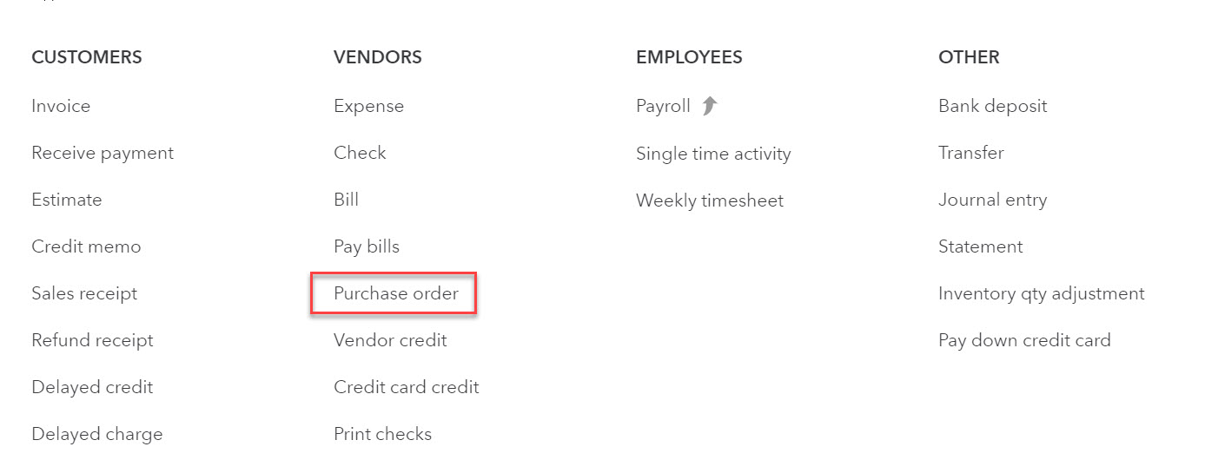
Creating Purchase Orders
The purchase order form is accessed by clicking 1 on the navigation bar and selecting Purchase Order.

Slide 13
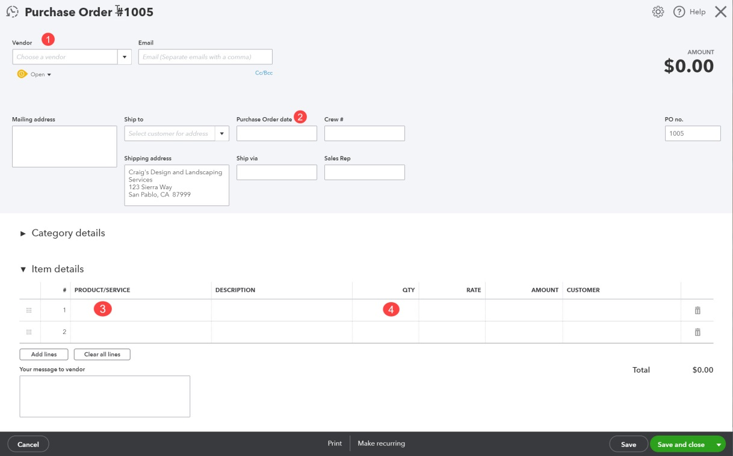
Creating a Purchase Order
Vendor name, date, and items ordered (including quantity) are included on the form.
QBO will automatically display the cost included in the item record in the RATE column.
The RATE can be changed on the purchase order form and/or on the final bill form.
Purchase orders are non-posting transactions. No journal entries are created.

Slide 14
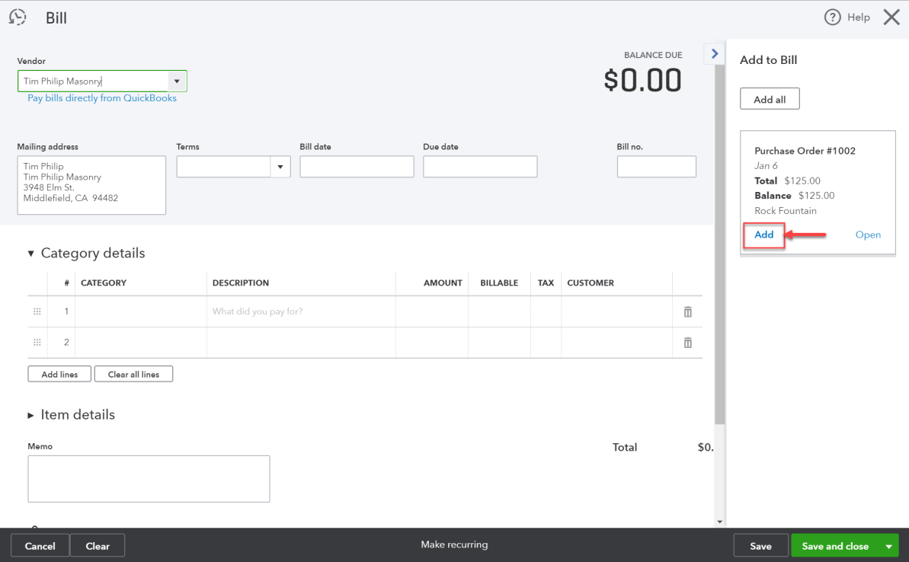
Receiving Products Previously Ordered from Vendors
When items previously ordered are received, a bill form should be opened for the appropriate vendor.
Open purchase orders will automatically be displayed in the sidebar. Quantities ordered and estimated costs are automatically added to the bill by clicking Add.
If a partial shipment is received, the quantity field should be adjusted.
The purchase order will remain open.
Costs can also be changed if necessary.

Slide 15
Receiving Inventory Without a Bill
Vendors may send shipments with a packing slip but no vendor invoice.
A bill should still be created so that inventory stock levels are appropriately adjusted.
Any adjustments to the amount due (unit cost differences or shipping charges, for example) can be made to the bill when the vendor invoice is finally received.

Slide 16
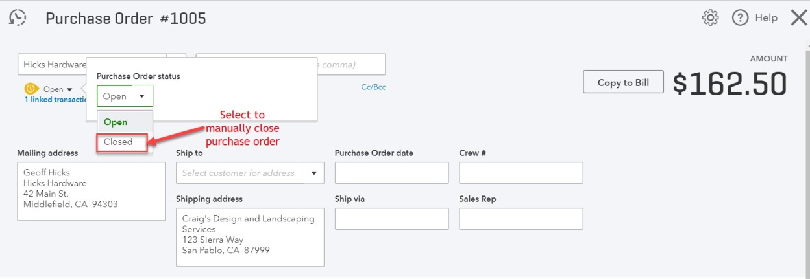
Closing Purchase Orders
Purchase orders can be manually closed in QBO by:
Opening the purchase order.
Clicking the dropdown menu just below the vendor name.
Selecting Closed.

Slide 17
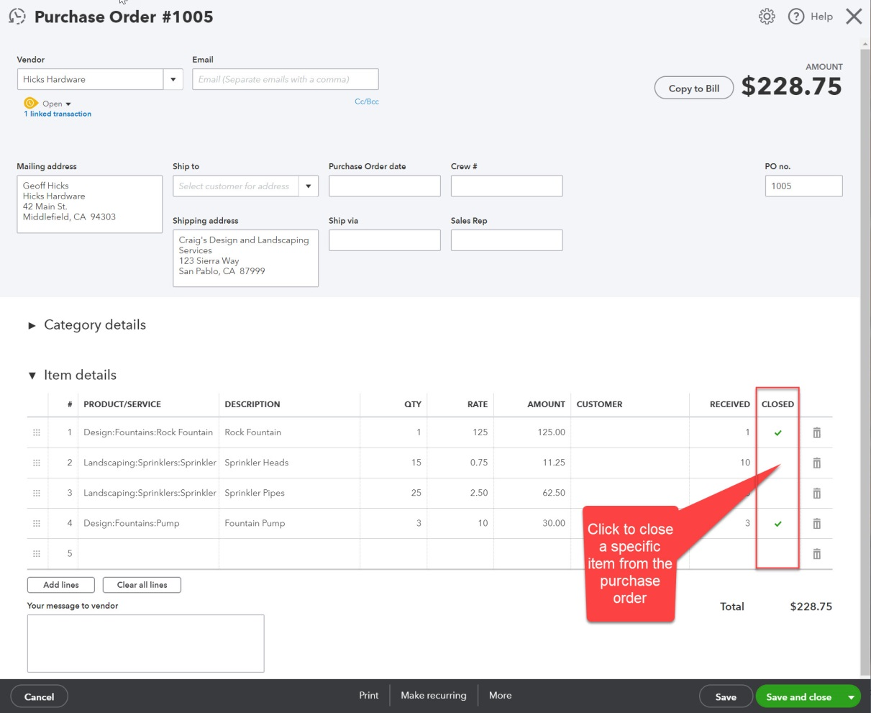
Closing Purchase Orders
If only specific items should be closed, users can check the CLOSED field for the appropriate row.

Slide 18
SIDE NOTE: Searching for Open Purchase Orders
To find an open purchase order:
Use the Advanced Search feature and select Purchase Orders in the first Search field.
The Advanced Search feature is accessed by clicking the on the icon bar.
OR open the Open Purchase Order List report.
The report is in the Expenses and vendors section on the Standard tab of Reports.
OR open a purchase order form and click the icon in the upper left corner. A list of most recent purchase orders will be displayed.

Slide 19
Recording Vendor Credits

Slide 20
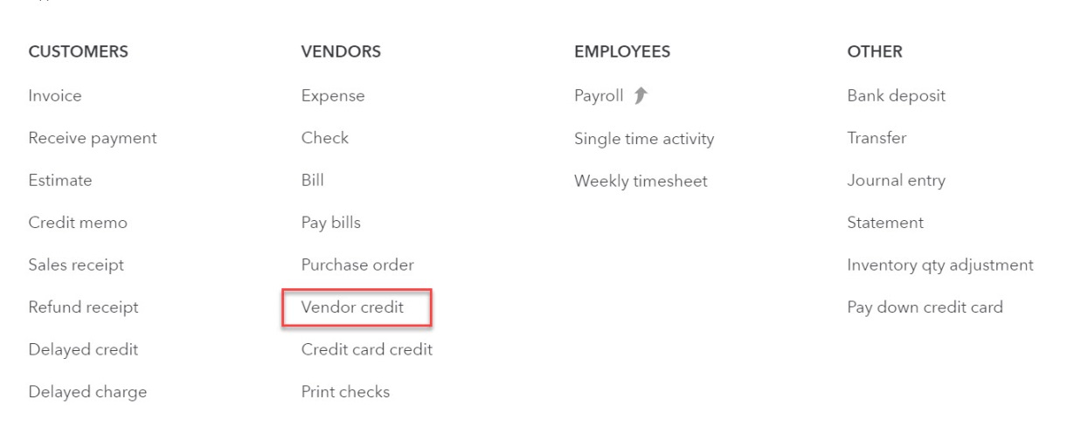
Recording Vendor Credit Memos
Credit memos from vendors (Vendor Credit transaction type) are recorded by clicking on the navigation bar and selecting Vendor Credit.

Slide 21
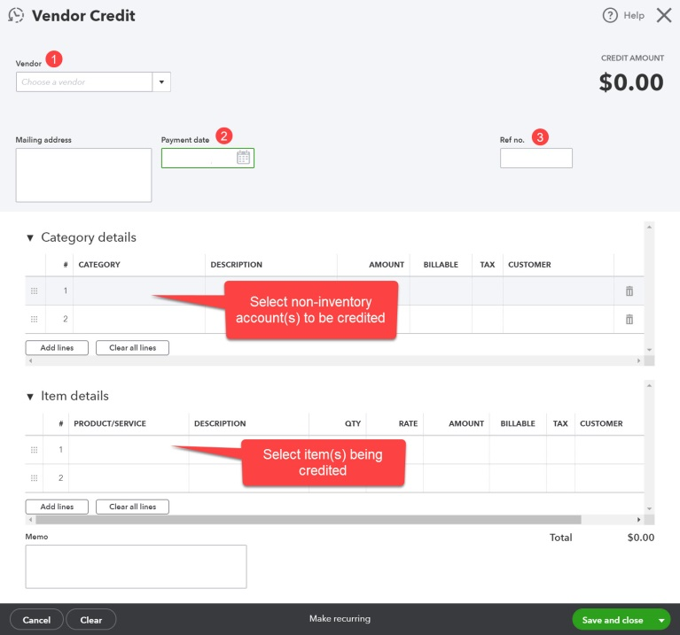
Recording Vendor Credit Memos
The vendor name, date, and general ledger accounts or product/service items affected are selected.
The vendor credit is tracked in the vendor record.

Slide 22
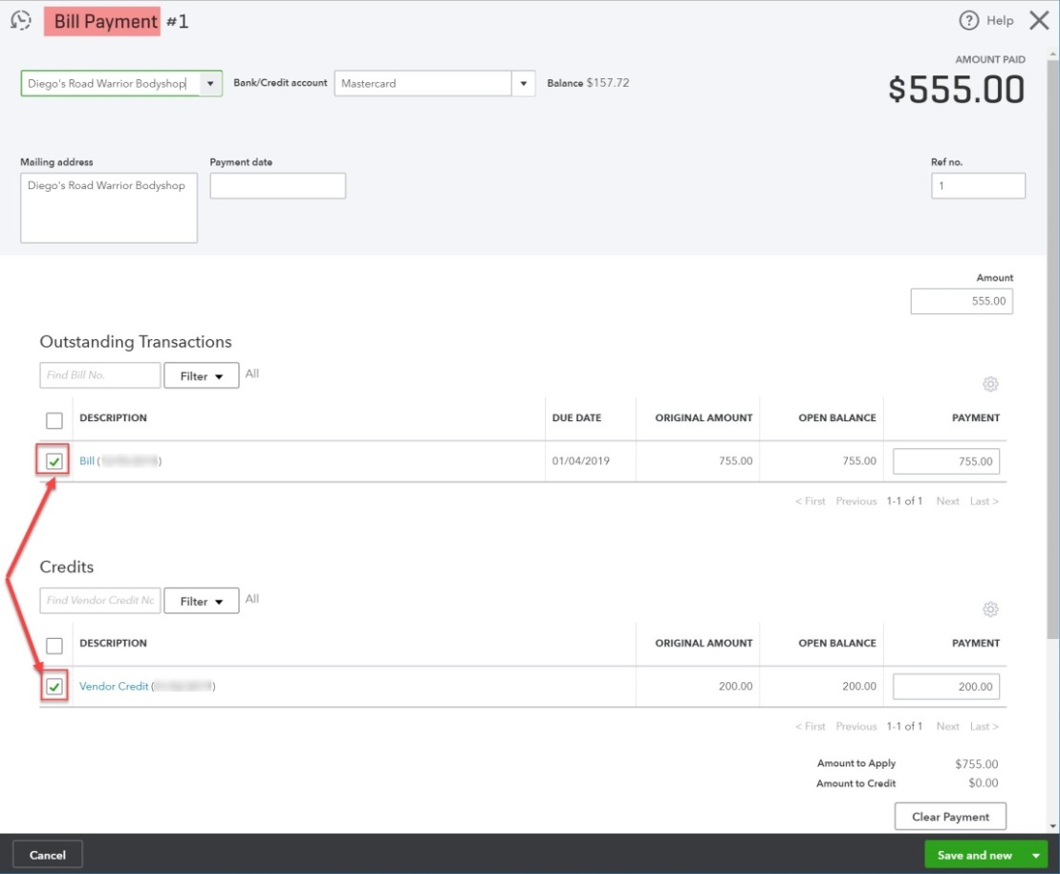
Applying Vendor Credit Memos
QBO will automatically display and select any available credits when a bill payment transaction is created.
Users can uncheck the credit if they wish to retain the credit for use on a different bill.
If the credit is not applied properly, uncheck all boxes and clear the Amount field.
Check the Bill box first. The PAYMENT field should display the OPEN BALANCE.
Check the Vendor Credit box.
The Amount field should autofill with the correct amount.

Slide 23
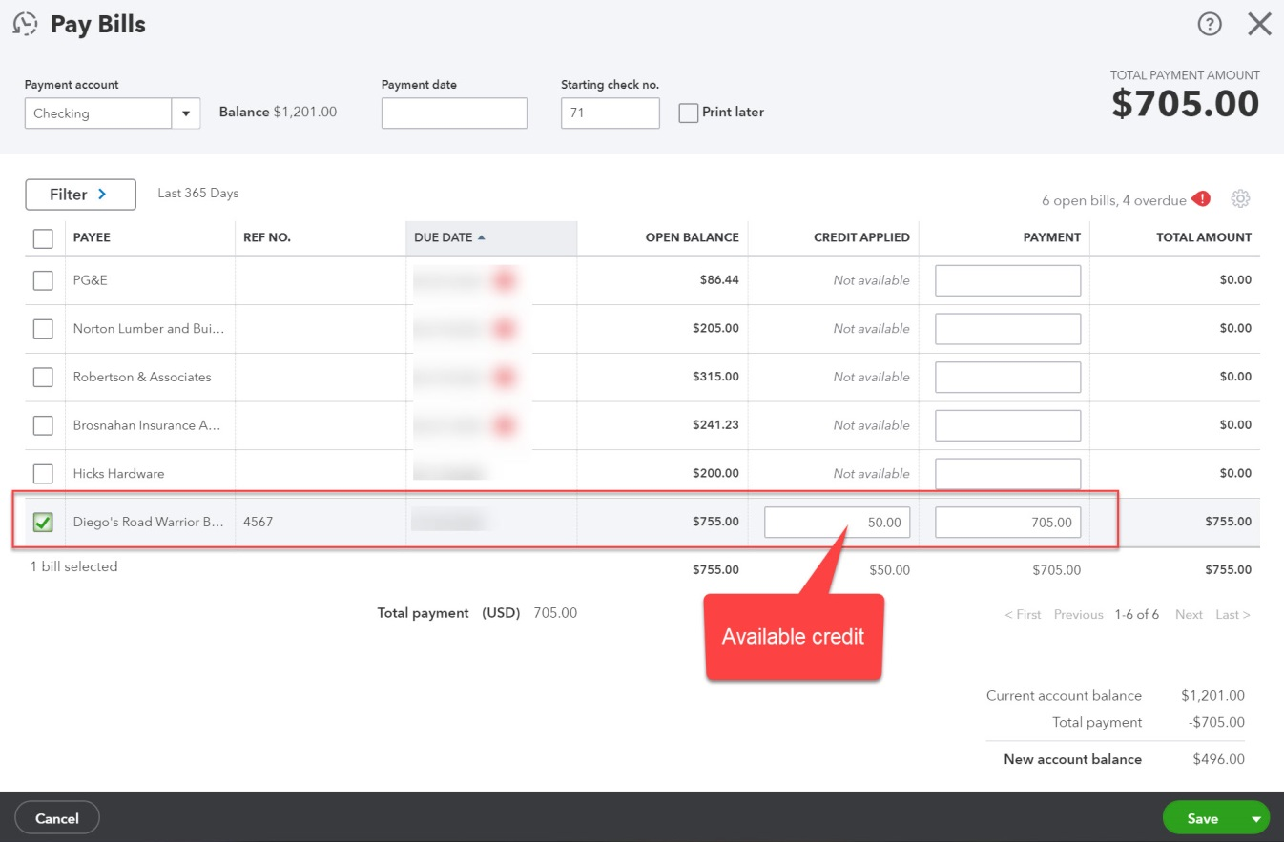
Applying Vendor Credit Memos
Vendor credit amounts are also available when payment is made through the Pay Bills screen.
The credit amount appears in the CREDIT APPLIED field when a specific bill is selected.

Slide 24
Recording Early Payment Discounts on Vendor Payments

Slide 25
Vendor Early Payment Discounts
Automatic processing of early payment discounts is not yet available in QBO.
2%/10, 1%/10 are examples of terms that include a discount for early payment.
As a work around:
A vendor credit in the amount of the discount to be taken can be created just before the payment is processed.
Account selected would normally be Purchase Discounts.
The credit is applied when the bill payment is recorded.

