Slide 2
Project Tracking and Billing for Time and Expenses
10

Slide 3
Project Costing

Slide 4
Tracking Information by Project
Intuit has been developing QBO’s project costing system over the last couple of years.
Companies that would likely use project costing include:
Construction companies
Professional services companies (law firms, accounting firms, architectural firms, etc.)
Custom manufacturers

Slide 5
Setting Up Projects

Slide 6
Activating Project Tracking
The first step is to activate project tracking.
Project tracking is activated on the Advanced tab in Account and Settings.
Once activated, a Projects link will appear on the navigation bar.

Slide 7
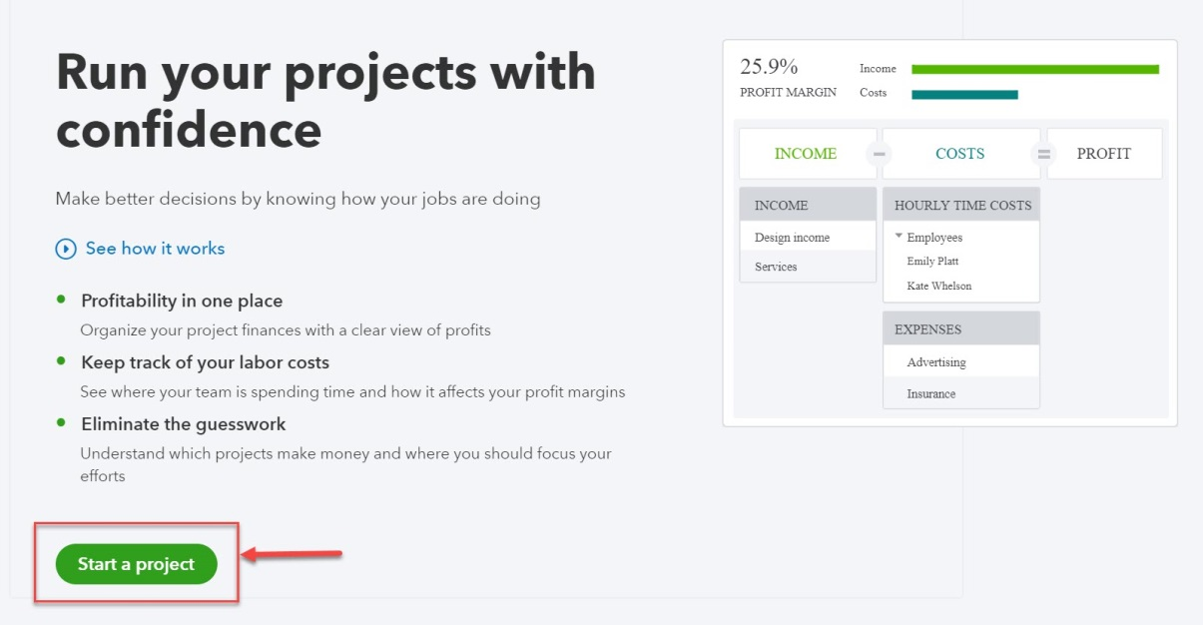
Setting Up Projects
Click Projects on the navigation bar to create your first project.
Click Start a project.
NOTE: Once the first project is created, clicking Projects on the navigation bar will open the Project Center. Click New to add additional projects.

Slide 8
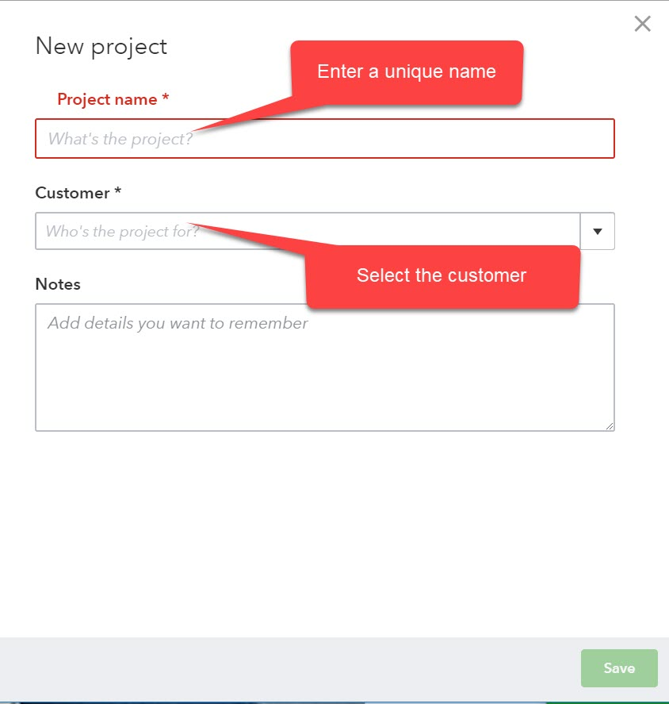
Setting Up Projects
Basic information about the project is entered in a sidebar.
Enter a unique name for the project and identify the associated customer.
Once created, projects can be accessed through the Project Center. record.

Slide 9
Project Center
Click Projects in the navigation bar to open the Project Center.
Click the project name to open the project record.

Slide 10
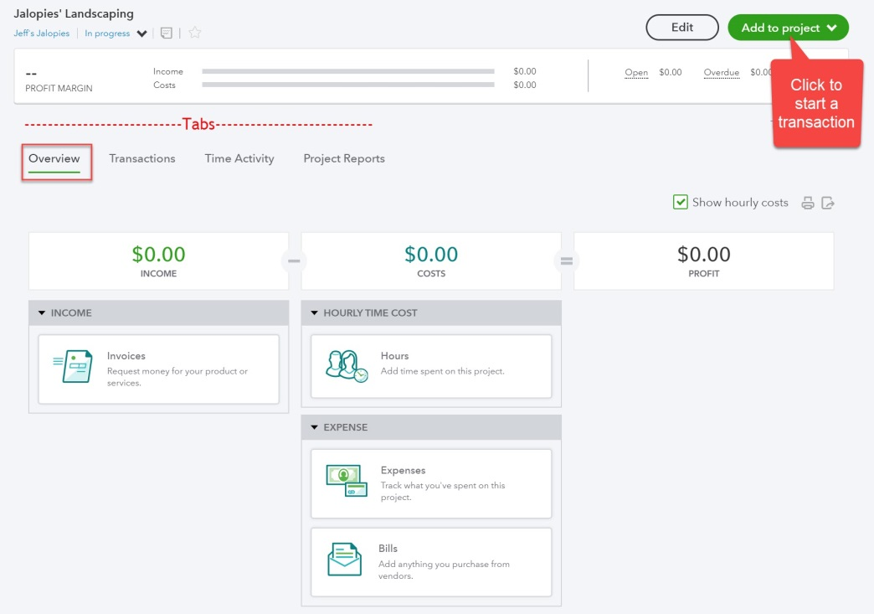
Project Record
All information about projects (revenues, hours, and outside costs are included in the project record.
Summary information is included on the Overview tab.
Specific transactions are listed on the Transactions tab.
Details about employee or subcontractor time (date, service provided, hours and billable hours) are included on the Time Activity tab.
The Project Reports tab includes a profitability report, a project labor report, and a report of unbilled time and costs.

Slide 11
Independent Contractors

Slide 12
Independent Contractors
Companies might use both employees and independent contractors to work on projects.
In QBO, independent contractor hours can be tracked on timesheets and billed to customers from timesheet data.

Slide 13
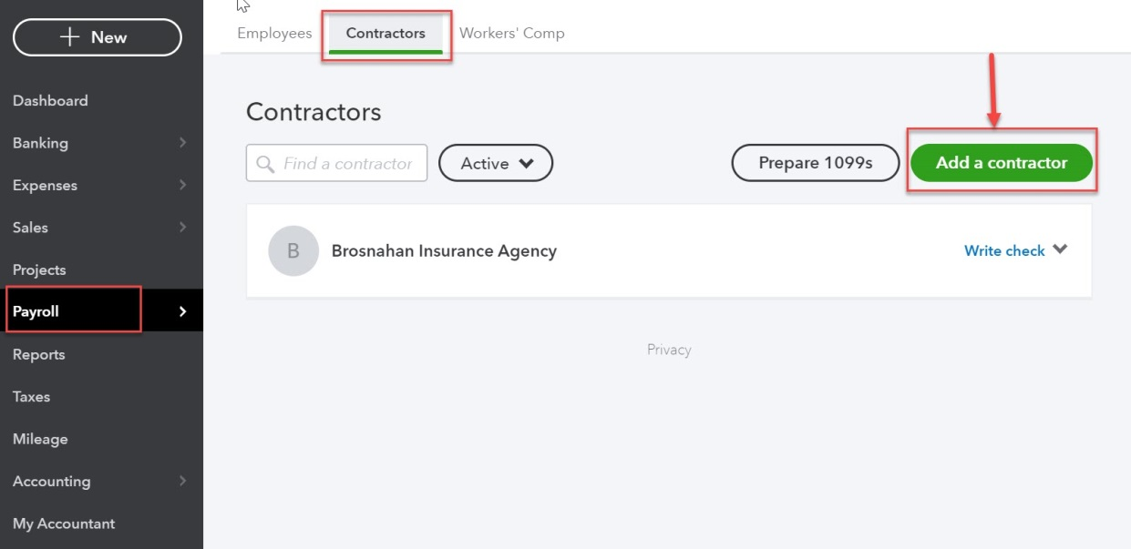
Setting Up Independent Contractors
Click Employees on the navigation bar.
This link was formerly called Workers.
Click the Contractors tab.
Click Add a contractor.

Slide 14
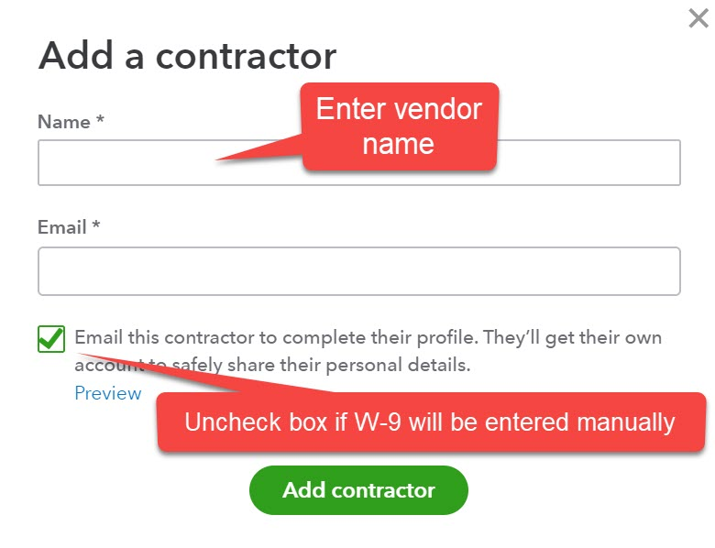
Setting Up Independent Contractors
The contractor’s name is entered in the sidebar.
Most independent contractors are 1099 vendors. If the Email this contractor to complete their profile box is checked, the vendor will be able to submit the required information (W-9 information) directly.
If the feature isn’t used, the company would need to have the vendor complete a paper W-9 form. Information from that form would be entered in the Contractor details screen.

Slide 15
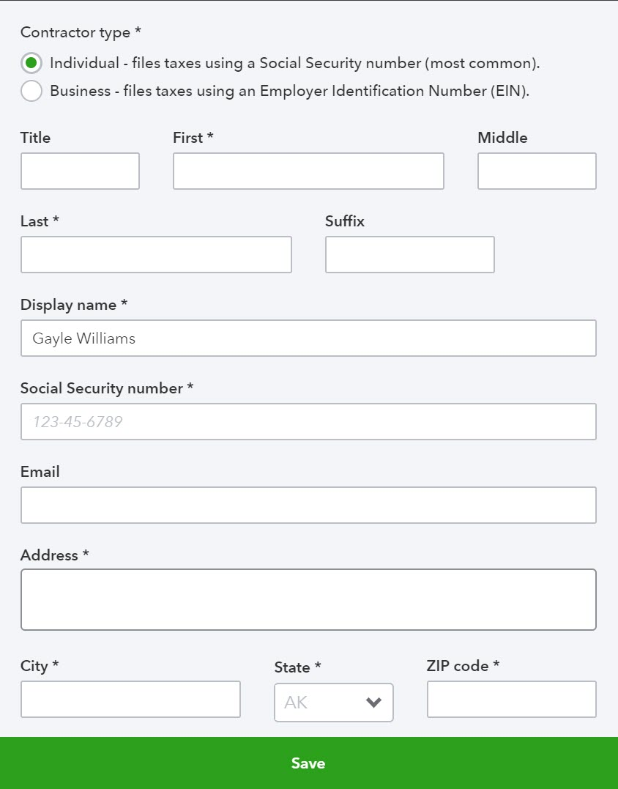
Required Information for Contractors
Required information for contractors include:
Type - Individual or Business
Full name
Tax ID number (social security number if an individual)
Full address
Once a contractor is set up, it will appear in the Vendor list. (Similarly, if a 1099 vendor is created through the vendor list, it will automatically show up in the Contractor Center.

Slide 16
Timesheets

Slide 17
Using Timesheets
Timesheets can be used:
As part of payroll processing (payroll is covered in Chapter 12)
Hours are used to determine amount owed to employees paid on an hourly basis
To track employee hours (billable or not billable) by project, customer, or task
Can but does not need to be linked to payroll processing
To track contractor hours by project, customer, or task (billable or not billable)
Not currently linked to vendor payment processing

Slide 18
Activating Time Tracking
Time tracking is activated on the Advanced tab of Account and Settings.
If timesheets are used for billing purposes, both Add service field to timesheets and Make Single-Time Activity Billable to Customer should be turned on.

Slide 19
Tracking Time (by customer or project)

Slide 20
Tracking Time for Projects or Customers
Hours for employees and contractors working on projects should be tracked.
This is required if the company intends to use QBO for billing clients and all or part of the billable amount is based on hours worked.
Time entered is automatically available when invoices or sales receipts are created.
This is optional (but helpful) if the company wants to track the amount of time spent on various projects even if hours are not used to bill customers.

Slide 21
SIDE NOTE: Project Labor Costs
Contractor labor costs:
Costs are charged to the project by including the project name when entering the contractor’s bill (or when paying them using a check or credit card).
Employee labor costs if payroll is not activated:
Can be tracked using “hourly cost rates”.
“Hourly cost rates” are set up in the Project Center (by employee and contractor)
The cost rate X hours (from timesheets) is included in the calculation of project profitability on the Overview tab of the Project Record. These are non-posting transactions, however.
Employee labor costs if payroll activated:
Project labor costs (compensation and payroll taxes) are charged directly to the project when employee paychecks are created.

Slide 22
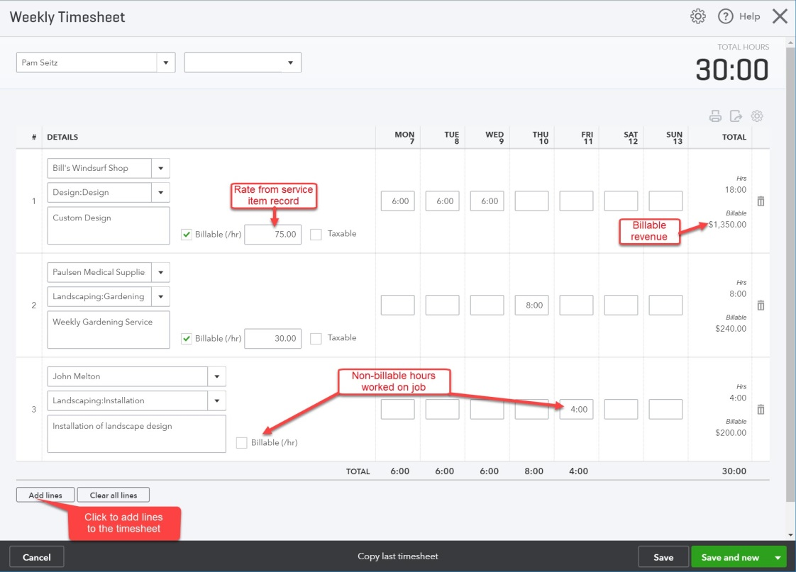
Timesheets for Projects
The project name and the type of work performed (service item) must be entered in the DETAILS section.
The Billable box must be checked if the customer will be billed based on the hours worked.
The sales price and tax status entered in the item record will be displayed if Billable is checked.
The rate and tax status can be changed.
Hours not associated with a client could also be entered on the timesheet.

Slide 23
Tracking Costs (Other than Labor) by Project

Slide 24
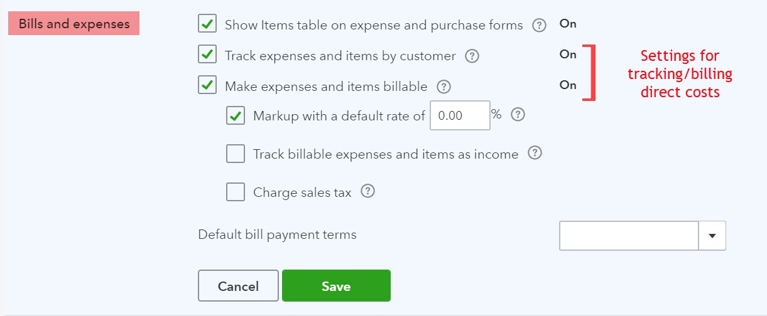
Activating Tracking Features
Click the on the icon bar and select Account and Settings.
Click the Expenses tab.
Check the Track expenses and items by customer and the Make expenses and items billable boxes.

Slide 25
Options When Make Expenses and Items Billable is Turned On
A default markup rate can be set.
The rate can be changed on transactions.
If selected, a markup account needs to be identified on the Advanced tab of Account and Settings.
The default tax setting for billable direct costs can be set to taxable. (Check Charge sales tax box.
This would be an unlikely default choice.
Track billable expenses and items as income is discussed on the next slide.

Slide 26
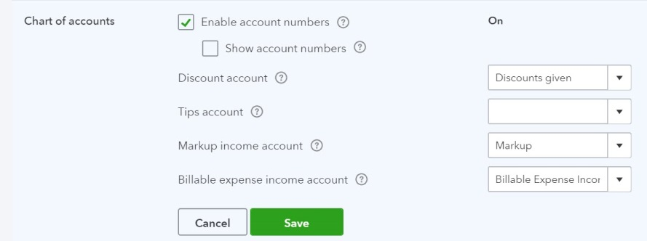
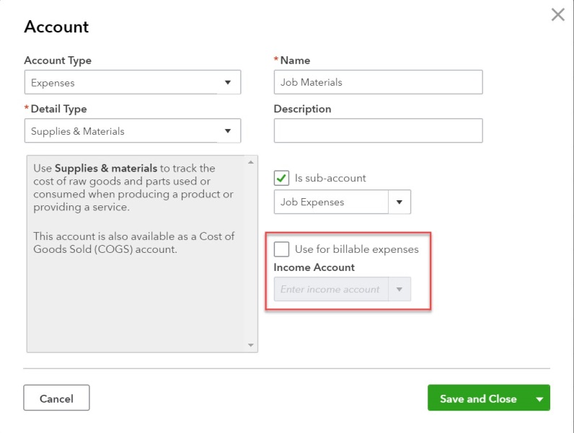
The Track Billable Expenses and Items as Income Option
If Track billable expenses and items as income is not turned on, the billed amount will be credited to the account used when the cost was originally entered.
If Track billable expenses and items as income is turned on, the billing amount will be credited to the account(s) selected by the user.
If a single account is used, the account is identified on the Advanced tab of Account and Settings
If billable direct costs are tracked in multiple accounts, the account options must be identified in the account setup record.

Slide 27
Billing for Time & Costs

Slide 28
Billing for Time and Costs
In QBO, clients can be billed for:
Outside costs
Products/Services
Hours

Slide 29
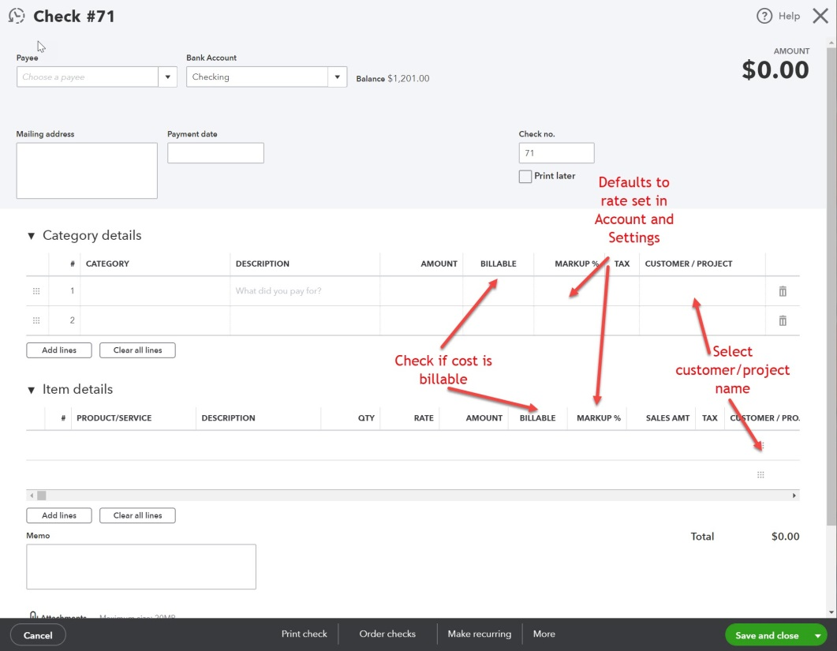
Identifying Outside Costs and Items as Billable
To bill an outside cost, it must first be identified as billable in the Category details or Item details tab of the check, expense, or bill.
To flag a cost as billable:
Select the customer or project in the Customer/Project field.
Place a checkmark in the billable field.
Costs charged to a customer or project but not marked as billable, will be tracked but will not be available to include on an invoice or sales receipt.

Slide 30
Adding Time and Costs to Bill
All costs flagged as billable on checks, expenses, and bills, and all hours flagged as billable on timesheets, are available to add to an invoice or sales receipt.
By default:
Outside costs will be charged to the client at the original cost plus any markup indicated on the form.
Product or service items will be charged to the client at the sales price identified in the item record.
If no sales price is entered, cost will be used.
Hours will be charged to the client at the rate (sales price) identified in the service item record.

Slide 31
Adding Time or Costs to an Invoice or Sales Receipt
Billable hours and costs will be displayed in the sidebar when the customer or project is selected.
Only those costs billable to the specific customer or project selected will be displayed.
Click Add (or Add all) to transfer the details to the sales form.

Slide 32
Job Reports

Slide 33
Reporting on Projects
To review profitability of projects:
Select the Project profitability report on the Project Reports tab of the Project Record.
Select the Profit and Loss by Customer report in the Business Overview section of Standard reports.
To review hours charged to a project during a period:
Select the Time cost by employee or vendor report on the Project Reports tab of the Project Record.
To review billable direct costs and labor hours not yet billed to the customer for a project:
Select the Unbilled time and expenses report on the Project Reports tab of the Project Record.

